Slide 1


Female Genital Mutilation
DC 9773 Gillian SQUIRES
West Midlands Police
Public Protection Unit
Notes:
This is the first screen. Please add your presentation title. (You can delete this note when you’re done).

Slide 2
What is FGM?
All procedures which involve the partial or total removal of the external genitalia or injury to the female genital organs whether for cultural or any other non-therapeutic reasons
The World Health Organisation
Notes:
2

Slide 3
Types of FGM
Type 1 - removal of the clitoral hood with or without the removal of the clitoris
Type 2 - removal of the clitoris and partial or total removal of the inner vaginal lips
Type 3 - removal of the clitoris, vaginal lips and the stitching of the vagina, leaving a 1-2cm opening
Type 4 - piercing the clitoris, cauterisation, cutting the vagina, inserting corrosive substances.
Notes:
3

Slide 4
Health Consequences
Short term
Haemorrhage
Severe pain & shock
Urine retention
Infection including tetanus & HIV
Injury to adjacent tissue
Fracture or dislocation to limbs as a result of restraint

Slide 5
Long term
Fistula - Incontinence
Difficulty with passing urine & chronic urinary tract infections leading to renal problems or renal failure
Difficulties with menstruation
Acute & chronic pelvic infections leading to infertility
Sexual dysfunction/Psychological/Flashbacks
Complications during pregnancy
Chronic scar formations
DEATH!

Slide 6
Who is at risk?
Mainly Africa and Middle Eastern Countries and now in the immigrant population of Europe, America and Australia.
91.5 million girls & women aged over 9 in Africa are living with the consequences of FGM
2 million girls around the world every year are mutilated.
It is estimated that over 60,000 girls are at risk of FGM within the UK every year (Types 1-3)
Any girl potentially at risk – between birth - pregnancy

Slide 7

Prevalence
28 practising countries in Africa
Somalia – 97.9%
Guinea – 95.5%
Sierra Leone – 94%
Djibouti – 93.1%
Sudan – 90%
Eritrea – 88.7%
Egypt – 97%
Notes:
7

Slide 8
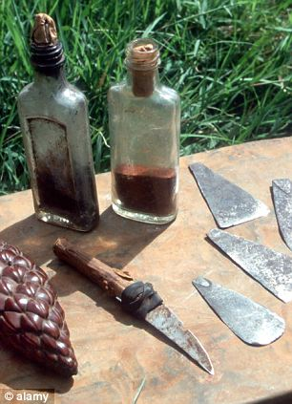
How is FGM carried out?
UK girls are taken on “holiday” to become a woman
Varies from community to community but generally by an elder woman in the community using non-sterile, blunt instruments without anaesthetic
Communities in the UK are believed to have their own practitioners here
Some doctors may do this under anaesthetic
Notes:
8

Slide 9
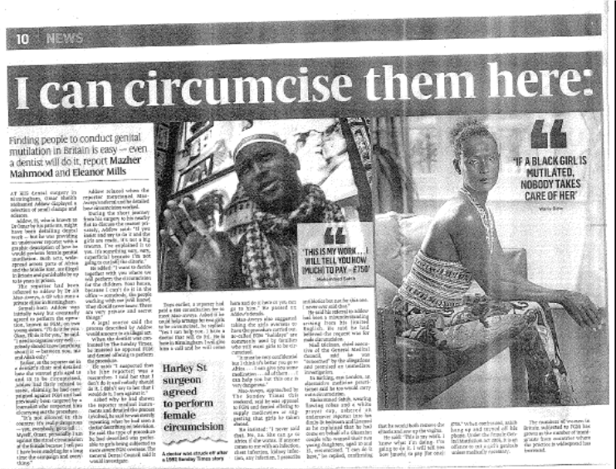
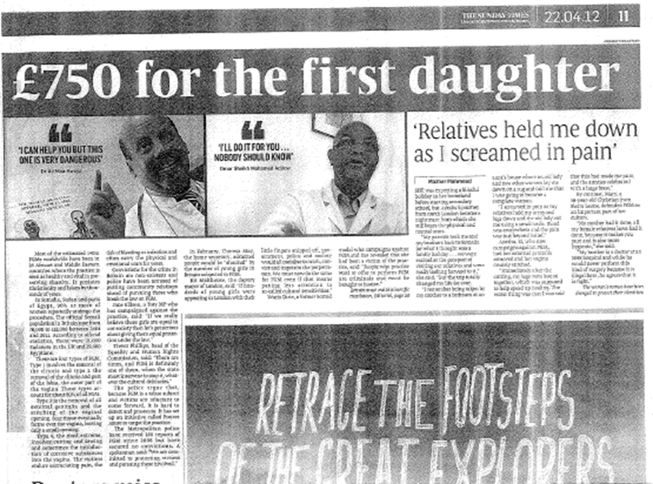
Sunday Times - April 2012

Slide 10
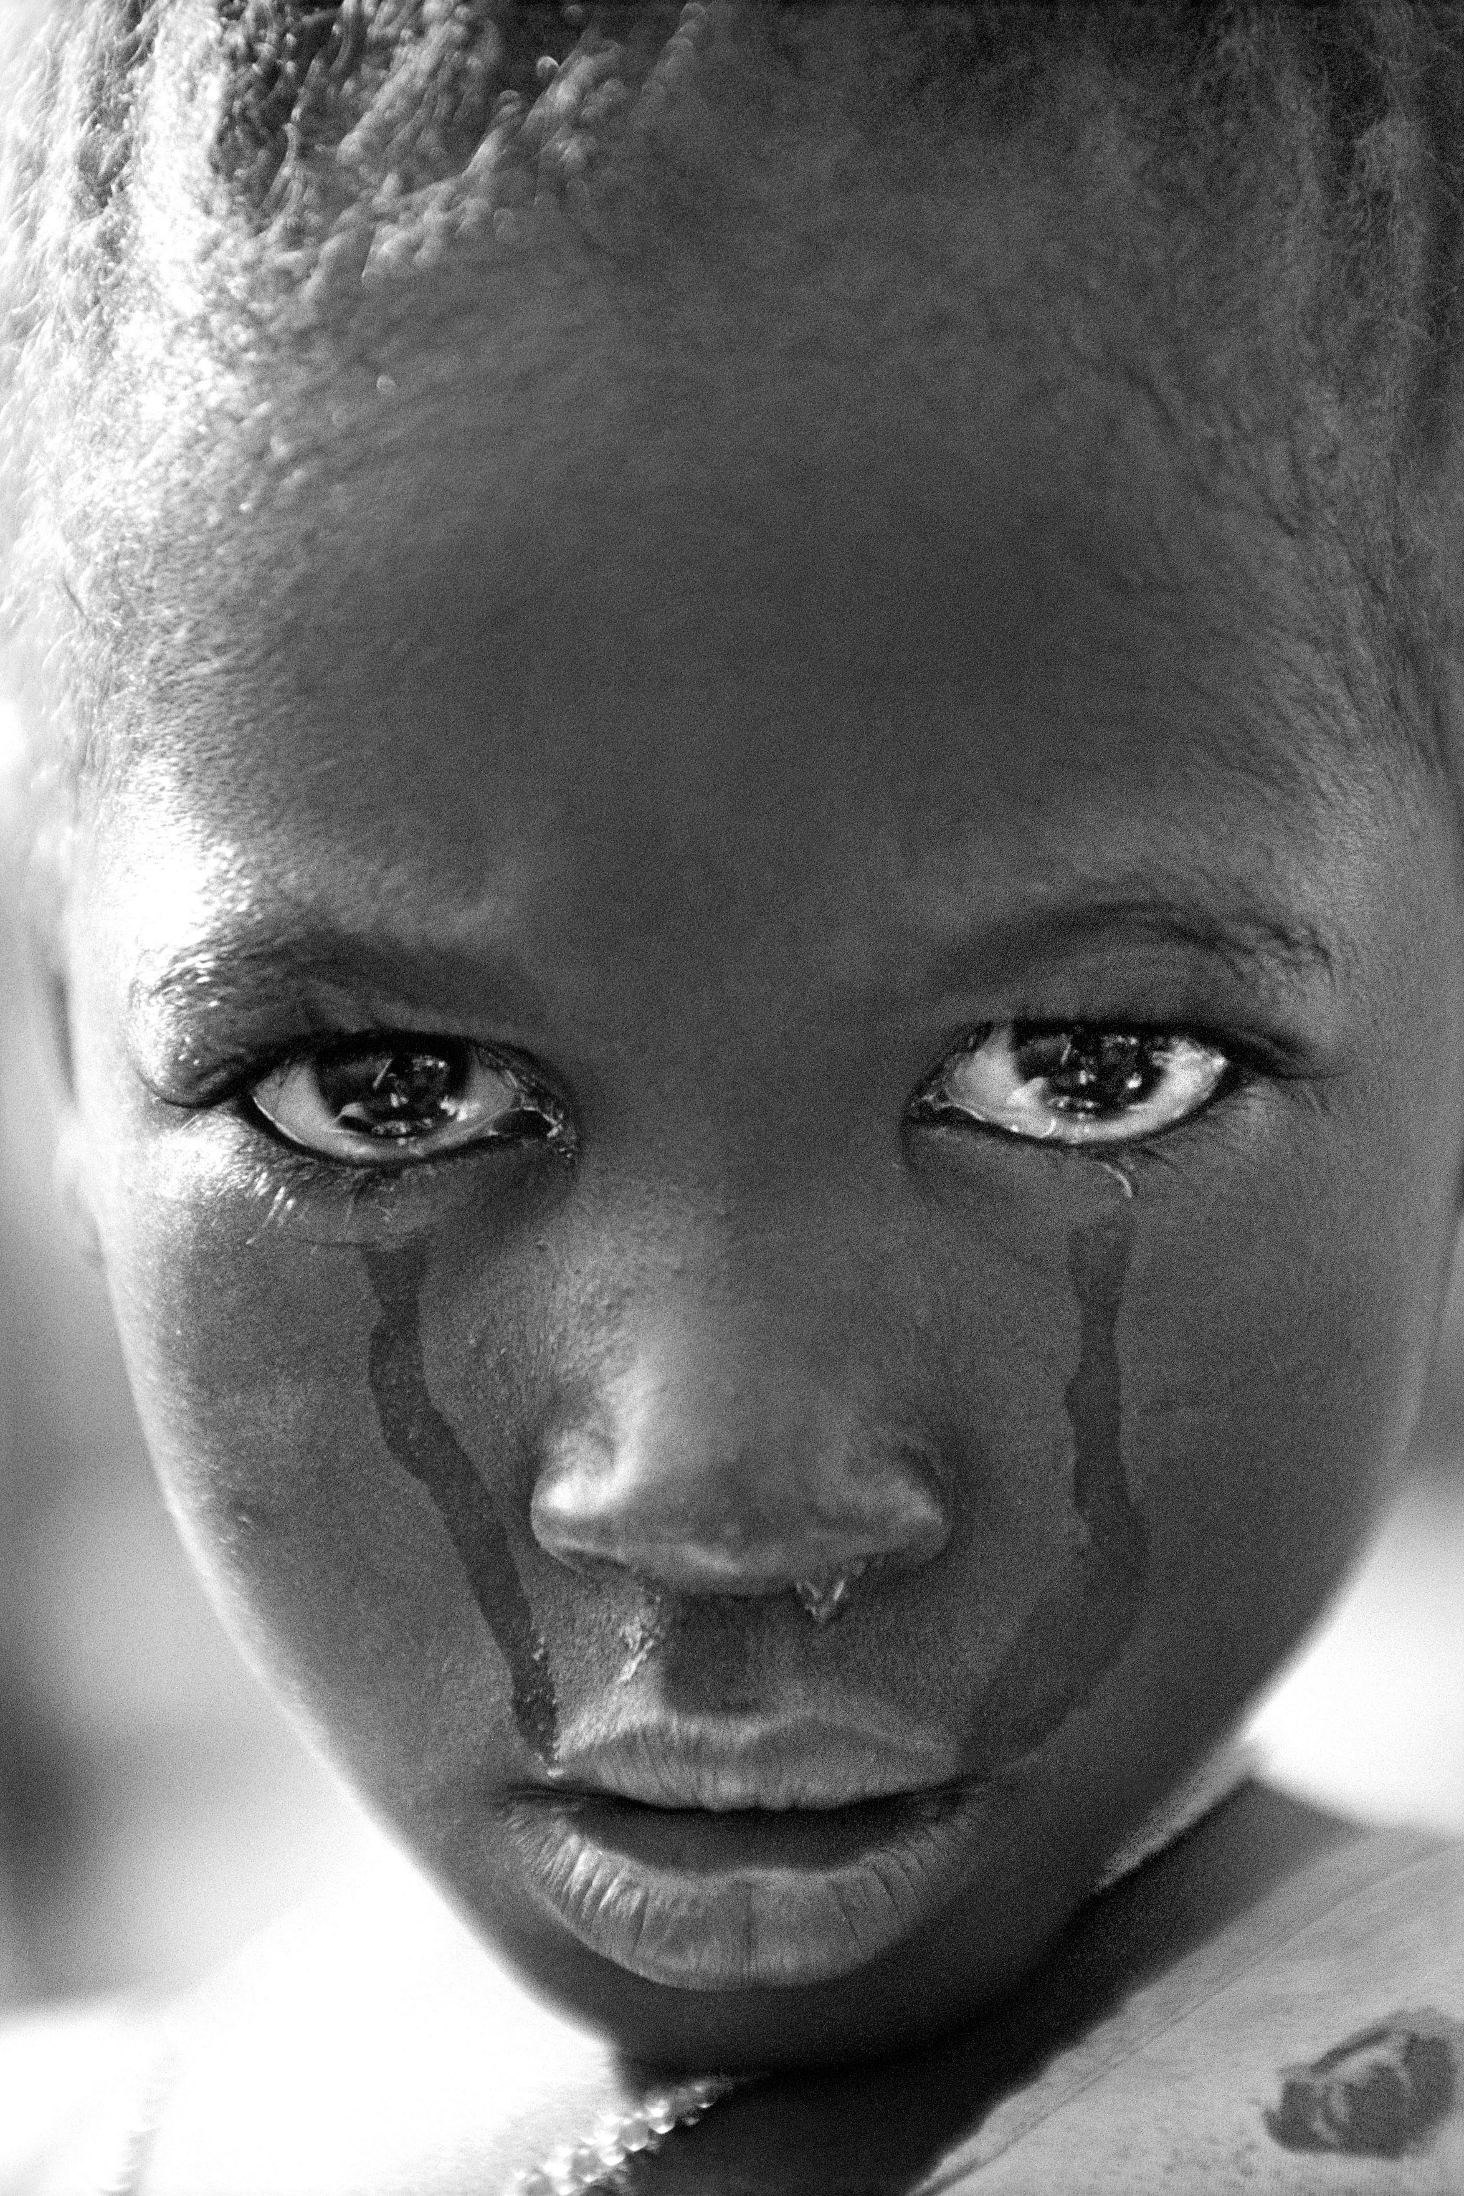
WHY?
Control of women’s sexuality
Marriageability
Deep Cultural Significance
Perceived religious requirement
Sociological
Hygiene
Aesthetics
Notes:
10

Slide 11
FGM is Child Abuse
It is often a single incident
Parents may believe they are doing this for the benefit of their child
Child’s care can be otherwise non abusive and there may be no other warning signals

Slide 12
Indications that FGM may be about to take place.
The family come from a community that is known to practise FGM
A child or parent may talk about a long holiday to a country where the practice is prevalent and may apply for leave of absence.
A child may confide that she is to have a “special procedure” or celebration

Slide 13
Indications that FGM has been carried out
Wearing tight clothing
In pain/restricted movement
Not participating in PE
Frequent and extended visits to WC
Days off school for UTI’s
Broken limbs
Change in demeanour.

Slide 14
Is FGM an issue in the West Midlands?
Heartlands Hospital
African Well Women’s Clinic
De-infibulation
2002 – 0.4%
2014 – 1 in 10 women presenting for ante-natal care have some form of FGM.

Slide 15
West Midlands Police Data
2001 - 2006 – 6 referrals
2007 – 4 referrals
2008 – 6 referrals
2009 – 10 referrals
2010 – 5 referrals
2011 – 8 referrals
2012 – 25 referrals
2013 – 41 referrals
2014 (Jan – Nov) – 118 referrals

Slide 16
When should a referral be made?
A plan to arrange FGM?
A girl who has undergone FGM?
A mother who has undergone FGM and has female children?

Slide 17
What next?
Report to Children’s Services/Police - Investigation
Strategy Meeting – gather information.
Joint visit.
Consider Police Protection / Inherent Jurisdiction Order / Emergency Protection Order?
Arrest if appropriate
Child Protection Conference?
Notes:
17

Slide 18
Female Genital Mutilation Act 2003
It is an offence for a person to excise, infibulate or otherwise mutilate the whole or any part of a girls labia majora, labia minora, or clitoris either in the UK (Excluding Scotland) or to arrange for a female to be taken abroad for the purpose of FGM.
The Female Genital Mutilation Act 2003 replaced The Prohibition of Female Circumcision Act 1985.
THE PENALTY IS UP TO 14 YEARS IMPRISONMENT

Slide 19
There are a number of offences which fall within the Act which include:
Carrying out the act itself
Assisting a girl to mutilate her own genitalia
Assisting a non-UK person to mutilate overseas a girls genitalia, even if FGM in that country is legal.
All of the above include aid, abet, counsel or procure .
**UK National/Permanent UK resident**

Slide 20
Until very recently there have been no prosecutions in either England or Wales.
WHY?

Slide 21
“We must not allow political correctness to lead us to moral blindness”
Mike O’Brien MP
“Cultural acceptance does not mean accepting the unacceptable”
Sir Ian Blair

Slide 22
“Do not stigmatise the whole of the community for the acts of a few.”
Nasheima Sheikh
Assistant Chief Executive, B’ham & Solihull Women’s Aid

Slide 23
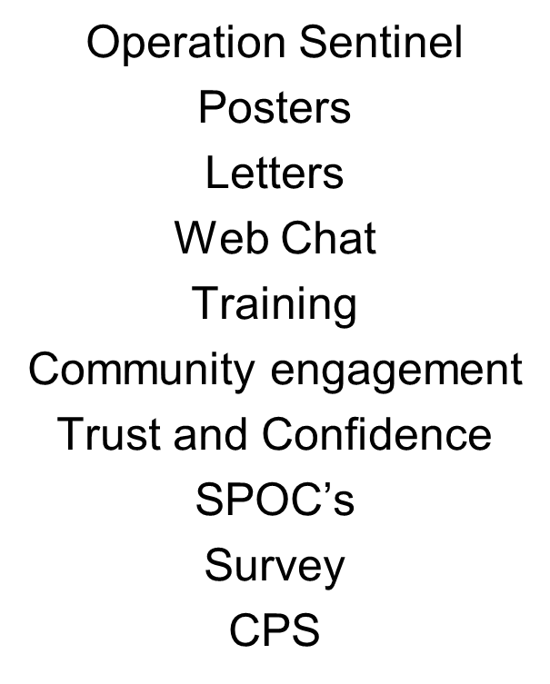


Slide 24
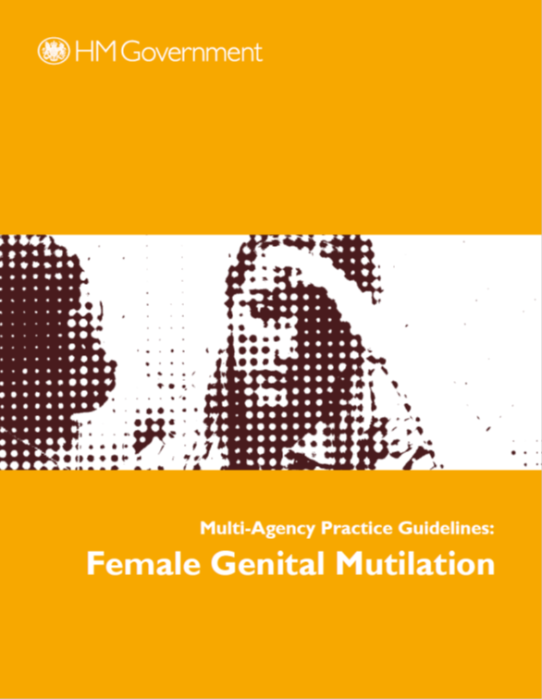
National picture
Multi Agency Guidance
HASC Inquiry
OFSTED
NSPCC helpline
FGM tool kit
Passport
National poster campaign June 2014.

Slide 25
How can you help?
Have FGM on your radar, be alert to signs
Be confident in making referrals
Display posters/distribute leaflets
Educate that FGM is not a religious practice
Who are the cutters? We believe that this may be happening in the West Midlands!
Intelligence!! Submit IMS

Slide 26
Female Genital Mutilation
Remember
School holidays (particularly summer) are a time when it is known that girls are taken out of the country to undergo FGM.

Slide 27
Female Genital Mutilation
FGM is a serious crime and can be fatal.
The survivors of FGM are serving a life sentence.

Slide 28
Female Genital Mutilation
Report any concerns.
Child Protection is everyone’s responsibility.

Slide 29
ANY QUESTIONS?

Slide 30
Useful Contacts
DC 9773 Gill Squires – 07990 634104
g.squires@west-midlands.pnn.police.uk
Specialist Midwife - Alison Byrne (Heartlands Hospital) 07817 534274
NSPCC FGM Helpline – 0800 028 3550
Birmingham and Solihull Women’s Aid – 0808 800 0028
Equality Now - 0207 304 6902
FORWARD - 0208 860 4000
Daughters of Eve – 07983 030488.

