Slide 1


The presentation can only be copied or altered for non-commercial personal or educational use.
© Citizenship Foundation Charity Reg No 801360 Author: M. Heath www.gogivers.org

Slide 2
Using Go-Givers lessons
This PowerPoint is designed to inform, and to support critical thinking and discussion.
Go-Givers PowerPoints can be used in their entirety OR content can be saved and edited.
In order for the links and animation to work, always show the PowerPoints in ‘slide show’ view.
The green dot in the bottom right hand corner of the slide indicates when the slide animation is complete.
More information about using PowerPoint can be found here
The LEARNING ACTIVITIES are an essential and integral part of this lesson. They are linked at the end of this PowerPoint.

Slide 3

Developing
Personal Filters

Slide 4
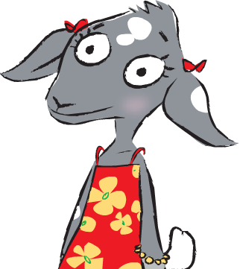
In this lesson we will be exploring the dangers of pornography, how to keep safe online, and how to develop personal filters.

Slide 5
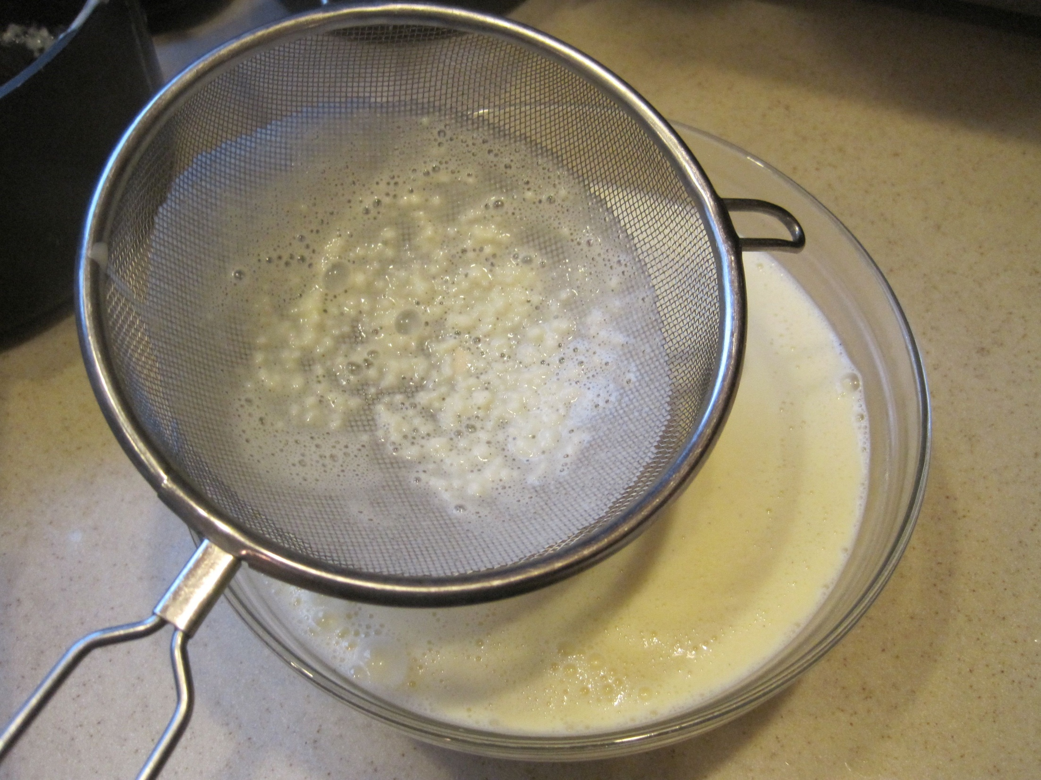
Do you know what is meant by a ‘filter’?
Think of it as a kind of sieve, that collects and removes all the bits you don’t want.

Slide 6
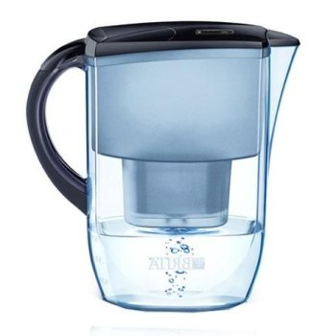


Can you think of anything that is filtered?
Water filter
Vacuum filter
Car engine oil filter

Slide 7

What needs to be filtered out on the internet?
Child Abuse
Drugs
Violent films
Sexual images

Slide 8

However, your own personal filter is far better than any filter on your computer!

Slide 9
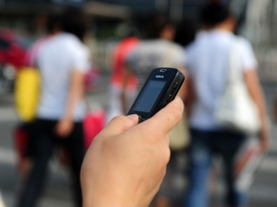
Pornography includes:
videos, magazines, writings, music, photographs, texts and telephone conversations of a sexual nature.
One of the most important things to filter out is pornography.

Slide 10
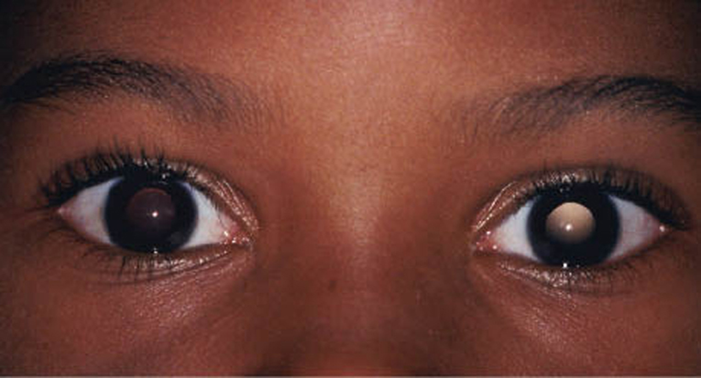
You will usually know when you are looking at something that is wrong!

Slide 11

Why does it matter?
It’s not about real relationships.
A real relationship involves:
care
gentleness
understanding
loyalty
affection

Slide 12
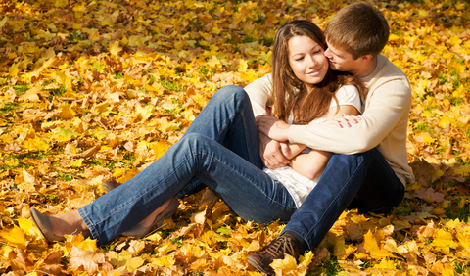
Most pornography is made-up. Viewing pornography can give young people the wrong idea about how to make real relationships.

Slide 13
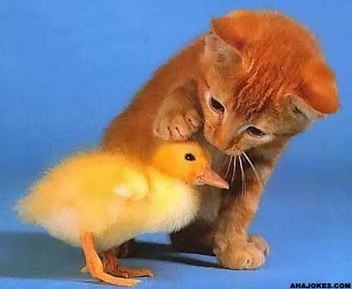
It’s often offensive and cruel.
In happy relationships people treat each other with respect and kindness.

Slide 14
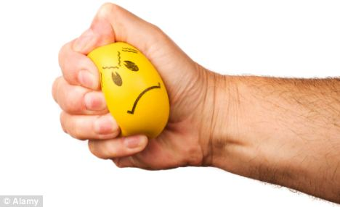
It often shows boys/men being aggressive towards girls/women.
It can cause people to develop abusive relationships with their partners later on.

Slide 15
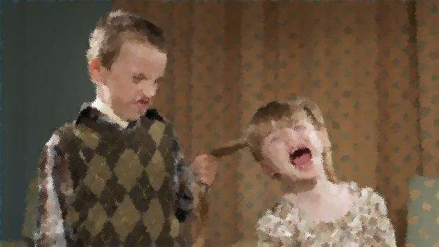
It can encourage aggressive sexual behaviour towards other children, even brothers and sisters!
Ugly – isn’t it?

Slide 16

It can make girls more likely to put up with abuse from boys, when they should be saying:

Slide 17
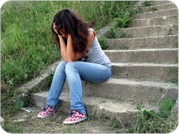
It can make people feel isolated and lonely.

Slide 18

It can be addictive
That means people find it difficult to stop looking at it, even if they want to stop!

Slide 19
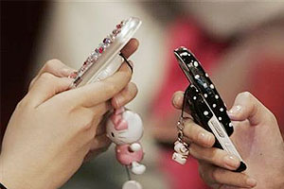
When teenagers send nude photos of themselves to boyfriends, girlfriends or other friends, it is called sexting.
Did you know that these photos are counted as child pornography? Sending or receiving them is a crime!

Slide 20
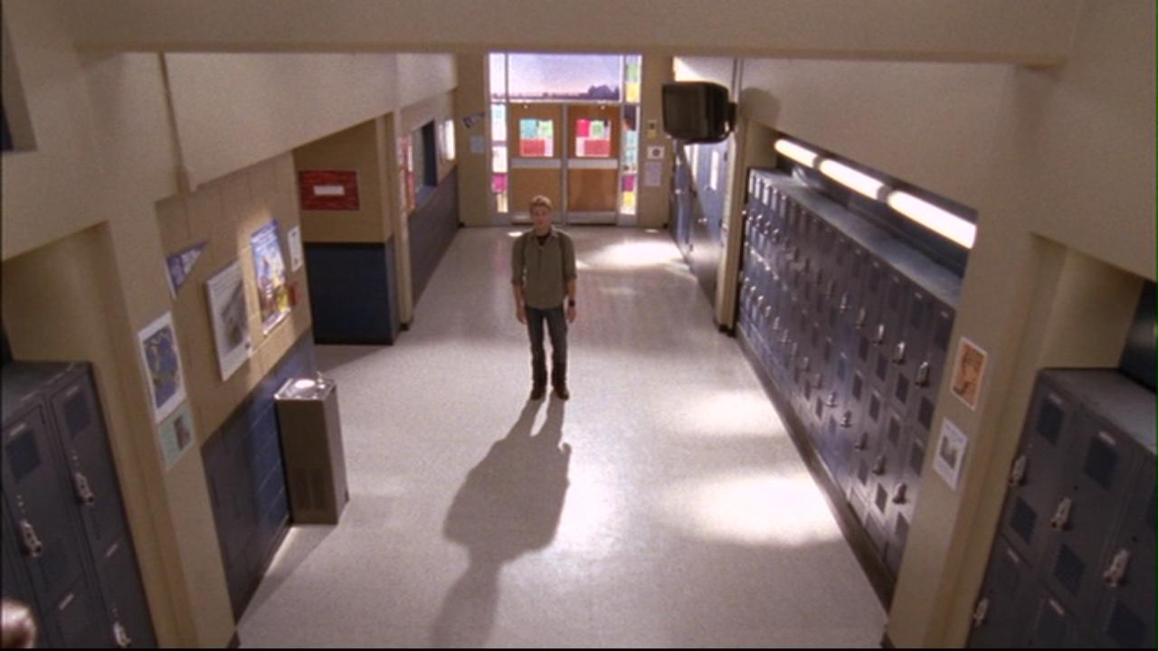
Sexting can cause embarrassment and a sense of shame. You can’t be sure that pictures will only be seen by the friend they were sent to. ‘Private’ pictures often get sent to other people out of revenge, and this can lead to cyber-bullying.
Sexting has made some people feel as though they have walked down their school corridor with no clothes on.

Slide 21
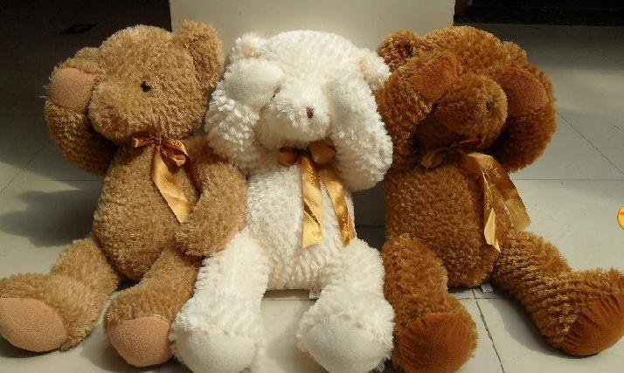
Pornography can cause great unhappiness.
Make sure your personal filter is working at all times!

Slide 22
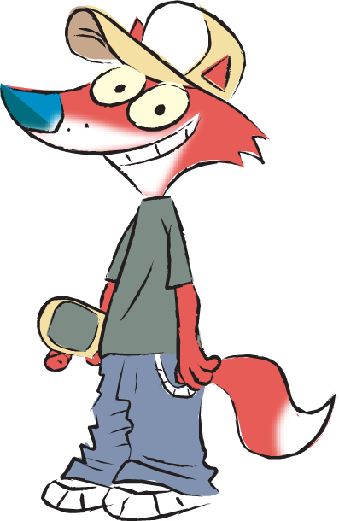
Glossary
Filter - sieve
Pornography – sexually explicit pictures etc.
Offensive – unpleasant, insulting
Abusive – rude, cruel
Addictive – makes someone dependent on something
Sexting – sending sexually explicit messages or photos.

Slide 23

Activities to complete this lesson include:
Rate this lesson here.
What makes a happy relationship?
Discussion about keeping safe on line
Sharing experiences
Debate about internet filtering.
Click on the image above to view and/or download learning activities.

