Slide 1



Greener Schools Award
Energy Saving examples

Slide 2



Award levels
Notes:
Next few slides are snippets from award applications showing different energy saving activities

Slide 3

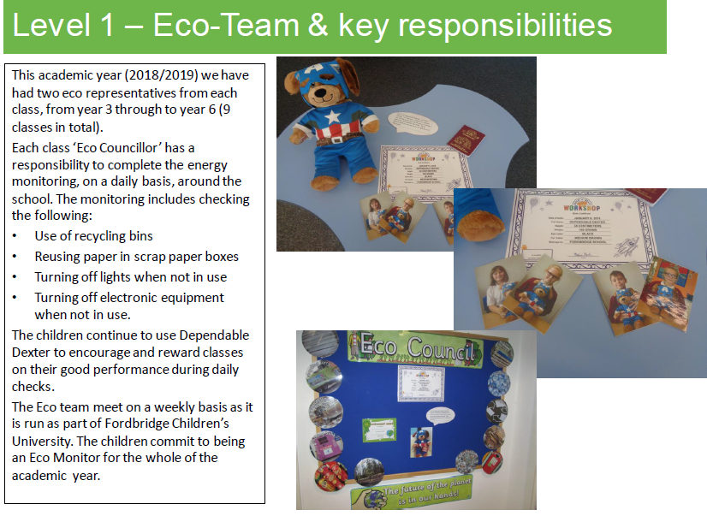
Fordbridge
Notes:
Team spread from Yr 3 to 6 -focus energy monitoring, check lights other equipment daily, Dependable Dexter as reward for best performing class, monitors commit to role for whole year.

Slide 4


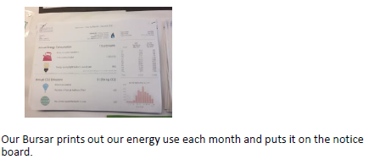
Haslucks Green
Notes:
Team read / record solar panels, monitor lights and door is winter
Stark data added to notice board by bursar each month

Slide 5
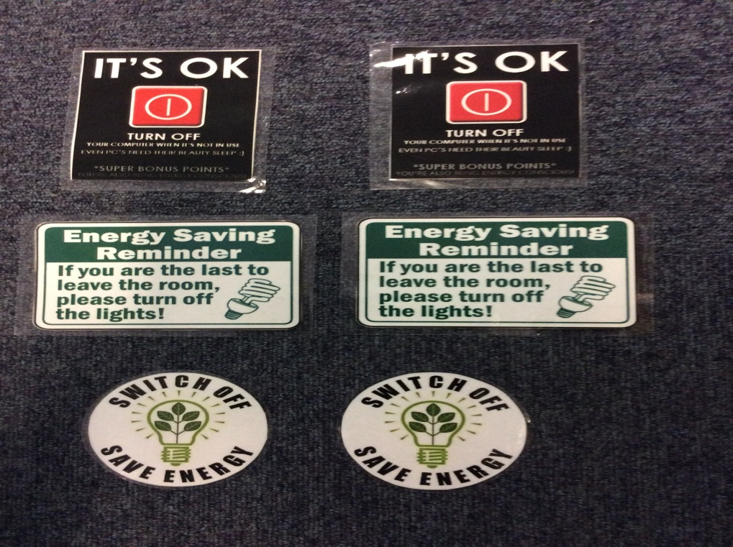
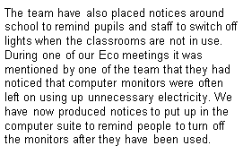
Widney Junior
Notes:
Awareness - Push on posters and notices to remind everyone to switch off, in classroom and computer suite (member of team noticed left on)

Slide 6

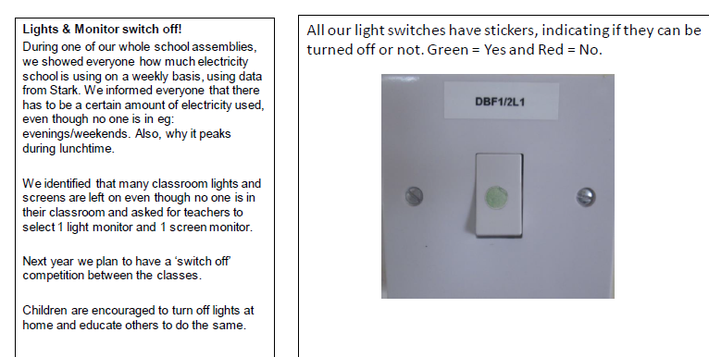
Balsall Common
Notes:
Class monitors – lights / screens
Assembly – share electricity used with whole
Check electricity consumption monthly, using Stark
Labelling light switches (Carbon Trust resource)
Encouraged to save energy at home

Slide 7
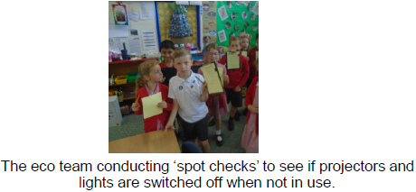

Burman Infant
Notes:
Team do spot checks on light / projectors
Maths / science – recording temperatures outdoor & indoor – ask Rebecca to share

Slide 8



https://www.wwf.org.uk/get-involved/schools/school-campaigns/earth-hour-schools#resources
https://jointhepod.org/campaigns/switch-off-fortnight-2019
March
November
November
May
https://outdoorclassroomday.com/

Slide 9

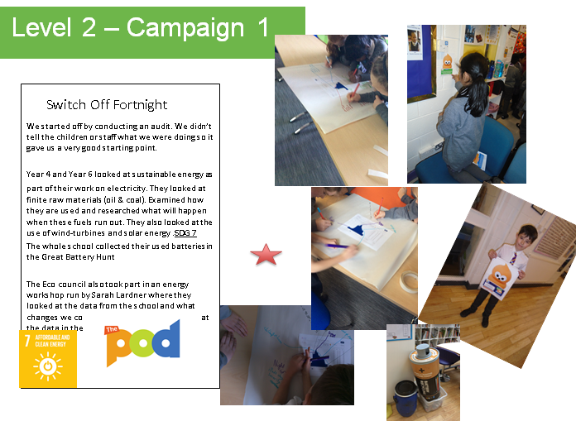
Monkspath
Notes:
Carried out secret audit
Lesson on electricity (yr 4 / 6 ) researched fossil fuels and renewables
Sarah Lardner – energy workshop, looking at daily graph / handling data, looking at peaks and trophs.

Slide 10
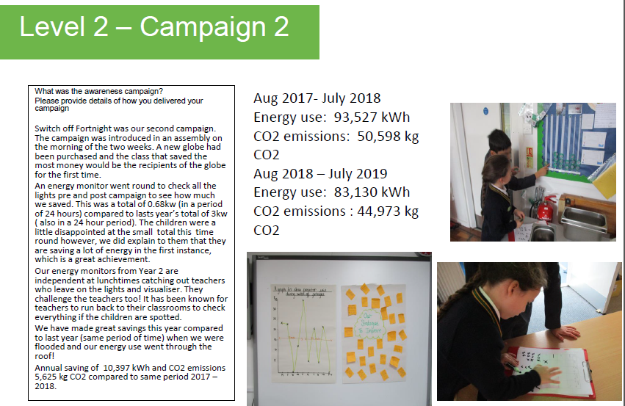

St Patricks
Notes:
Switch off fortnight
Assembly, introduced new reward (globe for best performer)
Monitors checked lights before and after 2 weeks
Year 2 monitors – check at lunchtimes twice a week alone
Other comments - They keep teachers on their toes, are stern when equipment left on, teachers have been known to run back to classroom when spotting monitors.

Slide 11
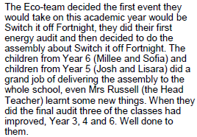
Yew Tree
Notes:
Team decided on event, they did an initial audit, children from yr 5/6 delivered assembly, final audit showed 3 classes improved

Slide 12

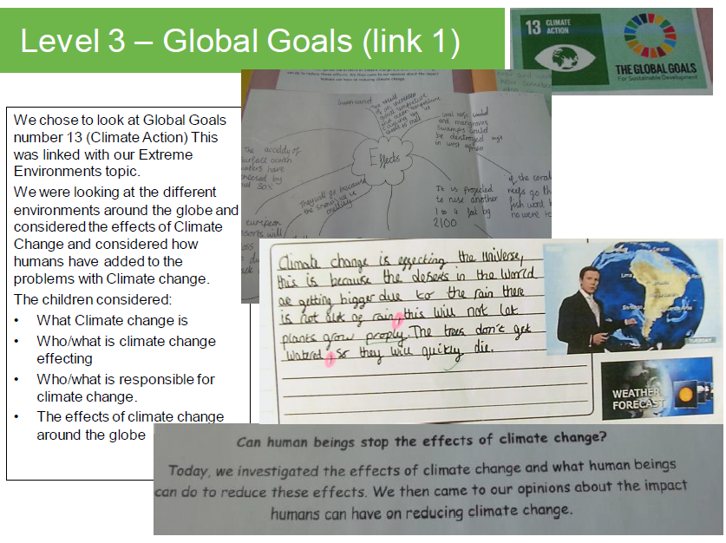
Fordbridge
Notes:
Climate change education resources (WM Sus Sch network group)

Slide 13
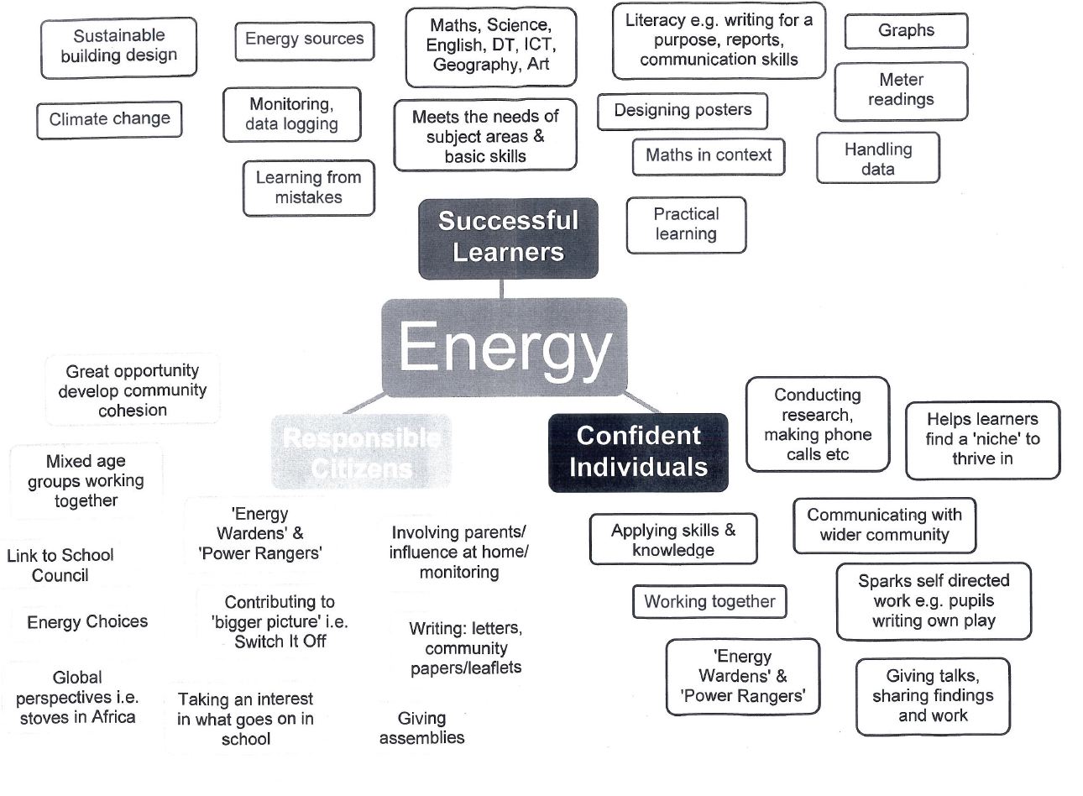
Responsible Citizens
Notes:
Scotland, curriculum of excellence

Slide 14
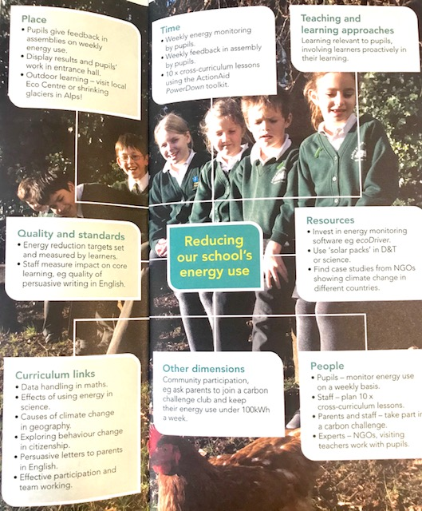

Slide 15
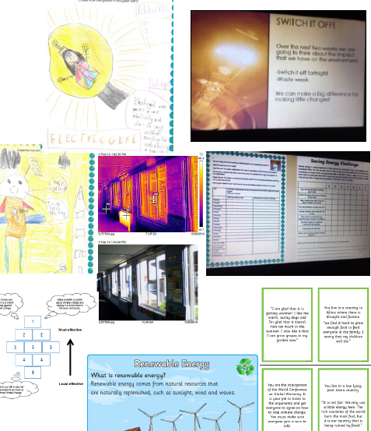
Sharmans Cross – case study
Energy Activities
Gemma Snowden

