Slide 1
Solihull Greener Schools Award Celebration event
Sarah Lardner, Engagement Officer,
Sustainable Development Team, Solihull Council
slardner@solihull.gov.uk

Slide 2
Agenda
13.30 Introduction
13:35 Welcome - Mayor
13:40 Awards ceremony
14:10 Close of ceremony
14:15 Award level process & case studies
15:15 Linking Life Ready & Green activities
15:30 Finish

Slide 3
Notes:
Award levels

Slide 4
Award levels

Slide 5
Awards Ceremony
Welcome Mayor
Business champions
Notes:
I would like to thank Mr Mayor and business representatives from …… for attending the Green Solihull Schools Award ceremony today. Local businesses have kindly offered to reward schools for their achievements, they have sponsored particular collaboratives, as most of you will know Solihull Schools are grouped into 5 collaboratives or areas. For the award ceremony we will go through the entries for each of the collaboratives, the business representatives will say a few words about the award applications, teachers will then come to the front to receive their certificates and for a photo with the Mayor. Those schools reaching level 3 will also receive a an additional award, an bespoke owl carving. Welcome Robert Elliot (Synergy), Andy Holding and Liz Allister (North), Sue Simpson (evolve), David Murphy (telephone europe) Rural and Mosaic.
Andy Holding, Sue Simpson, Sharon and Jo, Stuart Mansell, Liz Allister

Slide 6
Collaboratives
Tudor Grange, Alderbrook, St. Peters (SYNERGY)
Shirley & Olton (EVOLVE)
Lyndon & Lode Heath (MOSAIC)
Arden & Heart of England (RURAL)
North Solihull Community (UNITY)

Slide 7
Tudor Grange, Alderbrook, St. Peters (SYNERGY)
Widney Junior School
Monkspath Primary
St Patricks C of E Primary
Sharmans Cross

Slide 8
Shirley & Olton (EVOLVE)
Haslucks Green Juniors
Burman Infant

Slide 9
Lyndon & Lode Heath (MOSAIC)
Yew Tree Primary School

Slide 10
Arden & Heart of England (RURAL)
Balsall Common Primary

Slide 11
North Solihull Community (UNITY)
Merstone School
Fordbridge Community Primary

Slide 12
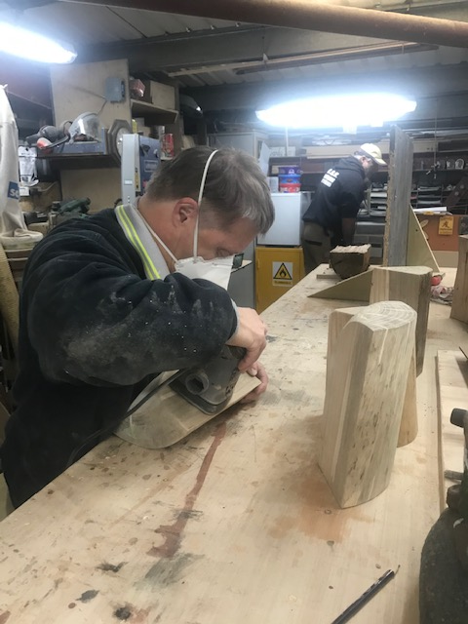
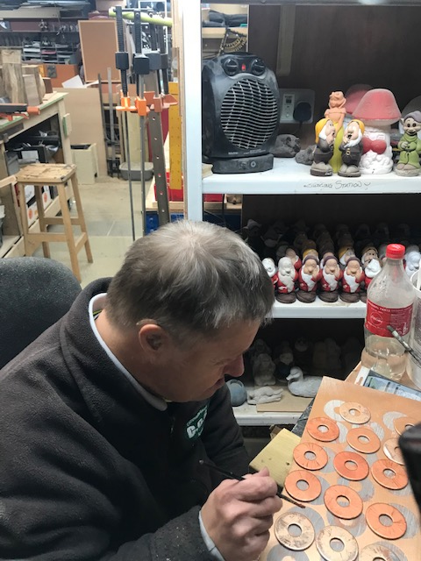
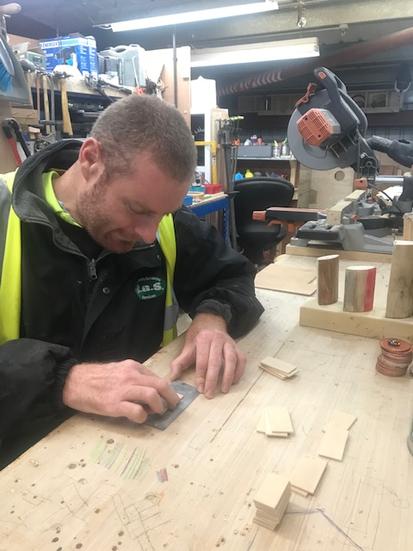
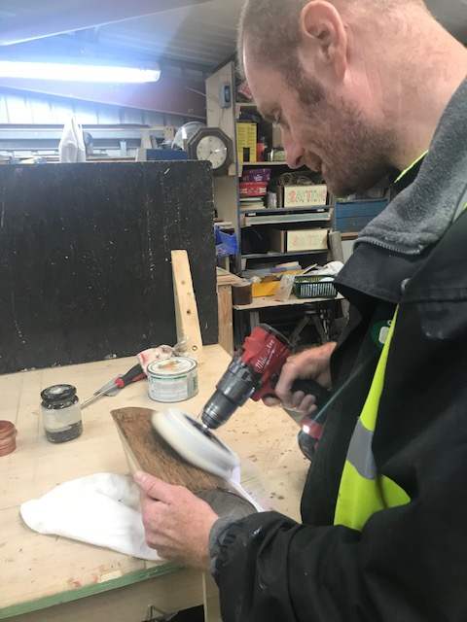
Community Gardening Services
Notes:
Community Gardening Services, Saxon Way, Chelmsley Wood part of Family Care Trust

Slide 13
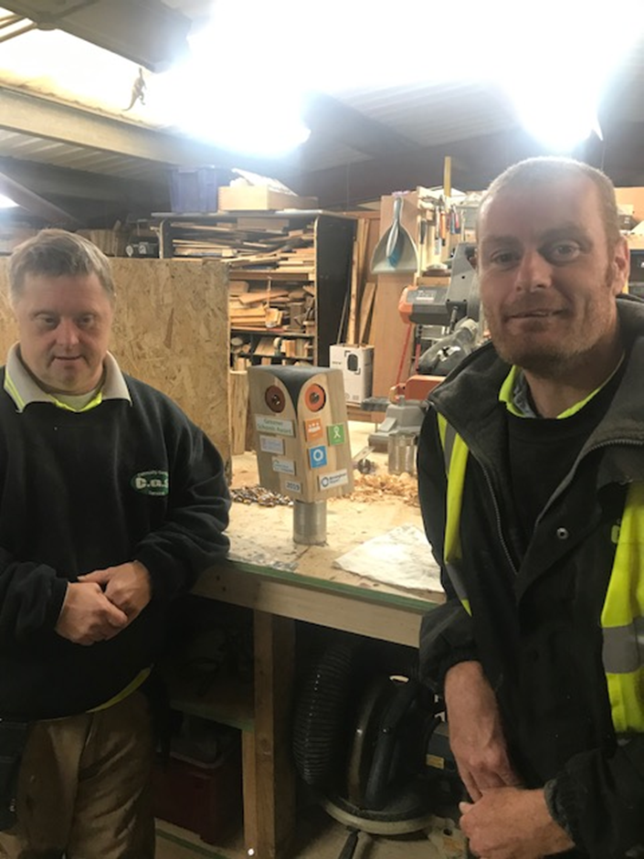
Owl carving

Slide 14
Close of Awards Ceremony

Slide 15
Award level process & case studies

Slide 16
Level 1
St Patricks – various groups (Eco-team, litter picking, energy monitors, Water Explorers Club, Gardeners
Sharmans Cross– Eco-reps (focus energy), write speech, voted in, work closely with garden reps.
Fordbridge – Eco-team (monitoring) work closely with Bear Grylls team (grounds)
BCPS – apply for Blue Peter Green Environment badges
Notes:
There are various to setting up teams in schools and the roles the team have. Some schools have a number of teams all helping the environment with different roles, at other schools there will be one team with a specific responsibility, you could think about supporting your team to gain blue peter badges, pupils at Balsall Common Primary have received Environment badges, they can get free entry into attractions.

Slide 17
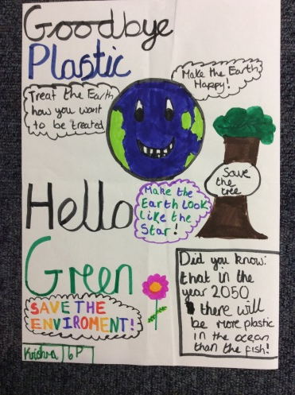
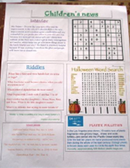
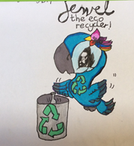
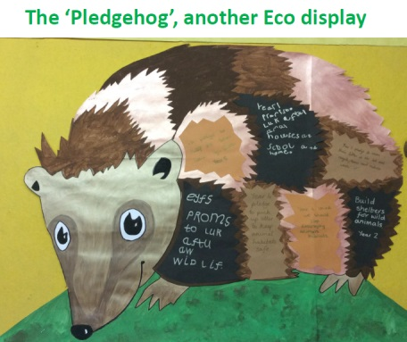
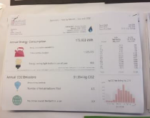
Awareness
Yew Tree – pledgehog display, different year groups
Widney – reminder notices and posters
St Patricks – children’s newsletter, Global Goals spot
Sharmans Cross - Stark readings on ‘science’ display board
Monkspath – new mascot
Balsall Common – whole school environment week
Notes:
There are many ways teams make the rest of the school aware of their activity, popular ways are through displays, newsletters and assemblies.
Pledges – EY, promise to look after animals, Yr2, Build shelters for wild animals, Yr 4, pick up litter to keep habitats safe

Slide 18
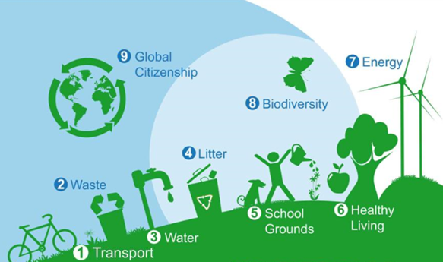
Transport / Healthy Living topics - Use one campaign, other 2 from other topics areas

Slide 19
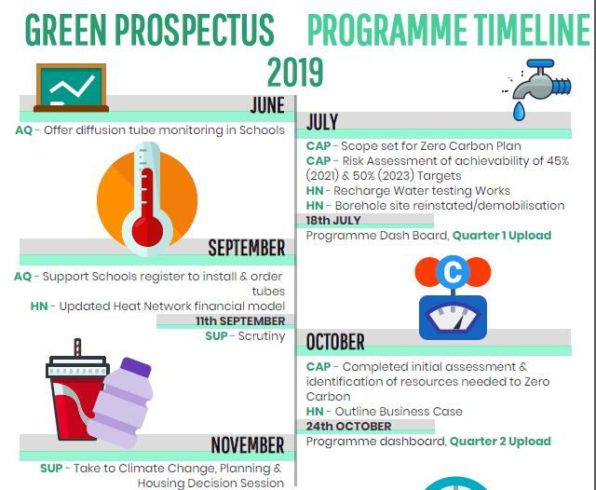
Hot topics / Council Strategy
Single Use
Plastics
Air Quality
Notes:
The Green Prospectus is the plan for sustainability for the council, all sustainability linked activities of Council teams are captured in the Green Prospectus. It’s reported on a 6 monthly basis to cabinet.
You can see from this snippet of the Green Prospectus programme timeline the hot topics of Carbon, Air Quality and Single Use Plastics, the Council has recently produced the Air Quality Strategy that includes an education strand and there is a draft of the SUP Strategy. This morning you saw examples of energy saving from the Greener Schools applications, this afternoons case studies will look example of schools running campaigns on Air Quality and Plastics

Slide 20
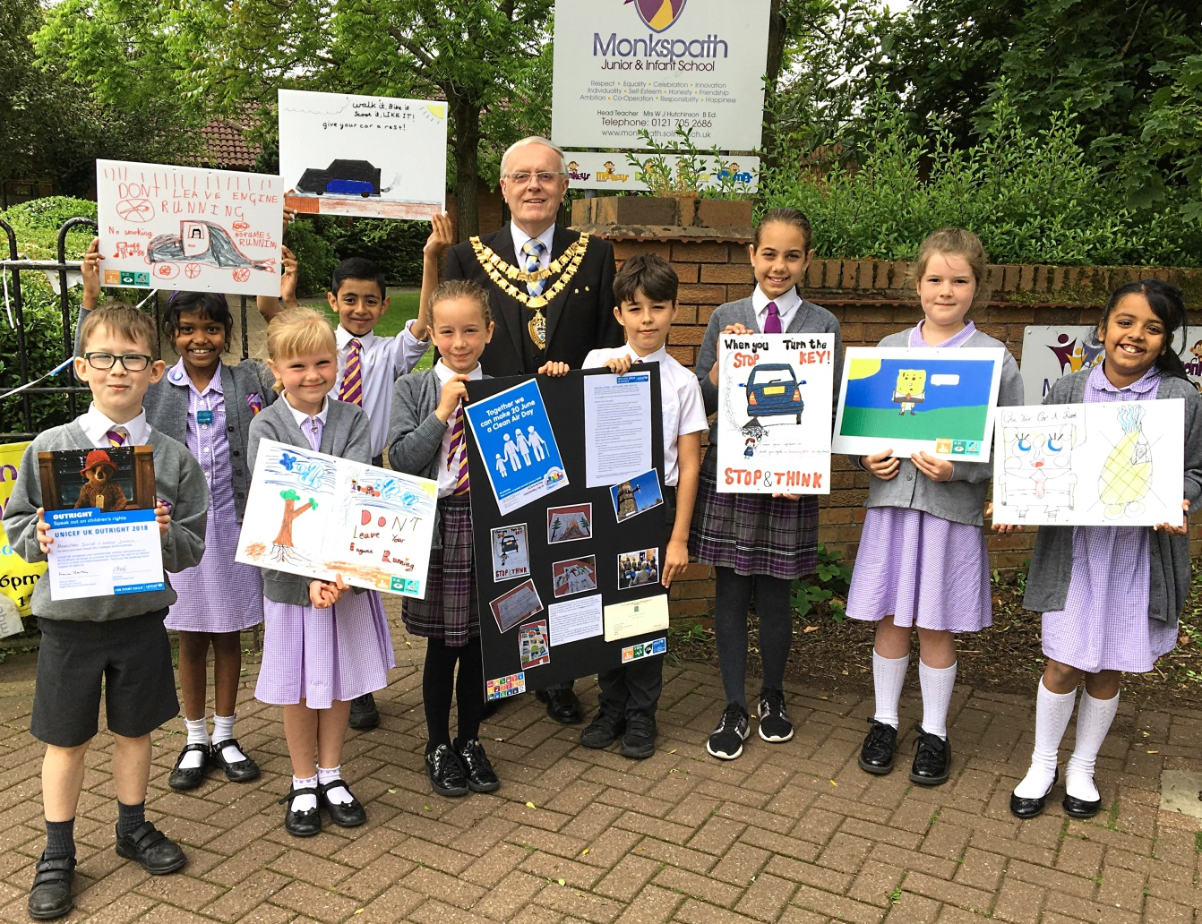
Clean Air Day - campaign
Monkspath School

Slide 22
Air Quality Resources
https://www.cleanairday.org.uk/pages/category/school-resources
Greenpeace
Friends of the Earth

Slide 23
Focus on Plastics -campaigns
Waste Week
St Patricks
Monkpath
Sharman’s Cross
Say No to Plastics
Haslucks Green

Slide 24
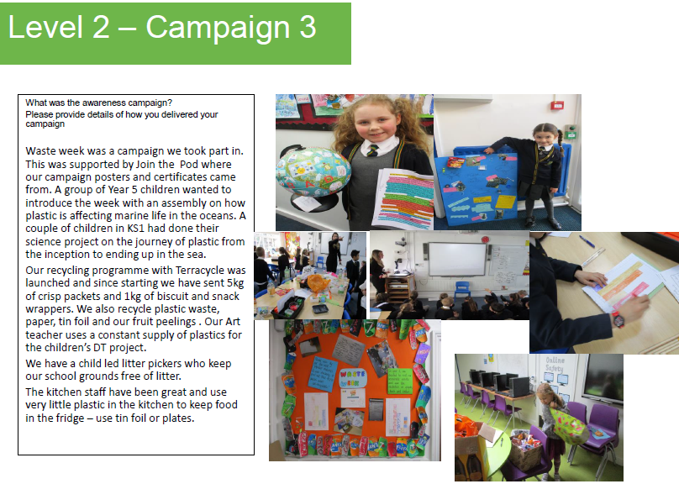
St Patricks

Slide 25
Monkspath

Slide 26
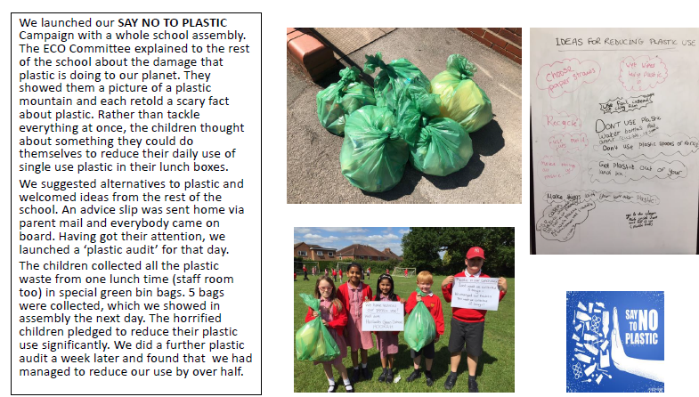
Haslucks Green

Slide 27
Resources
Plastic Investigators – ASDA Pack
Kids Against Plastic, Be Plastic Clever, Plastic Clever Schools Status
SAS – Plastic Free Schools
TerraCycle – Bic Pens, crisp packet collections
Waste Buster resource – Plastic recycling education pack
The POD – Waste Week Resources

Slide 28
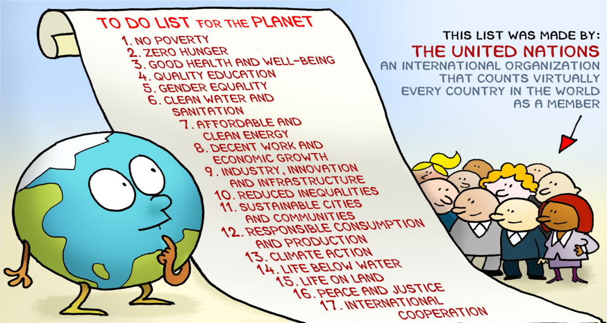
Notes:
In 2015, world leaders agreed to 17 goals for a better world by 2030.

Slide 29
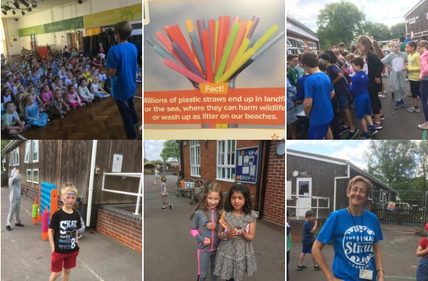
Case Study – St Patricks Global Goals Day
Notes:
Also links to other countries

Slide 30
Global Goals resources
https://www.un.org/sustainabledevelopment/student-resources/

Slide 31
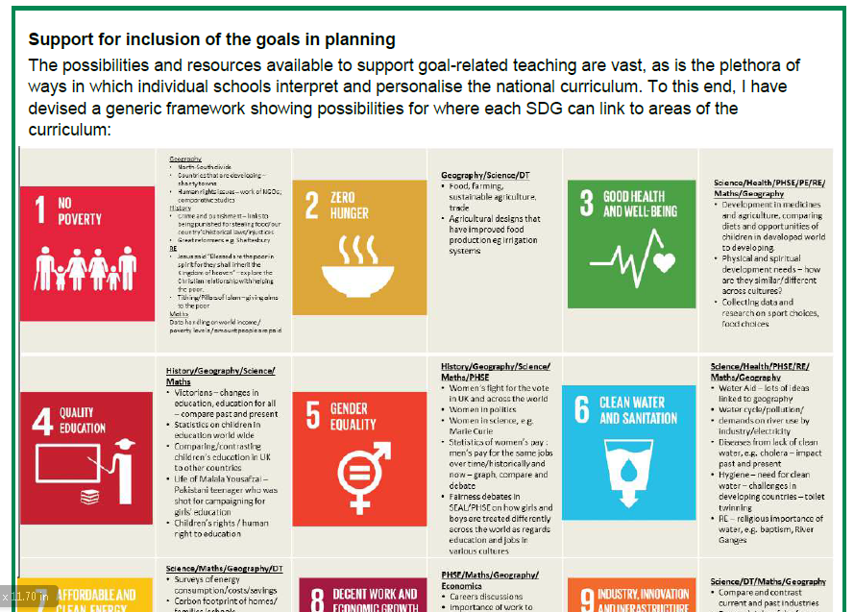
NAEE National Association for Environmental Education
http://naee.org.uk/latest-report-from-naee/

Slide 32
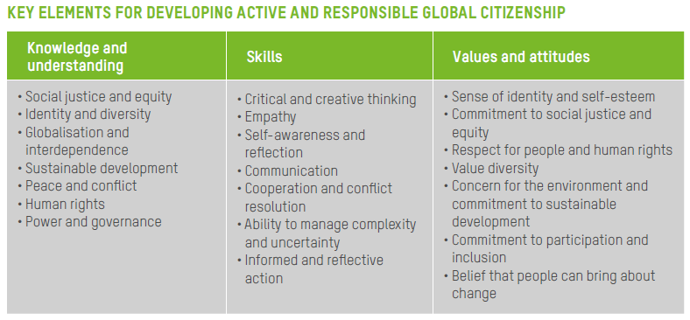
Oxfam
https://www.oxfam.org.uk/education/resources/the-sustainable-development-goals

Slide 33
Global Goal Links Monkspath School Case Studies

Slide 34
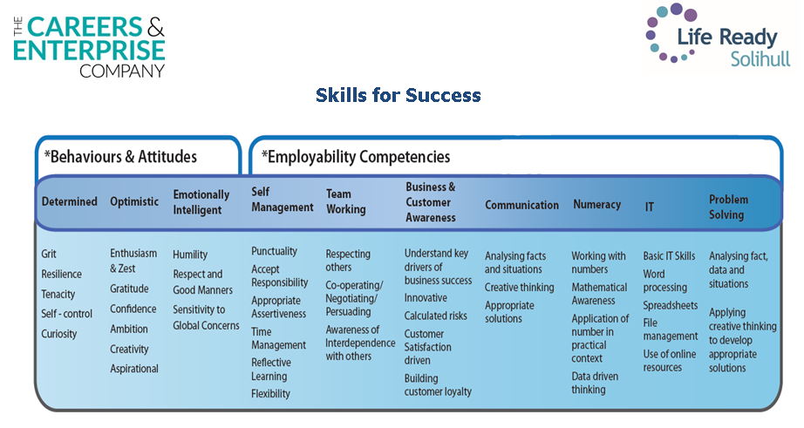
Case Study – Monkspath Linking Skills and Green activities

Slide 35
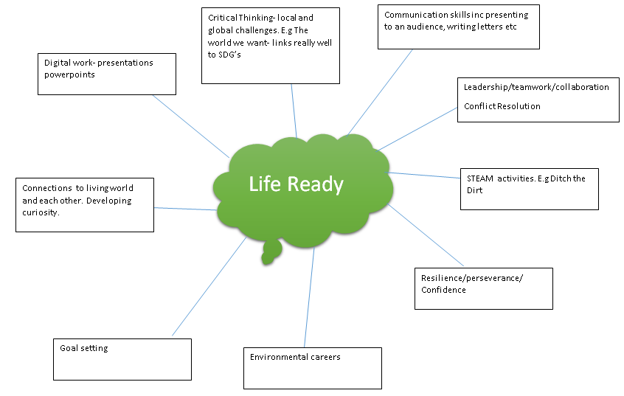

Slide 36
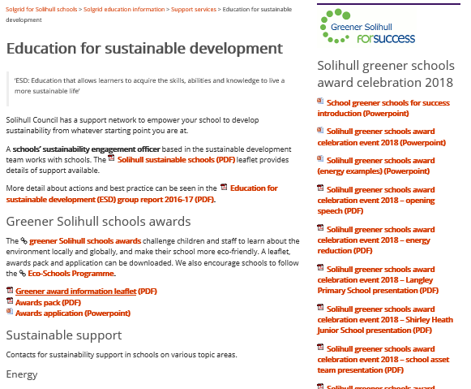
Solgrid

