Slide 1



Solihull Greener Schools Award Energy Examples
Sarah Lardner, Engagement Officer,
Sustainable Development Team, Solihull Council
slardner@solihull.gov.uk

Slide 2

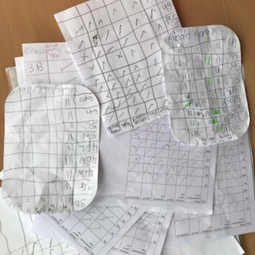
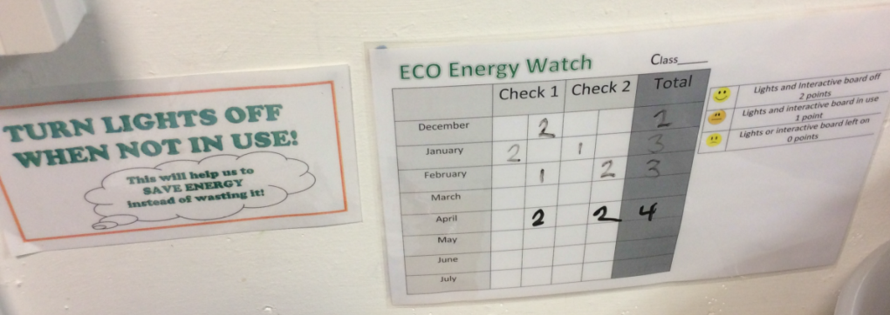
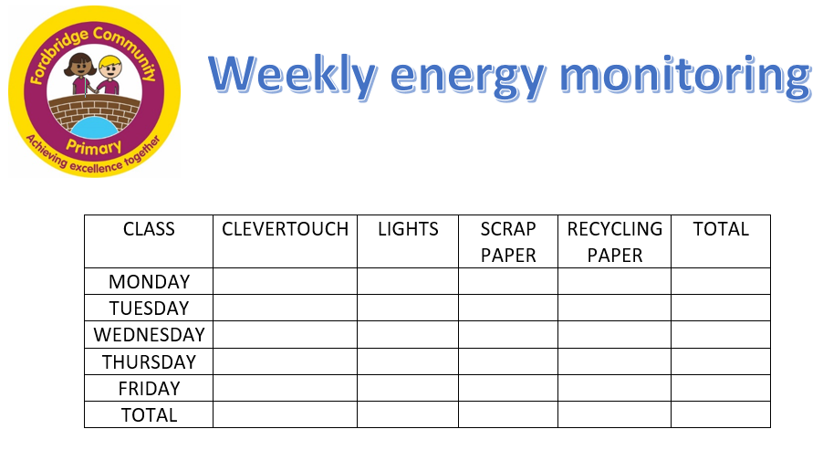
Eco-team Responsibility to reduce energy :
- Turning off when leave room (CBJS)
- Monitoring - mainly lights, whiteboards
-Monitoring Frequency
Daily (Fordbridge school every lunchtime)
Weekly (KS2 monitors, year groups can win cash)
Monthly - random checks, 2X month at break / lunchtime (CBJS)
Half termly (Dorridge eco-audit & check recycling bins /radiators, Fordbridge check scrap paper storage / recycling bins)
-Monitoring tables / checking sheets – various point scoring and formats

Slide 3
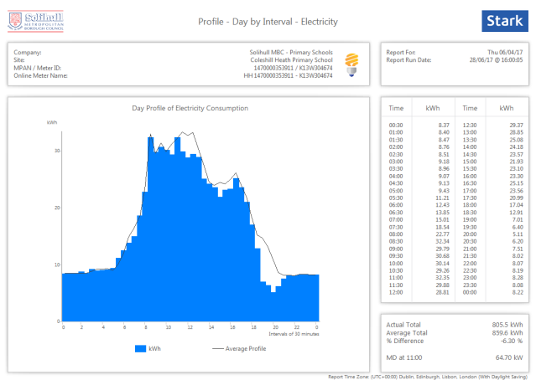
Eco team Responsibilities cont….
-Checking / analysing AMR data - compare yearly graphs, with support of Caretaker (Oak Cottage / Lady K)
-Ashden Audits – Involving children with visit, using infra-red cameras (photos from Burman / Monkspath)
Comments
-alerting children and staff to issues to be resolved (Fordbridge)
-allowed to be a bit bossy about switching off (Monkspath

Slide 4
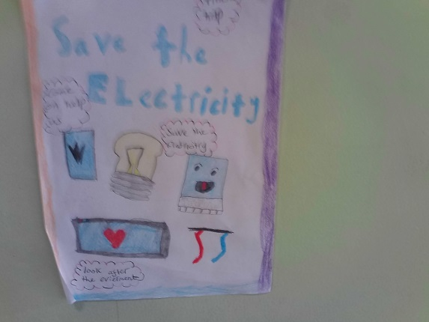
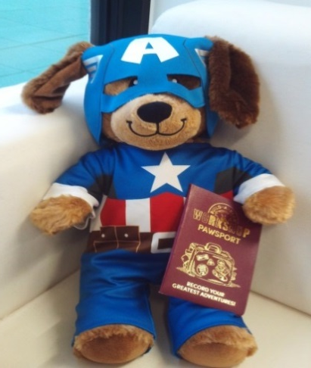
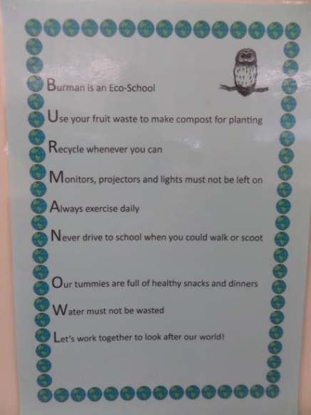
Raising awareness
Noticeboards – include energy watch data (CBJS)
Assemblies – look at energy use, why is it important to conserve, what can they do (CBJS), announce saving from Switch off fortnight (St Patricks), regularly to talk about energy saving (Dorridge)
Eco-code – acrostic poem includes energy saving to remind (Burman and Cranmore)
Posters – to encourage turning off (St Andrew’s and Cranmore)
Rewards – Dependable Dexter (Fordbridge), Money (Lady K), certificates (Dorridge), Globe trophy (Olton)
Pledges - what children would do to save energy (St Patricks)
Webpages / Newsletters

Slide 5




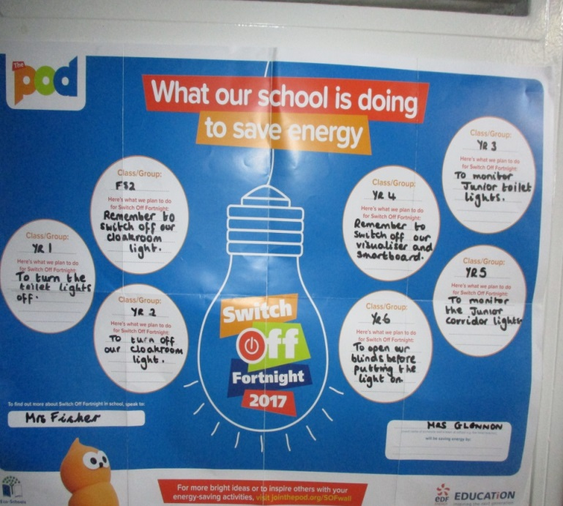

St Patricks and Monkspath
Switch it off Fortnight
Olton School – Earth Hour

Slide 6



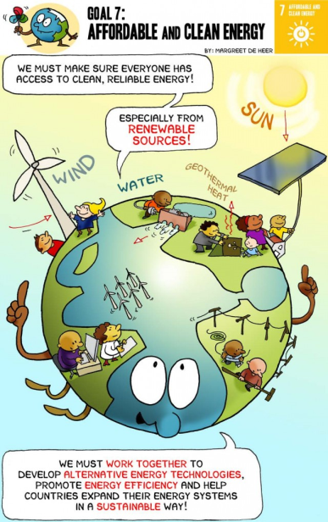
Worlds Largest Lesson
Teaching resources

Slide 7
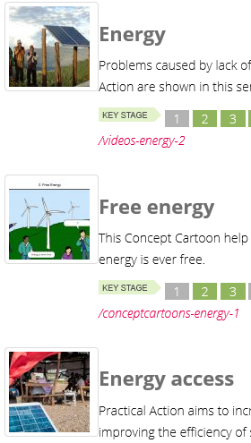

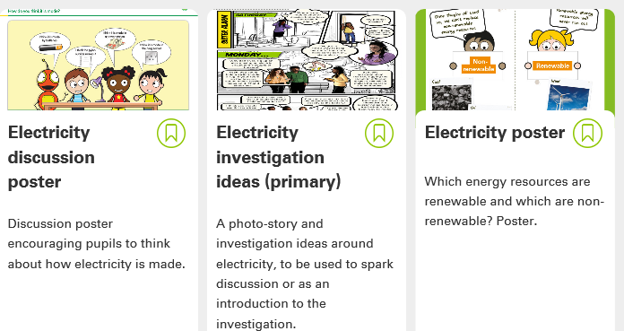
Teaching resources
Npower – climate cops teaching resource
BP Education Service
Practical Action
Eco-schools – energy pintrest
The POD
Sustainable Learning https://www.sustainablelearning.com/

Slide 8
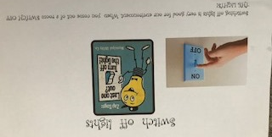
Chapel Fields Junior (Olton Primary)
Year 3 pupils monitor classrooms for switching off power that should not be in use every lunchtime. This has had a very positive impact on lights, computers not being left on. This has linked to our work on Less CO2. Many children now turn off lights left on round school and remind the adults what to do
Shown the school photos from the Ashden audit to see how we waste heat and light. This provided a spark for all the school to look at things from a different viewpoint.
Put notices round school to shut hall doors and outside doors to keep heat in. Reminded staff and pupils in assembly.
Explained in assembly how to keep rooms cool in the heat during the heatwave.
The team out The Greener Fields Award in assembly each week for the class who performed best during the week in switching off and keeping warm/cool rooms. It is in the shape of a globe.
Held a switch off campaign.
Earth Hour
We had an assembly to introduce Earth Hour with a film clip to explain what it means. Pupils were asked to go home and persuade parents to switch off on Saturday, as part of Earth Hour.
Pupils came back to school and were talking about what they did at home for Earth Hour.
We also linked it to switching off in school any electrical items not being used. A big emphasis was put on lights being on when they were not needed.
During the term Year 3 pupils had a visit from NEA where they learnt about energy use in the home and alternative fuels. The Greener Fields team also met with the presenter who gave them tips on how to run a campaign to reduce energy use.

