Slide 1
Solihull Greener Schools Award Celebration event
Sarah Lardner, Engagement Officer,
Sustainable Development Team, Solihull Council
slardner@solihull.gov.uk

Slide 2
Agenda
13.30 Introduction
13:35 Welcome - Madame Mayor
13:40 Awards ceremony
14:10 Close of ceremony (Cllr Meeson, Cabinet Member for Children, Education & Skills)
14:15 Award level process & case studies
15:15 Global Learning (British Council)
15:25 Final words
15:30 Finish

Slide 3
Notes:
Award levels

Slide 4
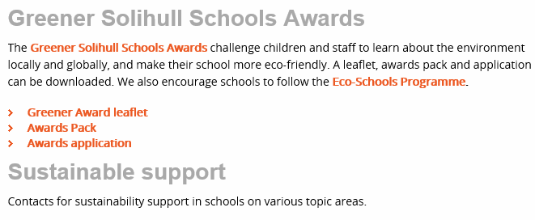
Website
http://www.solihull.gov.uk/education4sd

Slide 5
Award levels

Slide 6
Awards Ceremony
Welcome Madame Mayor
Business support
Notes:
Andy Holding, Sue Simpson, Sharon and Jo, Stuart Mansell, Liz Allister

Slide 7
North Solihull Community (UNITY)
Castle Bromwich Junior School
Fordbridge Community Primary

Slide 8
Lyndon & Lode Heath (MOSAIC)
Daylesford Infant
Greswold Primary
St Andrew’s RC Primary
Chapelfield Junior School

Slide 9
Shirley & Olton (EVOLVE)
Burman Infant
Oak Cottage Primary

Slide 10
Arden & Heart of England (RURAL)
Lady Katherine Leveson
Dorridge Primary

Slide 11
Tudor Grange, Alderbrook, St. Peters (SYNERGY)
Cranmore Infant
Monkspath Primary
St Patricks CofE Primary

Slide 12
Close of Awards Ceremony
Councillor Ken Meeson
(Cabinet Member for Children, Education & Skills)

Slide 13
Level 1
Monkspath – keep year 5 pupil as role models for year 6 and have joined eco-team and UNICEF team
Fordbridge – activities part of Children’s University, introduced ‘Dependable Dexter’ as a reward for class energy / waste savings
Oak Cottage – work with site manager, discuss AMR / energy, data and monitoring animal homes
Burman – eco-team partnered with other school for planting project
Daylesford – Focus litter and outdoor learning, afterschool club with parent support
Cranmore -Findings from monitoring project resulted in the school getting rid of the plastic straws and every class using reusable cup
Notes:
Eco-school approach to selection, voting in, keen students etc

Slide 14
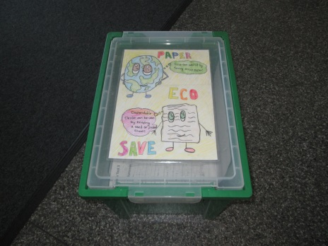
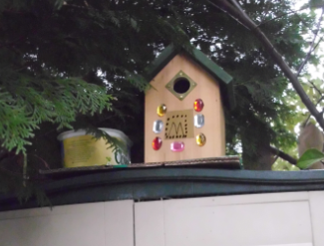
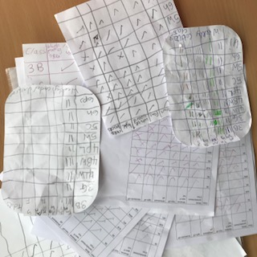
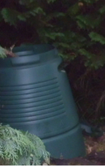
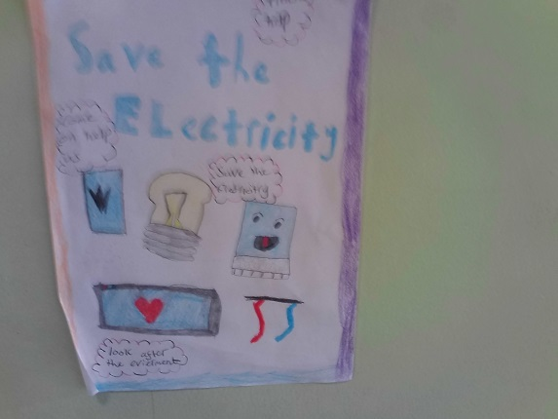
Responsibilities
Notes:
Burman , cbjs, cranmore, fordbridge meetings, paper recycling, energy monitoting, powerpoint for assembly, noticeboards, posters, energy checks, paper recycling, sorting waste, fundraising, gardening, looking after animals, composting, looking after school grounds,

Slide 15
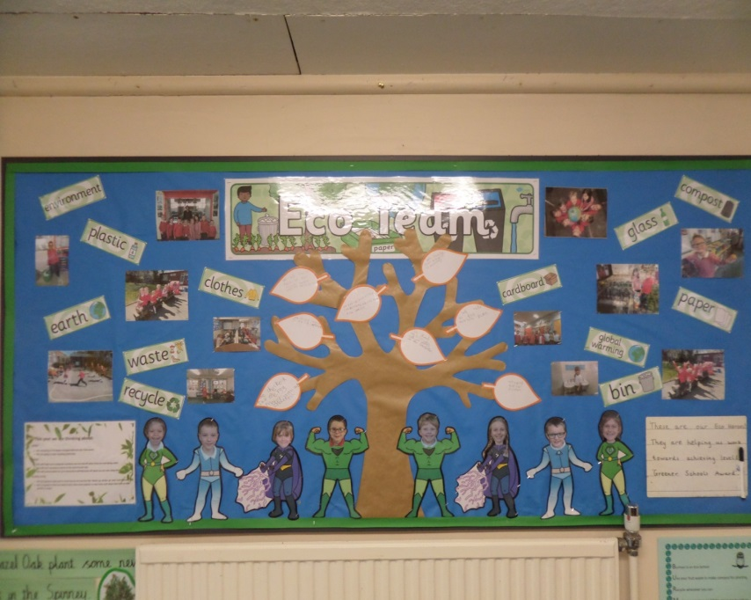
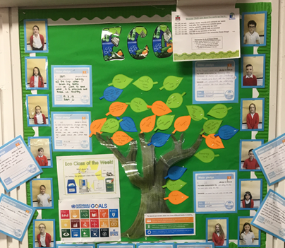
Progress Charts
Notes:
St andrews, Burman, CBJS

Slide 16
Case Study - Greswold Reduce, Reuse, Recycle club
Club- Pupils-led, unique creative approach, focus on 3R’s

Slide 17
The POD
Switch it off Fortnight
What’s under your feet,
Waste week
(examples Monkspath / St Patricks)
Council Supported Campaigns
Great British Spring Clean (Love Solihull)
Fairtrade Fortnight – Trail and Bake Off
(examples Greswold and St Patricks)
New for 2018 /19
National Air Quality Day (PH)
Green Great Britain Week (SD)
National Tree Week

Slide 18
Campaign topics / themes
Transport / Healthy Living topics
Use one campaign, other 2 from other topics areas

Slide 19
Case Study - Burman
Plastic Bag Free Day
Notes:
Laura Kendall ??????

Slide 20
St Andrew’s – National Plastic Bag Campaign

Slide 21
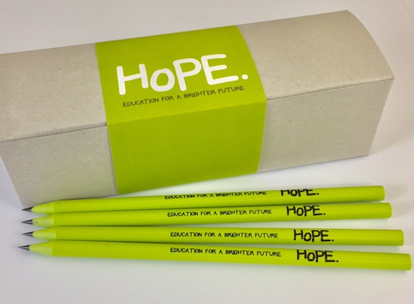
Share a Pencil Day - Hope
St Patricks Reception children’s comments:
“We had to wait a long time for the pencil”
“It made me feel funny”
“I wanted to carry on with my work”
“Not a lot of things to make my work pretty”
“We only had a pencil to do our work”
Chapel Fields School
An assembly introduced what the day is all about.
By working on a piece of work in class, but having to share a pencil, children could see how some pupils in other countries can struggle because they lack resources.
It also links to the Global Goal 4 Quality Education.
Pupils produced their own poster explaining why they love school

Slide 22
Notes:
In 2015, world leaders agreed to 17 goals for a better world by 2030.

Slide 23
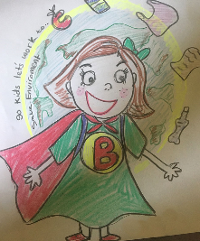
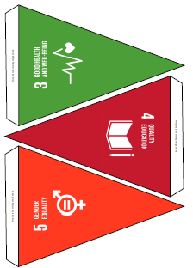
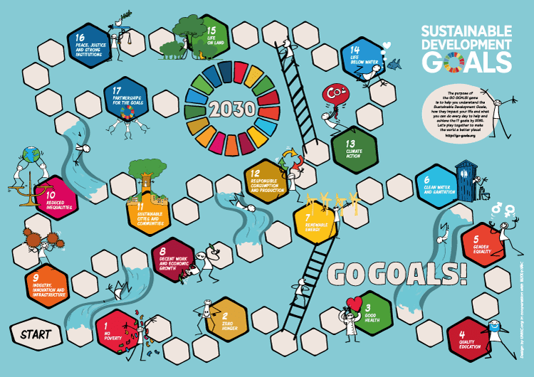
Resources
Worlds Largest Lesson website
Global Goals -bunting, paper chains, stickers, glasses
Certificates of participation
Go Goals! Board game
Climate Comic Contest
Blue Capes Global Game Changers
ESD Goals - Learning Objectives
Notes:
I can send all the links in a follow up email and I will be adding to Schools Pack

Slide 24
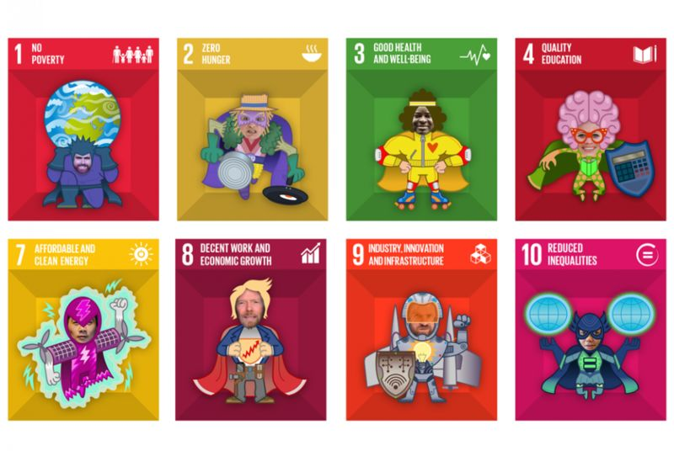
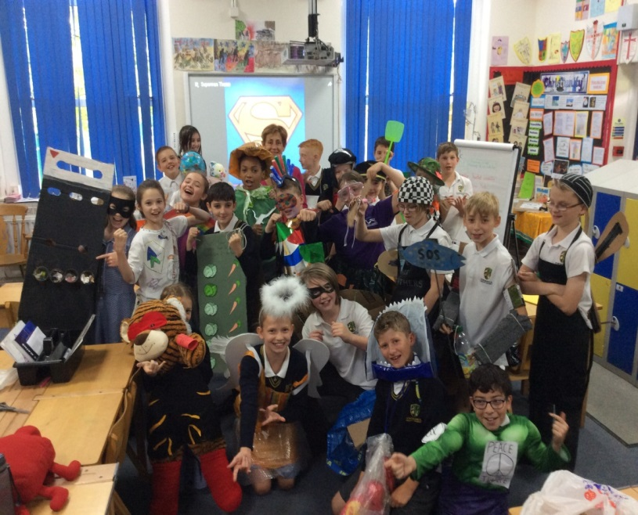
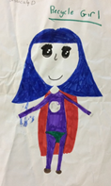
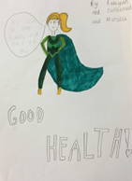
Superhero ideas
St Patricks – half term home learning project, making superhero costumes
CBJS – Golden time activity – superhero competition entries, drawings and stories

Slide 25
Case Study - Monkspath Global Goals Day
Notes:
Also links to other countries

Slide 26
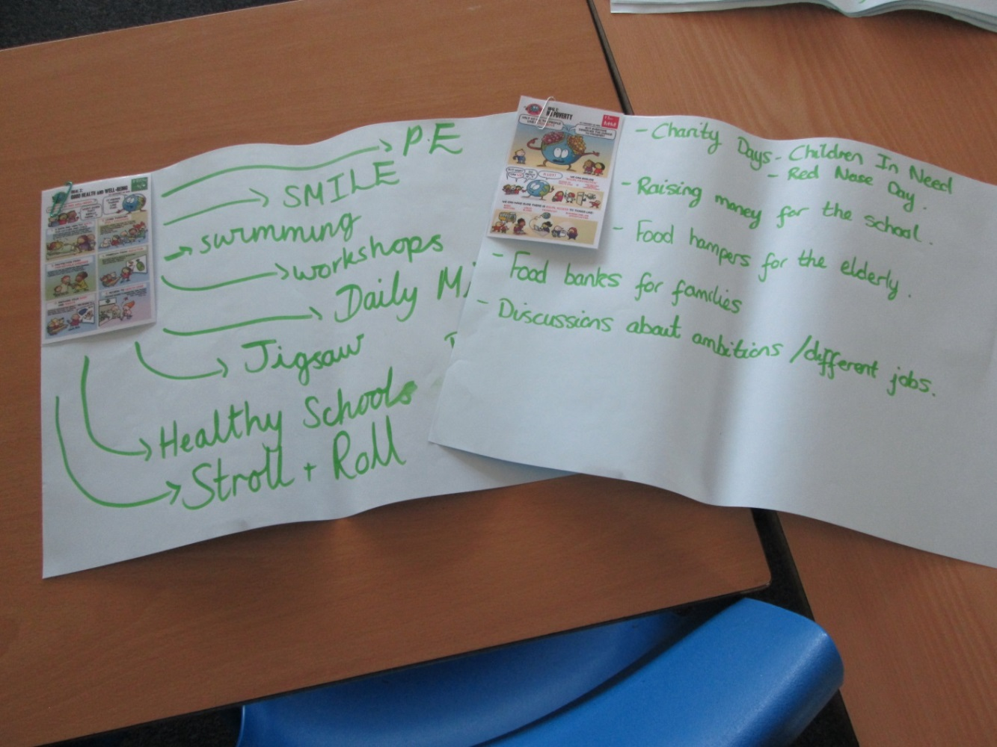
Case Study - Fordbridge
Global Goals - Culture Day
Curriculum links

Slide 27
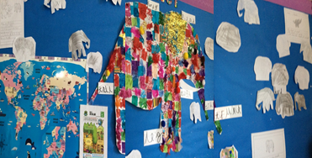
Literacy links
Assembly – Burman – Eddie and the penguins, climate change
Kapoc Tree – Monkspath, deforestation
Fordbridge – Fred the Fish, water polllution
St Patricks – Elmer the Elephant, destruction of rainforest and extinction
Resource: Environmental Stories CLPE
Notes:
Environmental Stories CLPECentre Literacy Primary Ed
NAEE article on literacy

Slide 28
GLP Expert Centre – Stella Bell
Global Goals event – June 2018
What is going to replace GLP ?

