Slide 1



Sarah Lardner, Engagement Officer (Education),
Sustainable Development Team, Solihull Council
slardner@solihull.gov.uk

Slide 2


Slide 3

http://www.solihull.gov.uk/Resident/Planning/sustainabledevelopment/GreenerSolihull
Notes:
Is the plan for sustainability for the council, All sustainability linked activities of Council teams are captured in the Green Prospectus. It’s reported on a 6 monthly basis to cabinet.
We have incorporated the Global Goals into the GP to help increase awareness of the Global Goals.
To help us create a sustainable, low carbon future we have developed a Green Prospectus which builds on our existing Sustainability Strategy.
The Green Prospectus sets out our vision for the future, along key themes that are essential if the borough is to be come more sustainable.

Slide 4
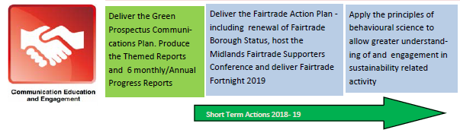
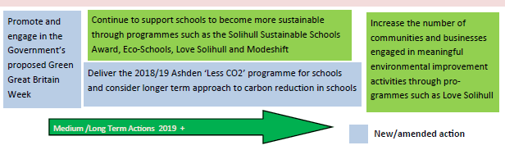

Slide 5
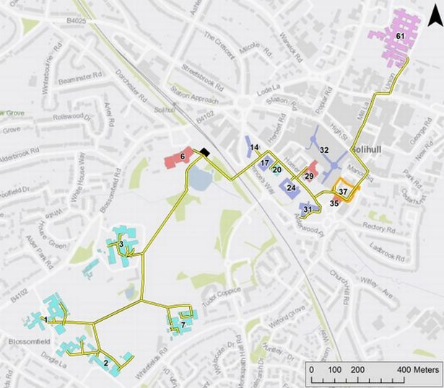
Solihull Heat Network
Notes:
Council looking at the possibility of drawing on the heat generated by a water source beneath Tudor Grange Park
Tudor Grange Leisure Centre, Solihull Council House and secondary schools near the town centre could be among the first buildings linked up to an underground heat network.

Slide 6
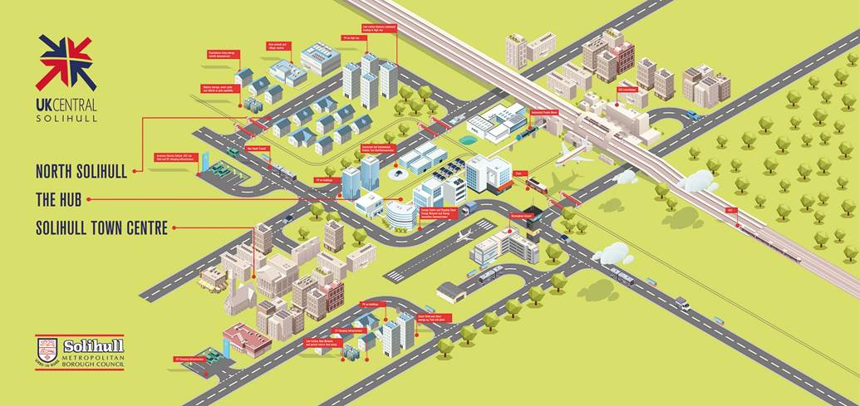
Solihull - Energy Innovation Zone
Notes:
Main focus of the EIZs is around low carbon technologies, supporting new approaches to clean energy, there will be less regulations, removing barriers (around being an energy supplier, highly regulated area at present) for them to flourish. They will be designed to stimulate local clean energy innovation and drive productivity, about encouraging innovation.
Red flags – PV on buildings / high rise, electric vehicle charging infrastructure, battery storage, low carbon heat network (ground source heat pump, transport - tram, people carrier, HS2

Slide 7
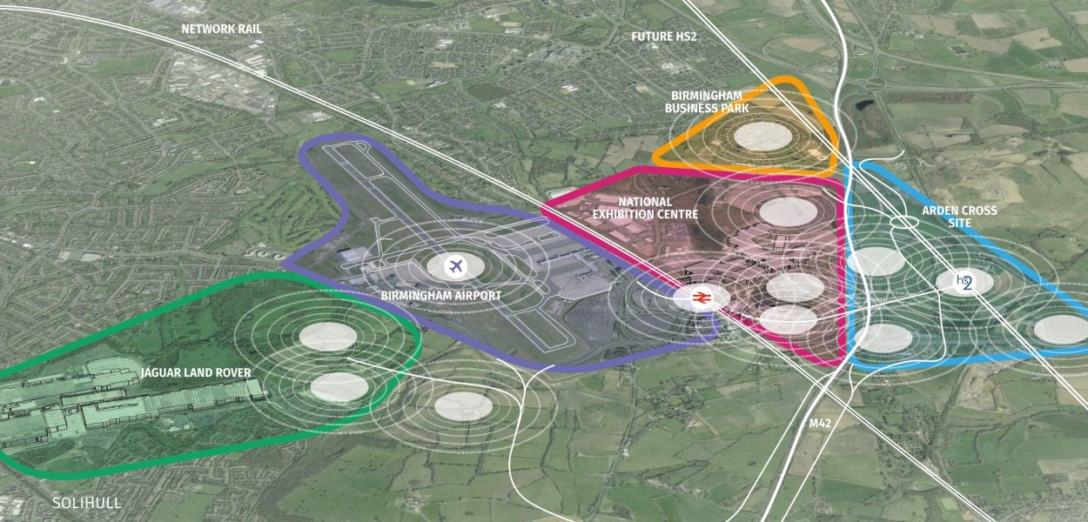
Zone 1 - The Hub
https://vimeo.com/259138896
Notes:
HS2 and the Hub / Solihull and development around (Arden Cross) Interchange Show video during last 15 minutes of lunchtime, 13:15

