Slide 1

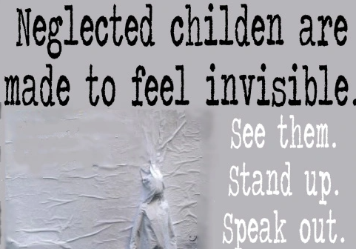

Child Neglect
Please click here to complete the pre-evaluation form or scan QR code image above.
(Clickable links in this presentation are available on a PDF version of the slides here: https://www.solgrid.org.uk/eyc/resources/safeguarding-and-welfare/neglect/
Notes:
Please ask scan the QR code or use the link https://forms.office.com/e/C3VGPr0QDs?origin=lprLink to complete a pre-evaluation before starting the course

Slide 2
Definition of Child Neglect
“Neglect is the persistent failure to meet a child’s basic physical and/or psychological needs, likely to result in the serious impairment of the child’s health or development.
Neglect may occur during pregnancy as a result of maternal substance abuse. Once a child is born, neglect may involve a parent or carer failing to:
• Provide adequate food, clothing and shelter (including exclusion from home or abandonment)
• Protect a child from physical and emotional harm or danger
• Ensure adequate supervision (including the use of inadequate caregivers)
• Ensure access to appropriate medical care or treatment.
• provide suitable education
It may also include neglect of, or unresponsiveness to, a child’s basic emotional needs Working Together 2023
Notes:
This definition is the official Government definition of neglect and is important as it supports a consistent understanding of neglect
However the definition can only be useful if there is a clear and shared understanding of neglect – and its impact upon a child’s health and development

Slide 3
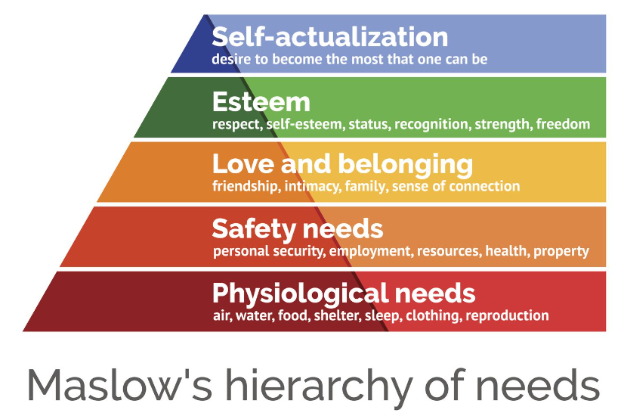
What is child neglect?
A child is being neglected when some or all of their basic needs are not being met;
Notes:
This power point will appear in sections when played as a slide show.
Ask the question What is Child Neglect? ; ask trainees having seen the government definition of neglect, what do they think it means for a child, give time to discuss in pairs or small group, take feedback.
The next click will display Child neglect is when the basic needs of a child are not being met. It is useful to discuss what is a ‘need’ or ‘want’ a child may say they need a play station for example, but that would be an example of what they want rather than what they need.
The click will display a diagram of Maslow’s hierarchy of needs; this helps us to see what a child needs to reach their full potential- self actualisation, the desire to accomplish everything that you can and become everything you are capable of.
Maslow presents the needs in a hierarchy, as he argues that the most basic need is for physical survival, and this will be the first thing that motivates behaviours. Once an individual's physiological needs are satisfied there is a need for security and safety. Safety can be fulfilled by the family and society, e.g. schools, medical care, police etc. and includes things like emotional security, financial security (employment or social welfare), law and order, freedom from fear, social stability, health & wellbeing, safety against accidental injury. Levels beyond this are social and involve feelings and belongingness. He suggests that love and belongingness including friendship, trust, acceptance, receiving and giving affection and love are especially strong in childhood and can override the need for safety. Esteem can be for an individual to have self-esteem; dignity, achievement, mastery, independence and the typical human desire to be accepted and valued by others.
The order of these levels is not completely fixed. For some, esteem outweighs love, while others may self-actualize despite poverty and of course these needs are interconnected; individuals can feel various needs at the same time, so this structure is not always as rigid as the diagram implies.
In the UK the law requires that someone with parental or carer responsibility meets these needs for their child, so child neglect happens when some or all of these needs are not being met.
Acts of omission and acts of commission: It is not always easy to identify why a child’s needs are not being met sometimes this can be because of acts of omission (someone forgetting to do something) and acts of commission (someone intentionally doings something neglectful) and both can occur simultaneously. For example, a parent leaving a child in the supervision of an unsuitable person involves both an omission to provide appropriate supervision and commission in leaving the child with someone unsuitable. The issue for those identifying neglect is less about understanding intent and more about recognising the child’s needs are not being met as this is what needs to be addressed at the earliest opportunity.

Slide 4
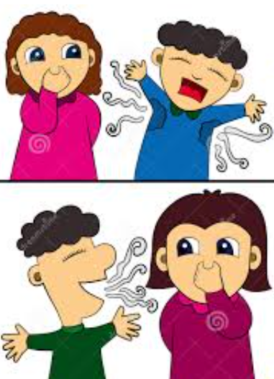
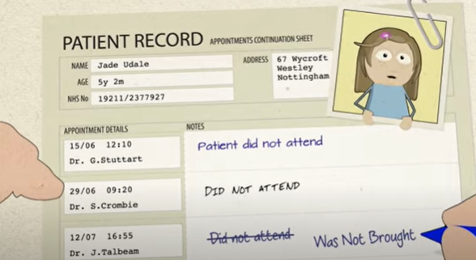
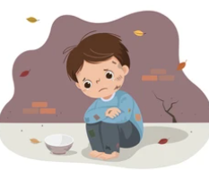

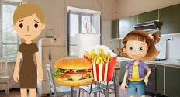
Children can experience different forms of neglect;
Medical neglect
Nutritional neglect
Emotional neglect
Educational neglect
Physical Neglect
Lack of supervision and guidance
Notes:
Jan Howarth (2007) identified six types of neglect and this breakdown is helpful for practitioners to begin considering where the child’s needs may be being neglected.
Ask people to think about what signs and indicators they might see for each one of these:
Medical – minimising or denying illness or health needs of children; failure to seek medical attention or administer treatments.:
Signs or indicators:
Poor dental hygiene
Dental decay (Did you know that for the past 3 years the leading cause of children being admitted to hospital has been dental decay; this can be linked to poor diet- nutritional neglect- but also children are not always taught how to clean their teeth or provided with a toothbrush or taken to see a dentist. Solihull dental services advise that every child can have access to an NHS dentist.)
Recurring illnesses
Frequent and untreated nappy rash
Faltering Growth
Medication not being provided for the child
Not being brought to appointments or seeking medical treatment in a timely manner
Recurring rashes
Non-registration with a GP
Malnutrition
Untreated headlice/flea bites/ring worm/scabies
Mother not accessing antenatal care
Late booking at midwifery
Mother misusing drugs/alcohol/smoking during pregnancy
Parental self-neglect
Death
Nutritional – not providing a balanced diet for healthy growth or understanding and providing for specific dietary requirements (allergies, medical needs etc.)
Signs or indicators:
The child may often be hungry
The child might steal food due to being hungry
The child may struggle to concentrate
The child may be very overweight or obese
The child may be extremely thin
The child may have obesity related medical issues
Not having a packed lunch, snacks or money to buy food
The child may be tired
The child may have anaemia
The child may not be growing or gaining weight as expected
Emotional – unresponsive to a child’s basic emotional needs; failure to interact or provide affection; failure to develop child’s self-esteem or sense of identity.
Signs or indicators:
Poor development of speech and language skills
Poor development of fine motor skills
Behaviour changes, becoming withdrawn, angry, upset, or self-harming
Anxiety
Low mood
Not knowing how to play or interact with others
Poor relationships with caregivers, peers, and professionals
Drug/alcohol use
Engaged in potentially harmful behaviours
Seeking attention
The child might be obsessive with objects or people
The child may self-harm
Educational – failure to provide a stimulating environment; failure to show interest in education or support learning; failure to respond to any special needs related to learning; failure to comply with statutory requirements regarding registration in education, attendance or home schooling.
Signs or indicators:
Child is not attending school everyday
Child is often late for school
The child doesn't have the right equipment for school
The child doesn’t access any activities outside of school
Non-attendance at school meetings by caregivers
Non-attendance at parents’ evenings
No recognition or celebration of child's achievements
Not registering a child to attend a school, with no intent of home schooling
Inappropriate environment and preparation to promote home learning
Physical – failure to provide appropriate clothing, food, cleanliness, living conditions.
Signs or indicators:
The child may struggle to concentrate
The child may be dirty
The child may smell unclean
The home might be cold
The home might be dirty
The home might be extremely cluttered
Hoarding
Clothes may not fit well or be appropriate for the weather
Shoes may not fit well and not be appropriate for the weather
Lack of supervision and guidance – failure to provide for a child’s safety, including leaving a child alone; leaving a child with inappropriate carers; failure to provide appropriate boundaries, failure to protect online
Signs or indicators:
Unexplained injuries
Frequent falls
Drug/alcohol use
Going missing
Harm outside of the home, including:
Involvement in Anti-Social Behaviour
Involvement in criminal activity
Inappropriate online activity
Inappropriate relationships with peers
Inappropriate relationships with other adults
Inappropriate sexualised behaviour/language or increased sexual awareness
Concerns about Criminal or Sexual Exploitation
Death
The NSPCC break these into 4 areas, as demonstrated by the colours shown;
Blue being Physical needs and includes Medical and Nutritional,
Purple being safety needs,
Pink Emotional care &
Yellow development needs
Children can show signs of neglect in a variety of ways – dependent on their age, the severity, frequency and duration of the harm, their resilience, the availability of alternative sources of care and support. Children may exhibit many, some or no indicators of neglect, so those who are able to build professional relationships and trust and be curious about what life is like for the child are more likely to recognise when their needs are being neglected.
Provide a copy of the SSCP screening tool designed to help professionals to recognise when a child's needs are not being met and prompt a response as early as possible. The screening tool can be downloaded from: https://westmidlands.procedures.org.uk/local-content/xkjN/localised-content-neglect-tools-and-pathways/?b=Solihull%20%20%20%20%20%20%20%20%20%20Manage%20Cookie%20Consent%20%20We%20use%20some%20necessary%20cookies%20to%20make%20this%20website%20work.We%27d%20like%20to%20set%20additional%20cookies%20to%20understand%20how%20you%20use%20the%20site,%20remember%20your%20settings%20and%20improve%20the%20website.See%20our%20full%20cookie%20policy%20for%20more%20information%20which%20includes%20a%20list%20of%20all%20of%20the%20cookies%20we%20use.%20%20%20%20%20%20Accept%20additional%20cookies%20%20%20%20Reject%20additional%20cookies%20%20%20%20%20%20%20%20Cookie%20Policy%20%20%20%20Manage%20Consent

Slide 5
The effects of neglect at different development stages
Type of effect | 0-2 | Early Childhood | School years | Adolescents
Development | Foetal disorders e.g. foetal alcohol syndrome Failure to thrive Poor intellectual capacity | Delay in learning new skills Language delays | Severe education deficits: learning difficulties, poor problem solving, poor reading, writing & maths | Very low academic achievement, exclusion or no longer engaged in education employment or training
Behaviour | Frozen baby Withdrawn, lethargic, depressed Self-stimulating- e.g. rocking | Either aggressive or withdrawn Indiscriminate friendliness Lacking social skills | Disruptive/ overactive in class Extremely withdrawn, few friends Desperate for attention overcompensation | Anti-social or possibly criminal behaviour Experiencing harm outside of the home Extremely isolated or withdrawn Lack of trust in adults
Emotional | No learned trust | Shame and self- doubt Lack of confidence and expectation of failure Poor self-concept | Guilt/ self-blame Self-harming | Difficulty in managing negative emotions Self-harm and suicide attempts, in some cases resulting in death
Physical | Poor growth/ overweight Nappy rash, infections, hospital attendances Fatal accident e.g. through co-sleeping under the influence of alcohol | Short stature, dirty, unkempt Malnourished/ obese | Disturbed eating patterns Repeated inability to control urination/ faeces | Eating disorders, substance abuse Repeated untreated health needs
Notes:
It is important to recognise that a child can have their needs neglected at any age, some children will experience neglect from the time they are conceived, and unfortunately this can go unnoticed. Other children will experience neglect at times of a major life event; this could be through bereavement, parental separation, change in family make up; new/changing parental factors; e.g. increased substance misuse, declining mental health difficulties, new partner, domestic abuse, new job etc. that take the focus away from the child’s needs. Some children may be neglected by one parent, some by all parents, some will have their needs met by extended family members rather than parents. Some children will have more resilience to cope, others will not, so it is impossible to say exactly what the impact of neglect will be at any stage for any individual. This table is therefore completed from information know about different age ranges in research and evaluations when needs are neglected but may not apply to every individual.
0-2 Under 16C(1) of the Children Act 2004 (as amended by the Children and Social Work Act 2017), a local authority in England must notify the Child Safeguarding Practice Review Panel if it knows or suspects that a child has been abused or neglected and serious harm or death has occurred, each local area then carries out a rapid review. In the 2022/3 analysis of the 393 rapid reviews carried out the largest age group represented were children aged under 1 (36%, n=142). This is consistent with previous years. The term frozen baby is used to describe a baby that has experienced emotional neglect, unavailability and a lack of responsiveness the child may appear to be numb or cut off from what is happening around them; they have learnt that crying doesn’t work because nobody comes.
While neglect is something that is usually persistent, unfortunately small children can be fatally harmed when a parent/ carer under the influence of alcohol or substances co-sleeps with their child there are campaign materials available to raise awareness of nominating a responsible person to be in charge of the child who will not drink or take substances; https://www.bhamcommunity.nhs.uk/whos-in-charge/
Early Childhood In the 2022/3 analysis of the 393 rapid reviews carried out 16% (n=63) of children were aged 1 to 5 years old and 8% (n=31) . This is usually the time where children start to become more familiar with the world outside their home, perhaps starting nursery or pre-school, their brain is still in rapid development, and as they are observed in learning and nurturing environments, this may provide the initial indications that there is something that needs more exploration and is often the first opportunity to recognise a child's needs are not being met.
School years In the 2022/3 analysis of the 393 rapid reviews carried out 8% (n=31) of children were aged 6 to 10 years old and (21%, n=84) were those aged 11 to 15 years. If earlier neglect is not addressed then at school the child is likely to have increasing difficulties, as the impact of having their needs unmet grows and id likely to have impact on their ability to learn, build and maintain friendships and play. Research suggests that if these effects are allowed to accumulate, they can extend into adulthood irrespective of whether the child is removed from the neglectful environment.
Adolescents In the 2022/3 analysis of the 393 rapid reviews carried out 18% (n=72) of children were aged 16 to 17. Adolescence is a term often applied to the stage the brain experiences further development, mainly in the frontal lobe. This part of the brain is responsible for emotional expression, problem solving, decision making and sexual behaviours. This can start as young as 10 and last until someone is 25, so the age range can overlap school years and adulthood. Older children who have lived with a long history of neglect are likely to display all the consequences of their earlier behaviour, and unfortunately professional stat to focus on the behaviours form the child, rather than the possibility they have been and are being caused because their needs have not and are not being met. Joint Targeted Area Inspections bring together four inspectorates – Ofsted, Care Quality Commission (CQC), HMI Constabulary and Fire & Rescue Services (HMICFRS) and HMI Probation (HMIP) – to ‘examine how well agencies are working together in a local area to help and protect children a report entitled Growing up neglected: a multi-agency response to older children reported on ‘the multi-agency response to older children who are living with neglect’ and summarised:
1. Neglect of older children sometimes goes unseen.
2. Work with parents to address the neglect of older children does not always happen.
3. Adult services in most areas are not effective in identifying potential neglect of older children.
4. The behaviour of older children must be understood in the context of trauma.
5. Tackling neglect of older children requires a coordinated strategic approach across all agencies.

Slide 6



Why is early recognition & response to neglect so important?
It is bad for children’s bodies
It is bad for children’s learning
  foetal neglect
  delayed growth within the womb
  Non-organic failure to thrive
  vulnerability to illness/infections/accidents
  poor medical care
  lack of exploration
  delayed speech and language
  impoverished play and imagination
  special educational needs / learning disability
  later educational failure
  poor life skills
Notes:
This and the following slides provide examples of possible impacts of neglect for children and the wider society; they are not exhaustive lists, so trainees may identify other things not included here

Slide 7

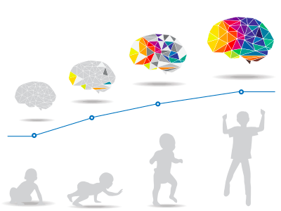
Why is early recognition & response to neglect so important?
It is bad for children’s brains
It is bad for children’s emotions
lack of nutrients - reduced growth
lack of stimulation – delayed brain development
unregulated stimulation - disordered neural circuitry
    Trauma
disturbed self-regulation
negative self identity
low self esteem
clinical depression
substance abuse
Notes:
This and the previous and following slide provide examples of possible impacts of neglect for children and the wider society; they are not exhaustive lists, so trainees may identify other things not included here
The word brains is linked to a video that explains child brain development https://www.youtube.com/watch?v=hMyDFYSkZSU from the NSPCC
The word trauma is linked to a video exploring the impact of trauma for children https://www.youtube.com/watch?v=xYBUY1kZpf8 from the UK Trauma Council

Slide 8


Why is early recognition & response to neglect so important?
It is bad for children’s relationships
It is bad for our society
  insecure/disorganised internal working model
  risk of grooming and/or exploitation
  transmission of relationship problems to significant others, for example, peers, teachers, substitute carers, professionals
  long-term effects on adult physical and mental health and on individuals’ social and occupational adjustment
  financial cost of treating or incarcerating victims
  possible association between child neglect and future anti social and criminal behaviour
  intergenerational transmission of neglectful parenting for future generations
Notes:
This and the previous slides provide examples of possible impacts of neglect for children and the wider society; they are not exhaustive lists, so trainees may identify other things not included here

Slide 9
Neglect is serious
Neglect can cause impairment of health and development and impair aspirations and achievement
At worst Neglect Kills
The annual report provided by the Child Safeguarding Practice Review Panel and Department for Education 2022/23 provides evidence from national and local reviews carried out when a child has been seriously harmed or killed, and reported:
“It is striking that over half of the reviews observed that a child had experienced neglect”
Notes:
Neglect has continued to be evident in over half of child safeguarding practice reviews for a number of years now, it is also nationally the most likely reason for a child being subject to a child protection plan. It is because of the impact and prevalence of neglect that it is a priority for the Safeguarding Children Partnership in Solihull.

Slide 10
Why children may not disclose Neglect
“I feel embarrassed to talk about my home life because I feel different to my friends”
“My parents are always talking to professionals, so nobody really notices or talks to me”
“My life is normal to me, I don’t know any different, so I don’t know if my care is good enough”
“I’m scared I will be taken away from my family if I teel anything & I don’t know what will happen”
“I don’t have the social skills or language to talk to you about my home life”
“I’m too young to talk”
Notes:
This slide will appear in sections when played as a slide show
Ask people to consider why they think children will not disclose – there can be many reasons, but the 5 speech bubbles that will appear with each additional click show some of the most common reasons children do not disclose neglect

Slide 11
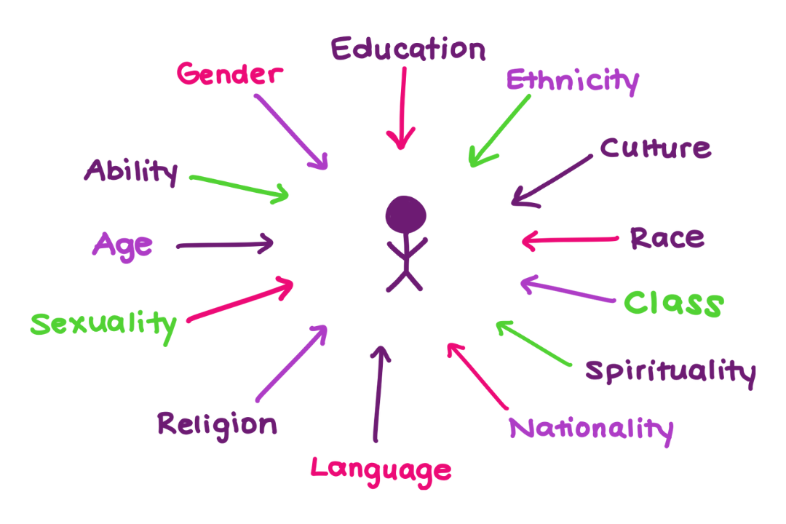
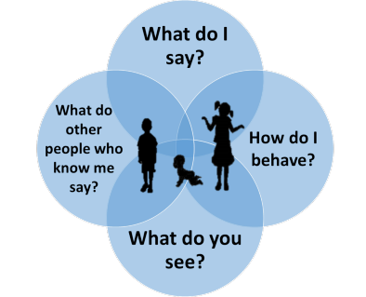
The Child’s voice
Notes:
The term ‘voice of the child’ automatically suggests that consideration is given to the words spoken by a child and listened to by the professional and volunteers, but really it means much more than this. It means an active process of receiving, interpreting and responding to communications that include all the senses and emotions and is not limited just to the spoken word.
It is therefore important, as many children will not disclose neglect to give consideration to the child’s age and development stage, first language, disability, ethnicity and culture, education, class etc. to really understand and analyse the behaviours, expressions and emotions of the child and the people around them. There is a guide that may help think more about this at https://www.safeguardingsolihull.org.uk/lscp/wp-content/uploads/sites/3/2024/02/VoC-new-logo.pdf
In 2021 around 11% of children in the UK were recorded as having a disability.- Children with a disability are at increased risk of abuse, particularly those who have difficulty in communicating needs and trauma. When parents/carers and professionals are focused on meeting the needs of children with disabilities or complex health needs may neglect the needs of their siblings, so it is important that each child in a family is considered individually.
The Child Safeguarding Practice Review Panel Annual Report 2022-23 recognised In comparison to the 2021 census figures for 0 to 17-year-olds, children from mixed/multiple ethnic groups and Black/African/Caribbean/Black British ethnicities were overrepresented in the rapid reviews (carried out when a child is seriously injured or dies). Conversely children from Asian/Asian British ethnicities or other ethnic groups were underrepresented in the rapid reviews. They suggest those working with children and families should always ask:
How the race, culture, faith, and ethnicity of the child and/or family are considered?
How any disability, physical or mental health issues, and any identity issues in the child and/or family impact on the child’s lived experience?

Slide 12
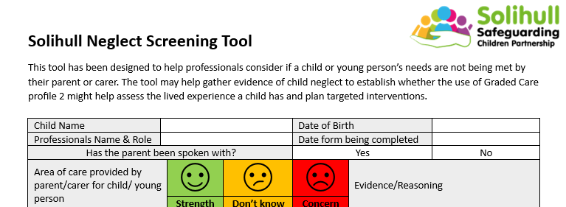
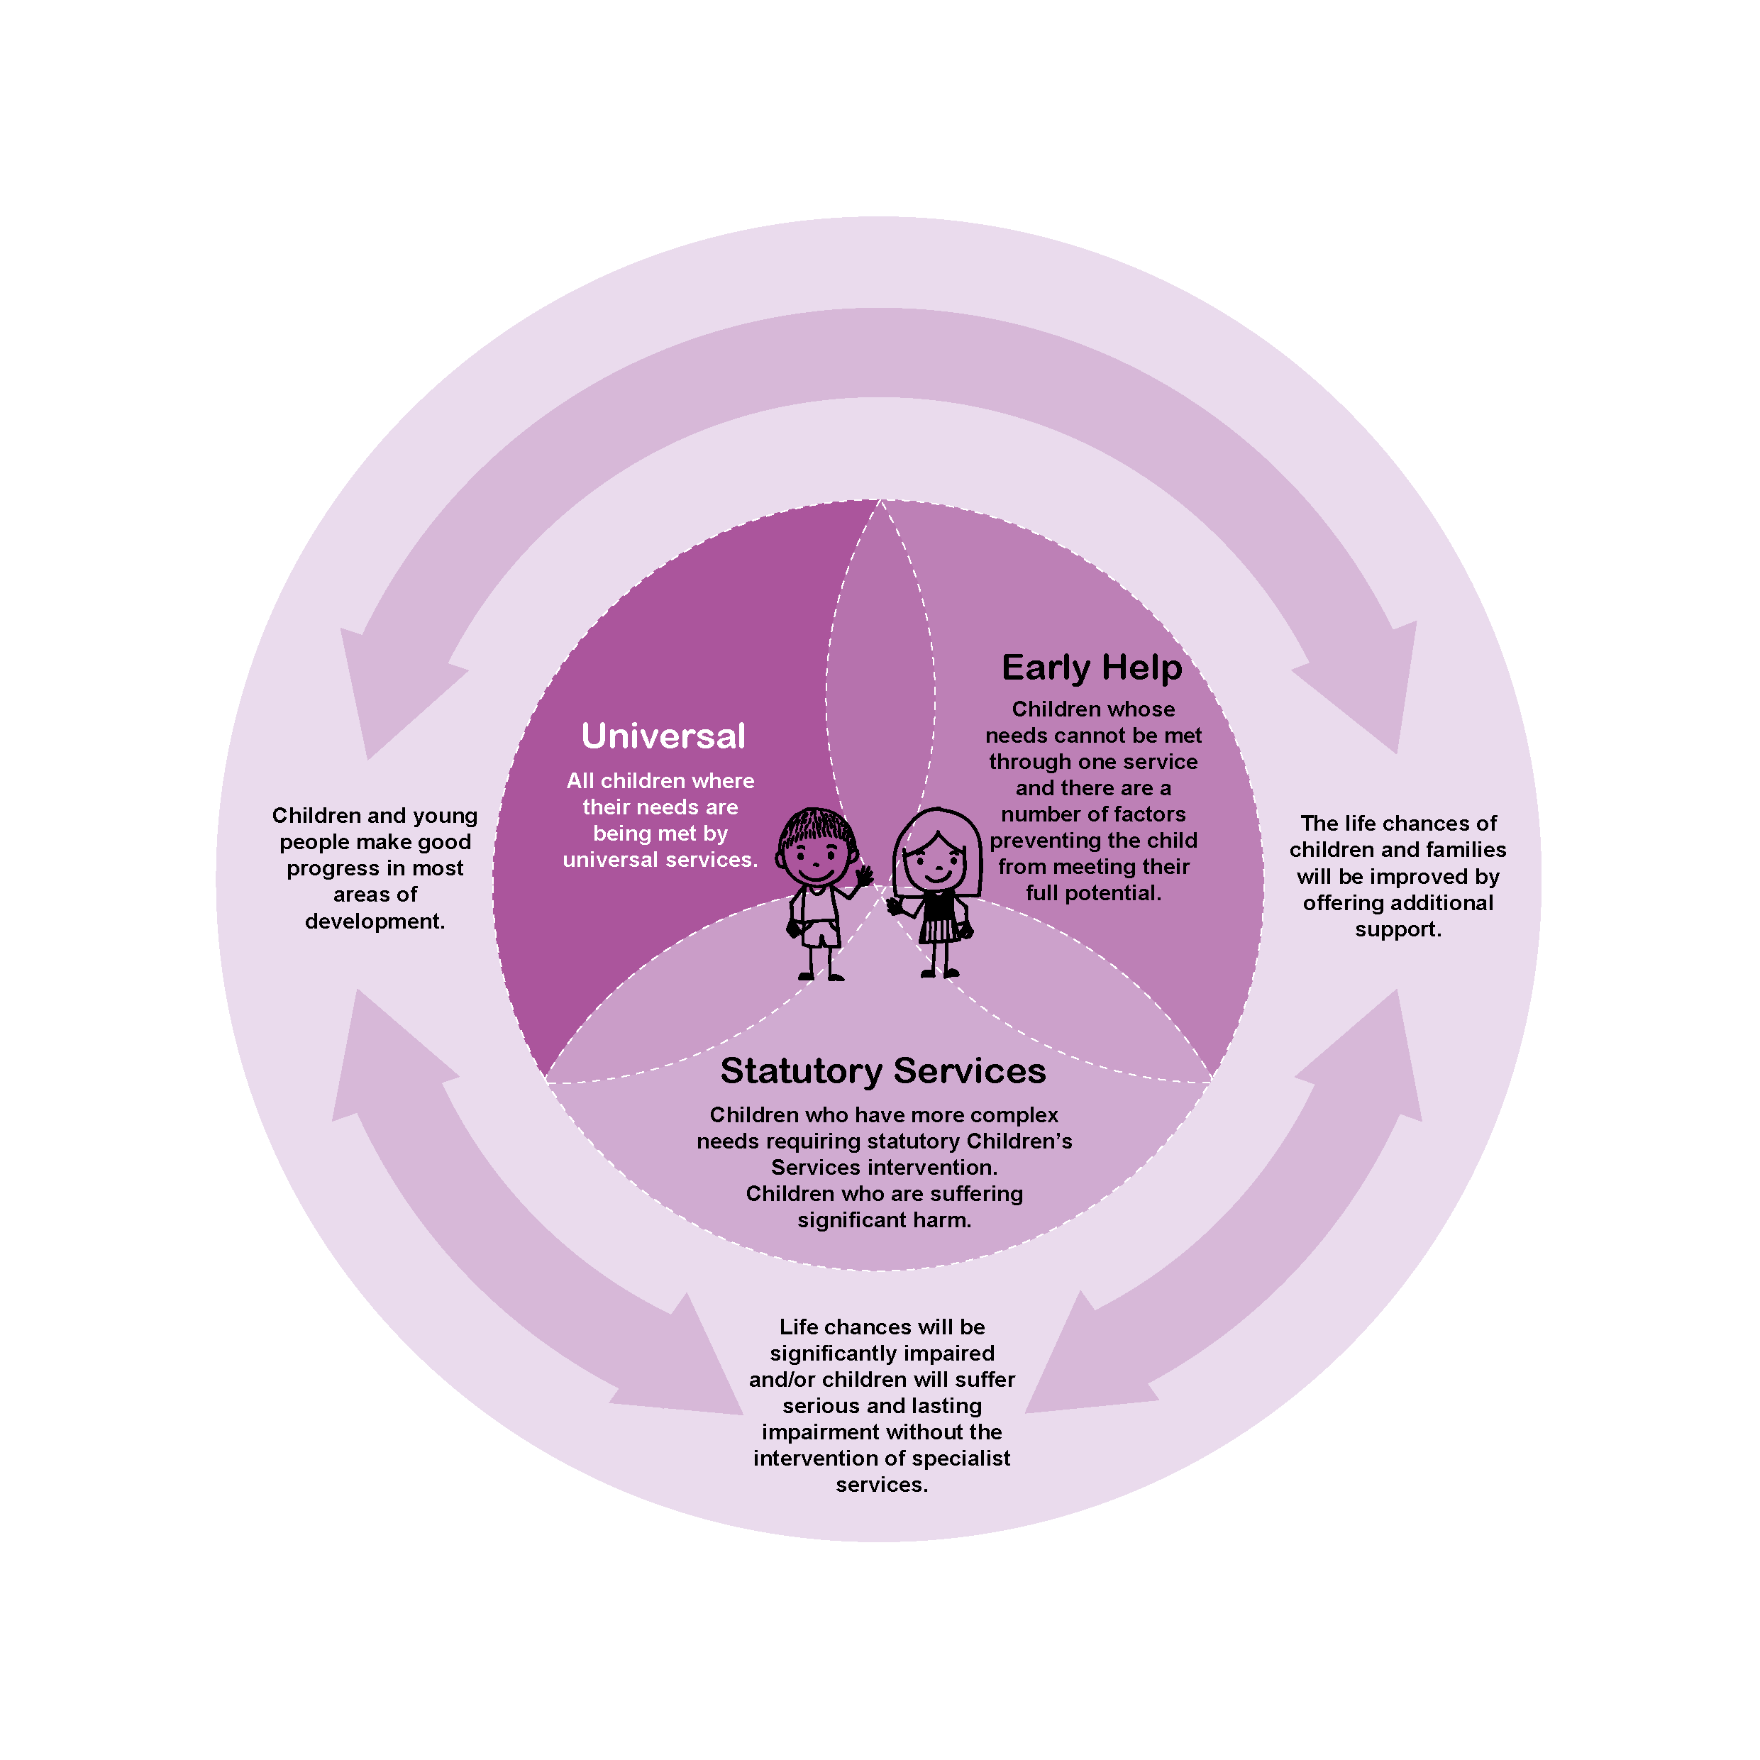
What do you do if you think a child is being neglected?
Talk to your designated safeguarding lead; it may be valuable to create a chronology
Complete a screening tool and follow the guidance
Follow Solihull’s Right Help, Right Time, Right Response guidance
Notes:
Every organisation should have a designated lead for safeguarding; this person should have up to date safeguarding training and be aware of local safeguarding procedures.
A chronology is a record in date order of all the significant events and key decisions made that prompt changes in a child or young person’s life. Many people will have chronological recording systems, where every contact or concern they have for a child is recorded, but a specific chronology will pick out the key events and decision making from these and help to reflect, make sense and notice any patterns happening in the child's life.
The right help right time right response guidance is available at https://westmidlands.procedures.org.uk/local-content/2gjN/localised-content-thresholds-guidance/?b=Solihull%20%20%20%20%20%20%20%20%20%20Manage%20Cookie%20Consent%20%20We%20use%20some%20necessary%20cookies%20to%20make%20this%20website%20work.We%27d%20like%20to%20set%20additional%20cookies%20to%20understand%20how%20you%20use%20the%20site,%20remember%20your%20settings%20and%20improve%20the%20website.See%20our%20full%20cookie%20policy%20for%20more%20information%20which%20includes%20a%20list%20of%20all%20of%20the%20cookies%20we%20use.%20%20%20%20%20%20Accept%20additional%20cookies%20%20%20%20Reject%20additional%20cookies%20%20%20%20%20%20%20%20Cookie%20Policy%20%20%20%20Manage%20Consent

Slide 13

Where can I find further information?
Solihull SCP Threshold Guidance – Right Help Right Time Right Response; guidance for practitioners on the response to be provided to children and families in Solihull at different levels of need
Neglect Tools
SSCP Neglect Continuum of Tools
Chronologies
Multi-agency Chronology Template
Multi-agency Chronology Guide
Screening Tool
Neglect Screening Tool
Neglect Screening Tool Guide
Graded Care Profile
SSCP Graded Care Profile
If you think a child is in imminent danger, call 999. If you have significant worries, please call the MASH Team to speak to the Duty Social Worker for advice:
  0121 788 4300 option 2 (Monday to Thursday 8:45am - 5:20pm, Friday 8:45am - 4.30pm), or
  0121 605 6060 (Evenings, weekends or bank holidays)
Further multi-agency training is available from Solihull Safeguarding Children Partnership
https://training.solihulllscp.co.uk/Learning-and-Development.aspx
Notes:
Please scan the QR code or use the link https://forms.office.com/e/48b9AgEFHD?origin=lprLink to complete a post course evaluation

Slide 14
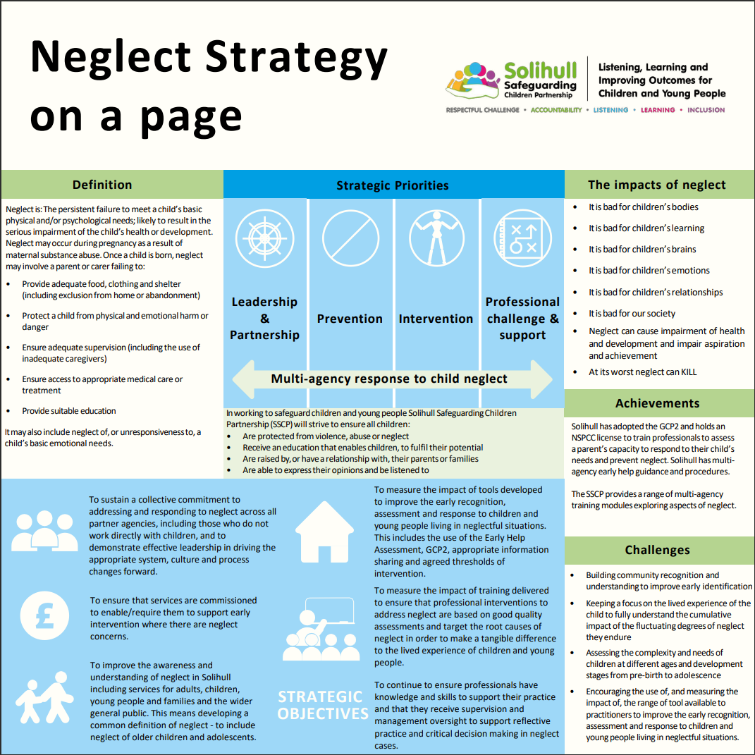
Notes:
This is Solihull Safeguarding Children Partnership Neglect Strategy overview the full strategy can be found at https://www.safeguardingsolihull.org.uk/lscp/multi-agency-procedures-and-practice-guidance/neglect-strategy/

