Slide 1



Child neglect- working with parents/ carers
Notes:
Please scan the QR code or us ethe link https://forms.office.com/e/xEU4955Xkz?origin=lprLink to complete the pre-evaluation before you start the course

Slide 2
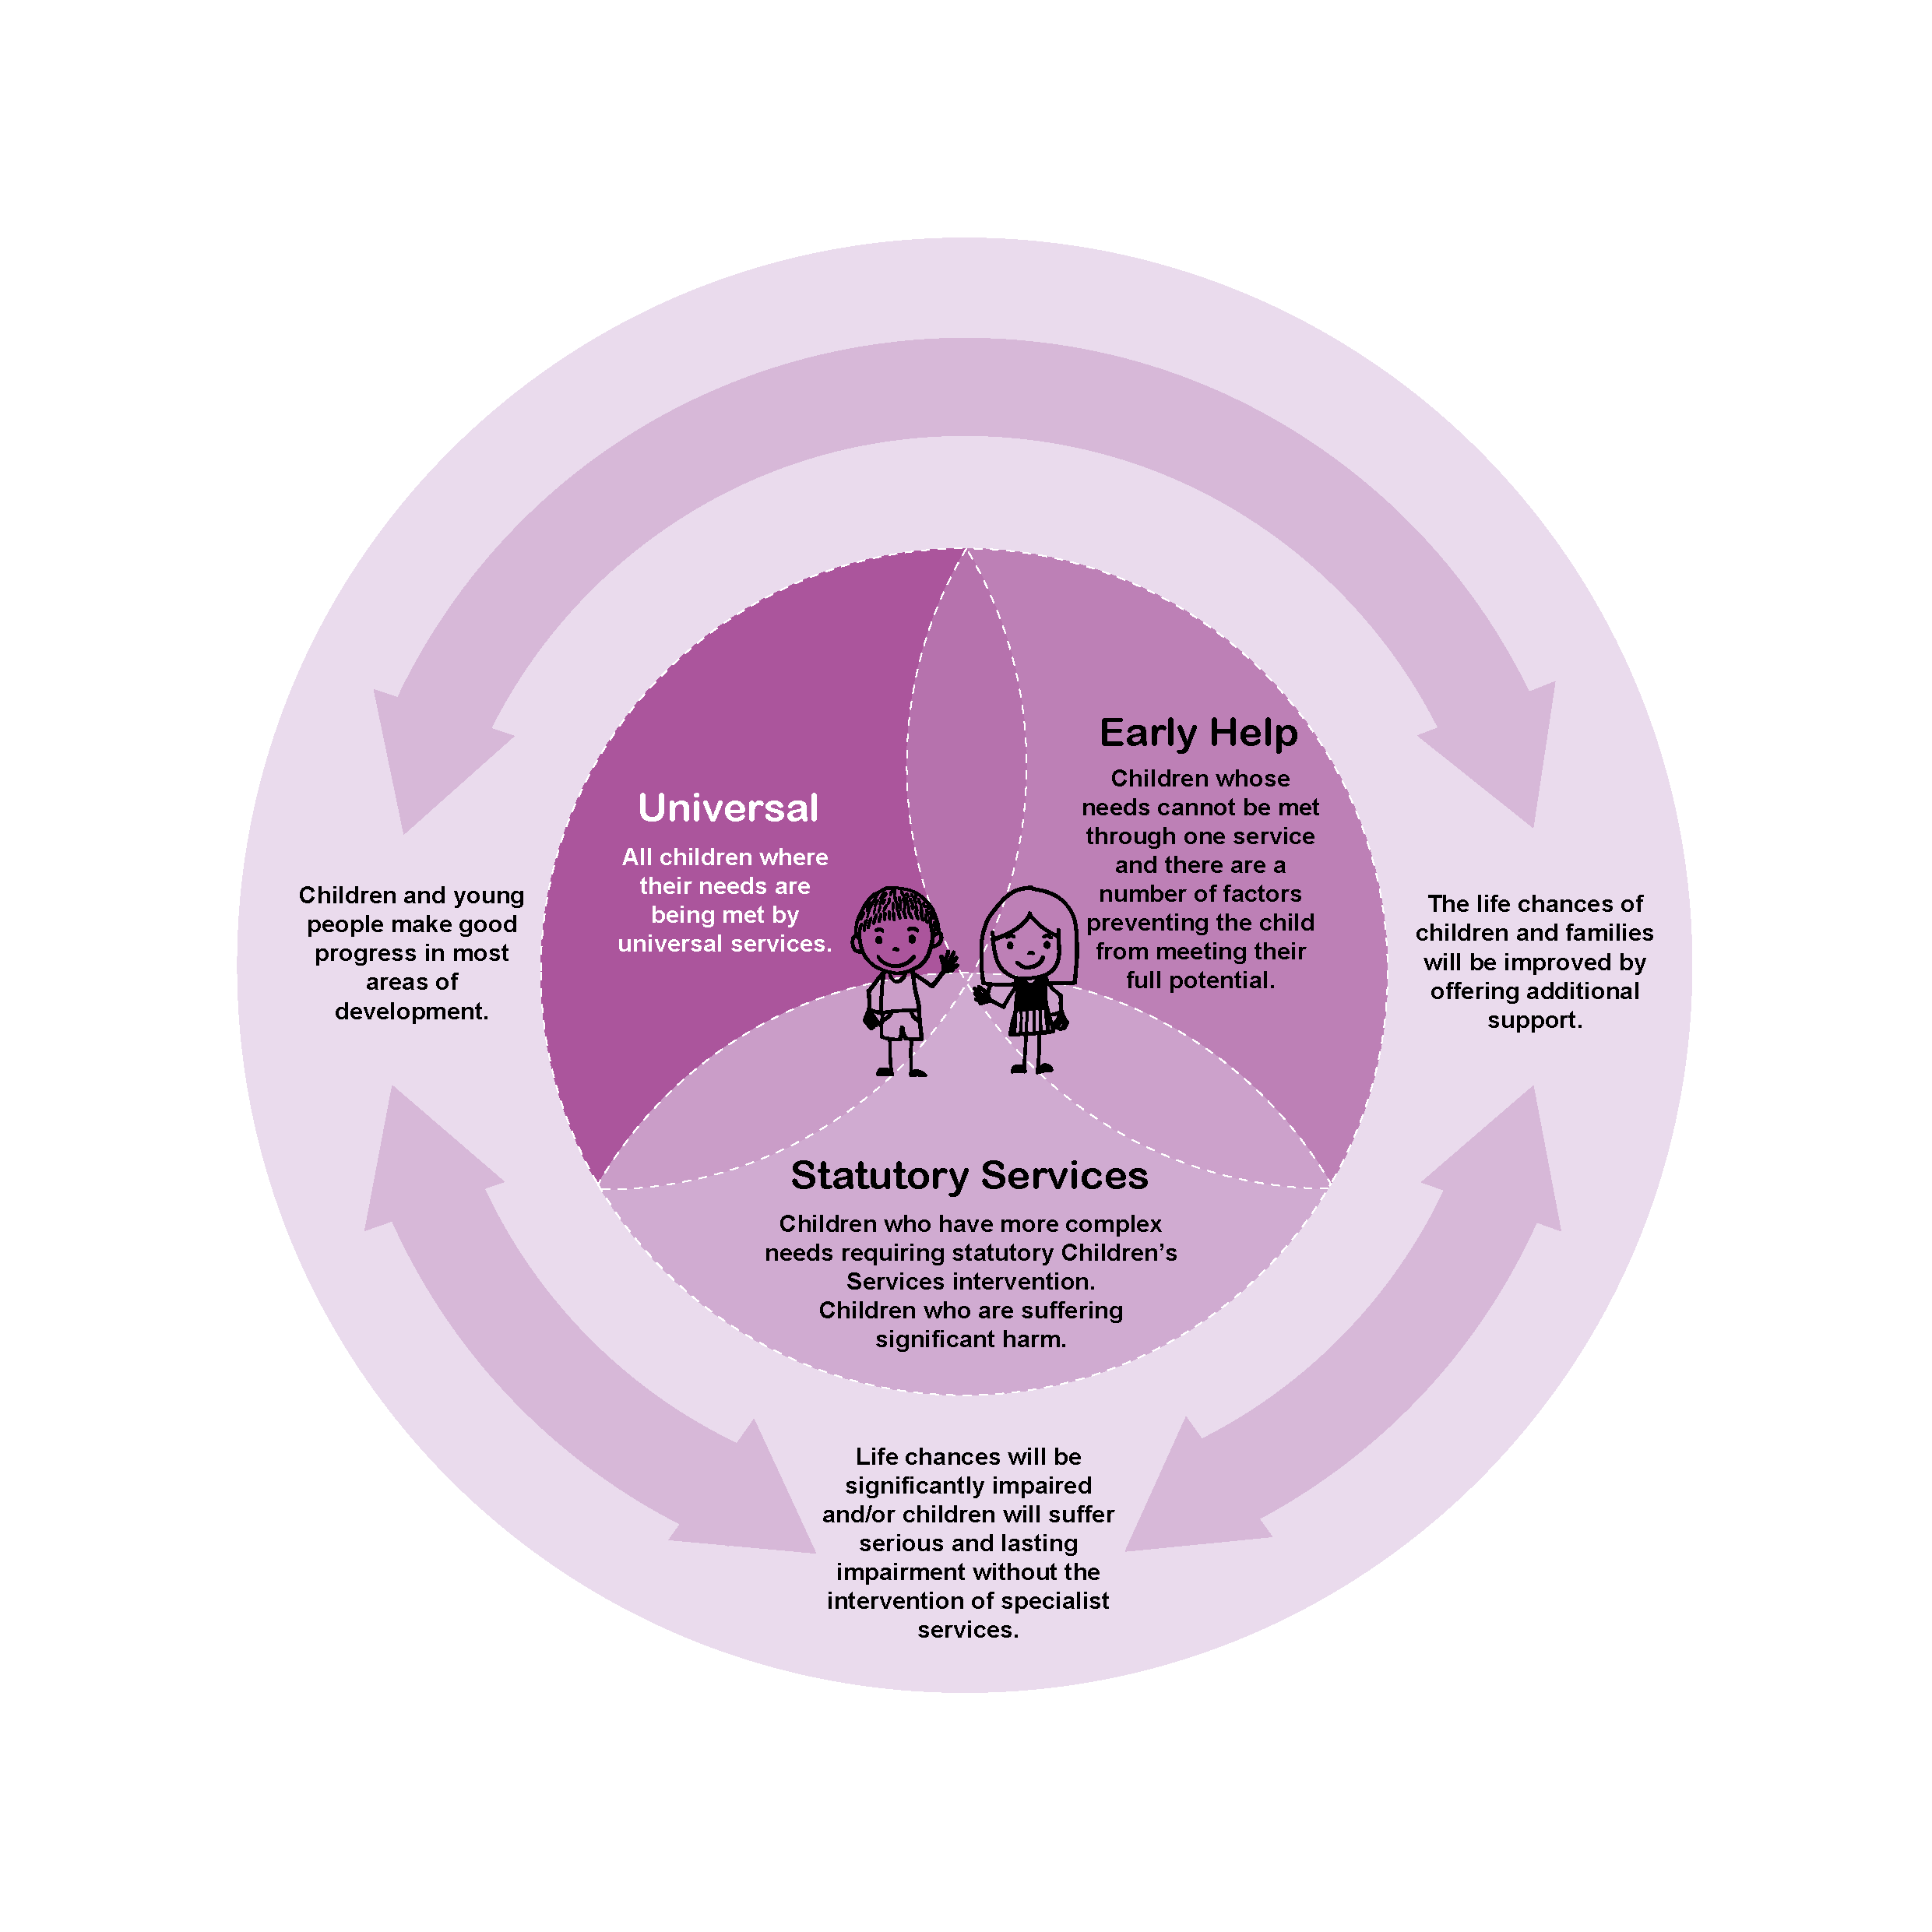
Early Identification
If we can identify problems at the earliest opportunity and work together to support each other, we will make a difference and prevent problems from escalating.
This is so important when addressing neglect.
Sometimes speaking with parents/ carers about the care their child is receiving from them can be daunting and difficult, as these conversations can often become emotional and can put a strain on your relationship with them.
Notes:
Anyone who works with children, young people and families should be alert and looking out for any concerns that may impact on a child’s life.
The earlier a need is identified the easier it can be to ensure that things are put into place that improve the problem and prevent things getting worse.
It isn’t always easy to raise concerns with parents/ carers, but we should always consider what is best for the child.

Slide 3


Tips on starting and managing these conversations
Start talking about concerns as soon as they are noticed or reported- it will be easier to talk about emerging concerns and offer support than to discuss child protection concerns and social care referrals
Take time to understand the parent or carers position
Encourage parents and carers to use their established networks for help and support
Be respectful
Be courteous
Be on time for any pre-arranged appointments
Don’t use jargon, use language that the parent or carer will understand
Give clear explanations of your concerns and how you would like to be able to support the child and family
Be open and honest
Take the time to really listen
Take away distractions so you are able to give the conversation your full attention
Listen and really hear what is being said
Have patience
Take a break and arrange some time to revisit the conversation in the coming days
Notes:
It's important to keep the focus on the child and actively listen to what parents/ carers have to say; each human being will have many different experiences, views and opinions, listening carefully is fundamental to gaining an understanding of what is happening & may help to improve circumstances.

Slide 4

Three things that may impact parents/ carers engagement
1. If the parents and carers have experienced adversity themselves and had a steady supply of highly stressful circumstances; a consequence may be continually activated stress response.
If the stress response is being easily aroused, the person may stay on high alert, which reduces cognitive resources, limits the ability to self- regulate, and has an impact on health & wellbeing.
Someone identify that you may not be meeting the needs of your child, can bring stigma and shame and reinforce negative beliefs about the parent/ carer's own abilities
Notes:
Many parents and carers may have experienced adversity and be coping with a lot of stressful situations, this can mean that they are not always responding to what is actually happening at a given time, but instead have overdeveloped ‘fear circuitry’ making them more likely to perceive any focus and attention as a potential threat.
Because they have been coping with adversity & stress, this may have impacted on their ability to learn and use skills like self-regulation – the ability to draw on the right skills at the right time, and respond effectively to the world around us, and executive functioning- the ability to focus, sustain attention, set goals, follow rules, solve problems, and delay gratification.
It is important that those working with families understand that underlying issues may mean that parents are reluctant to engage, but those who are able to build positive relationships and maintain focus on what is best for the child are more likely to succeed in exploring & understanding what is happening for the parents/ carer’s and informing child’s daily life.

Slide 5

Notes:
This power point introduces “Toxic Stress” and helps us to understand that parents may have their own adversity that has impact on their ability to look after their children.
The video link is https://www.youtube.com/watch?v=sutfPqtQFEc

Slide 6
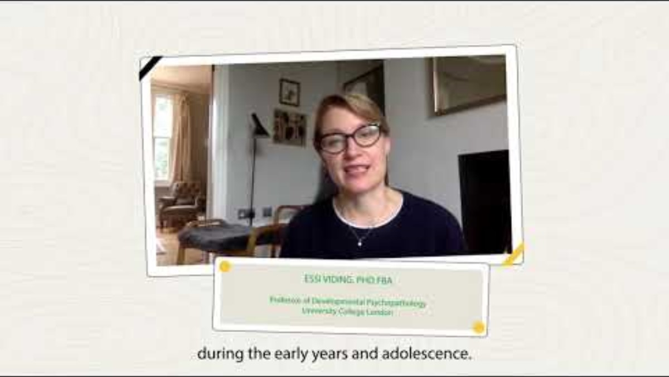
Understanding how stress affects our brain
Notes:
This film explains the difference between different types of stress. It is available at https://www.youtube.com/watch?v=tifg45kbE-I
The NSPCC provide a booklet to help professionals share the information about stress and its impact on the brain; https://learning.nspcc.org.uk/media/2547/sharing-the-brain-story-metaphors-summary-booklet.pdf

Slide 7

Develop responsive relationships
Healthy relationships are essential for adults who need to make substantial changes in their own lives, as is typically the case for parents/carers whose child is being neglected.
These relationships are a source of emotional and practical support for adults and knowing that another person cares about them helps build hope and the possibility of change.
Helping to build and support strong relationships should therefore be an essential element for all those who work with children, young people and families.
Notes:
It is important that those who work with children, young people and families have the ability to treat parents and carers respectfully and navigate any power imbalance involved.
You need to be able to communicate to parents/ carers that you want and believe they can succeed in making the required changes, if you don’t, they are likely to assume you want them to fail.
It was traditionally considered a mother’s responsibility to raise children and historically, fathers have been the breadwinners, spending more time working outside the home and less time with their children. This is no longer the case, with both parents often now equally being responsible for working and raising children, yet many professionals are still more likely to talk to Mothers than Fathers when they have concern about their children. As a result, many fathers feel that the role they play in their child’s life is not valued when they want to be involved in raising and nurturing their children.
Effective engagement of men in any child’s life is essential; the national panel are notified when a child is seriously harmed or killed when abuse or neglect is present, the highest proportion of these notifications are for children under 1 years of age, and the abuser quite often are men who too often are ‘hidden’ or ‘invisible’ to safeguarding professionals.

Slide 8

Notes:
It is impossible to know or remember everything about every culture, practicing cultural humility means that you are aware of social power imbalances and that you do not believe any one culture is superior to another. It is important that practitioners consider:
How the race, culture, faith, and ethnicity of the child and/or family are considered?
How any disability, physical or mental health issues, and any identity issues in the child and/or family impact on the child’s lived experience?
The video is available at https://www.youtube.com/watch?v=c_wOnJJEfxE

Slide 9

Helping adults build and use core capabilities is essential
Aim- to relieve some of the key stressors in people’s lives:
What can be done to reduce the stresses that deplete someone's self-regulation skills?
What can be done to minimizes stigma?
What can be done to address basic needs?
Aim- to build self-regulatory and executive functioning skills
Can coaching and training help develop skill and build strategies, for example, in assessing stressful situations and considering alternatives?
This Photo by Unknown Author is licensed under CC BY-NC
Notes:
Can you work with other organisations to reduce environmental stressors by meeting basic needs (for example, dangerous housing conditions, urgent unpaid bills, or insufficient food or household supplies) in the lives of parents and children. These concrete supports reduce the immediate burden of stress pressing upon parents, allowing them to focus on longer-term priorities such as building the skills needed to care effectively for their children.
Can you simplify, coordinate or broker support from other services to reduce demands being made on the family at any one time.
Helping adults build and use these core capabilities is essential not only to their own success as parents and workers, but also to the development of the same capabilities by the children in their care.

Slide 10
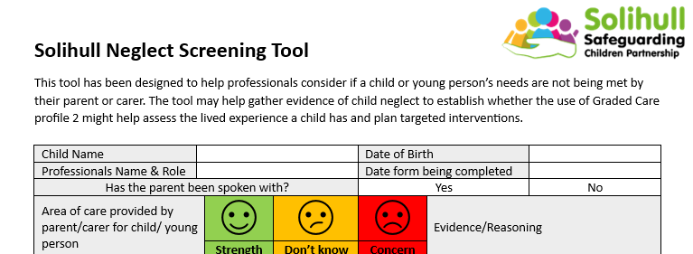
What do you do if you think a child is being neglected?
Talk to your designated safeguarding lead; it may be valuable to create a chronology
Complete a screening tool and follow the guidance
Follow Solihull’s Right Help, Right Time, Right Response guidance
Notes:
Every organisation should have a designated lead for safeguarding; this person should have up to date safeguarding training and be aware of local safeguarding procedures.
A chronology is a record in date order of all the significant events and key decisions made that prompt changes in a child or young person’s life. Many people will have chronological recording systems, where every contact or concern they have for a child is recorded, but a specific chronology will pick out the key events and decision making from these and help to reflect, make sense and notice any patterns happening in the child's life.
The right help right time right response guidance is available at https://westmidlands.procedures.org.uk/local-content/2gjN/localised-content-thresholds-guidance/?b=Solihull%20%20%20%20%20%20%20%20%20%20Manage%20Cookie%20Consent%20%20We%20use%20some%20necessary%20cookies%20to%20make%20this%20website%20work.We%27d%20like%20to%20set%20additional%20cookies%20to%20understand%20how%20you%20use%20the%20site,%20remember%20your%20settings%20and%20improve%20the%20website.See%20our%20full%20cookie%20policy%20for%20more%20information%20which%20includes%20a%20list%20of%20all%20of%20the%20cookies%20we%20use.%20%20%20%20%20%20Accept%20additional%20cookies%20%20%20%20Reject%20additional%20cookies%20%20%20%20%20%20%20%20Cookie%20Policy%20%20%20%20Manage%20Consent

Slide 11

Where can I find further information?
Solihull SCP Threshold Guidance – Right Help Right Time Right Response; guidance for practitioners on the response to be provided to children and families in Solihull at different levels of need
Neglect Tools
SSCP Neglect Continuum of Tools
Chronologies
Multi-agency Chronology Template
Multi-agency Chronology Guide
Screening Tool
Neglect Screening Tool
Neglect Screening Tool Guide
Graded Care Profile
SSCP Graded Care Profile
If you think a child is in imminent danger, call 999. If you have significant worries, please call the MASH Team to speak to the Duty Social Worker for advice:
  0121 788 4300 option 2 (Monday to Thursday 8:45am - 5:20pm, Friday 8:45am - 4.30pm), or
  0121 605 6060 (Evenings, weekends or bank holidays)
Further multi-agency training is available from Solihull Safeguarding Children Partnership
https://training.solihulllscp.co.uk/Learning-and-Development.aspx
Notes:
Please scan the QR code of use the link https://forms.office.com/e/0Jpi6xcGFG?origin=lprLink to complete the post course evaluation

Slide 12
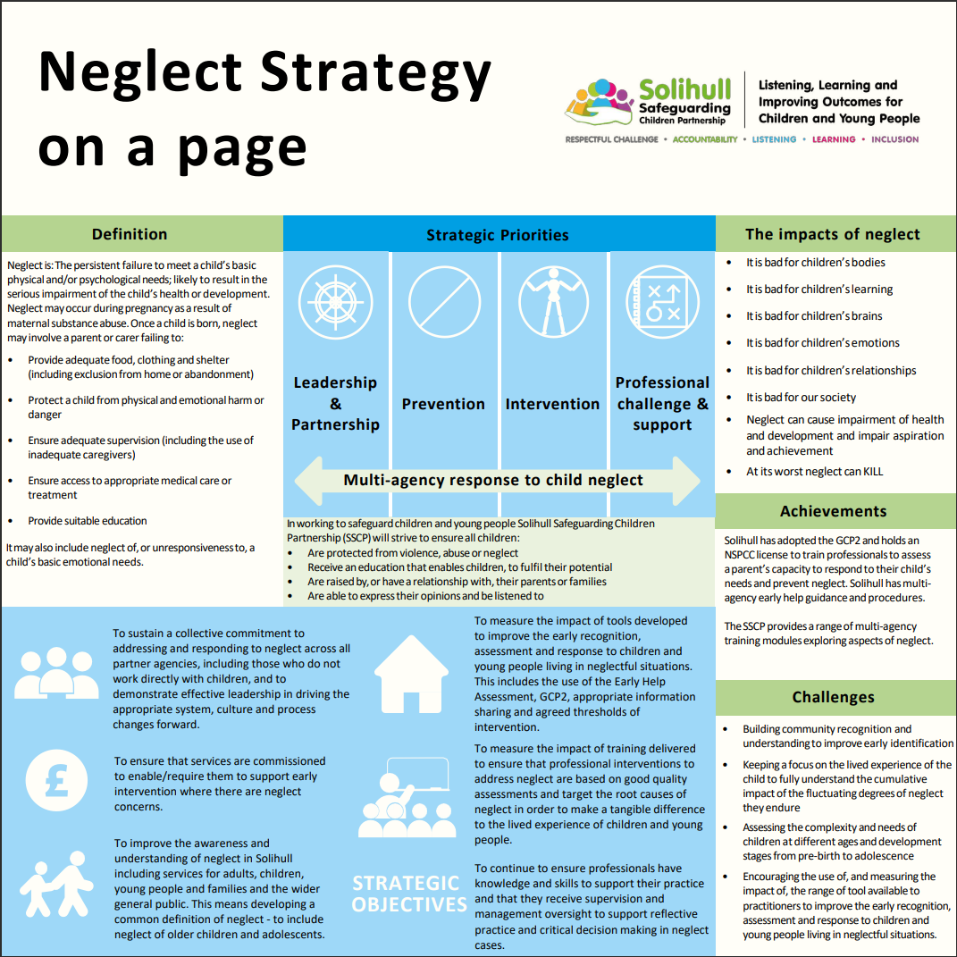
Notes:
This is Solihull Safeguarding Children Partnership Neglect Strategy overview the full strategy can be found at https://www.safeguardingsolihull.org.uk/lscp/multi-agency-procedures-and-practice-guidance/neglect-strategy/

