Slide 1
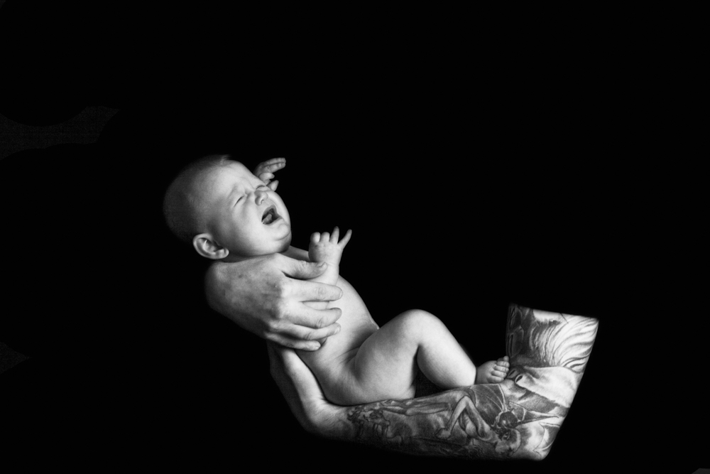


Training for trainers and professionals:
The ICON message
© ICON

Slide 2
Aims of this training session
This training is designed to equip you with the knowledge, information and skills that you will need to discuss ICON: ‘Babies cry, you can cope’ with parents and carers
The training will help you to:
  share the message that crying in babies is normal
  support parents/carers to soothe their baby
  support parents to cope with a baby’s crying
  understand more about Abusive Head Trauma

Slide 3
What is Abusive Head Trauma?
Also known as Shaken Baby Syndrome, is Child Abuse
Catastrophic injuries:
  Brain injuries
  Bleeding behind the eyes
  Bony injuries
Our goal for ICON is to communicate to parents/carers that they can expect crying, prepare for it and cope with it
Our aim is to reduce the incidence of AHT triggered by crying
https://iconcope.org/parentsadvice/

Slide 4
More facts about Abusive Head Trauma
AHT is the most common cause of death or long term disability in babies
24 out of 100, 000 hospital admissions for babies are due to abusive head trauma
200 children are killed or hurt annually in the UK
These figures certainly underestimate the real numbers involved

Slide 5
WHO SHAKES and why?
70% perpetrators are males – fathers/male surrogates
Coping with crying can feel like living on a cliff edge
Caregivers lose control and shake
Can occur in every socio-economic group
Demonstrable relationship between the normal peak of crying and babies subject to AHT.
Increase in babies in the 1st month of life, a peak at 6 weeks during the 2nd month and a decrease during the 3rd to 5th months of life
Research shows that babies are most likely to be shaken when they are 2-4 months old… the time when babies cry the most.

Slide 6
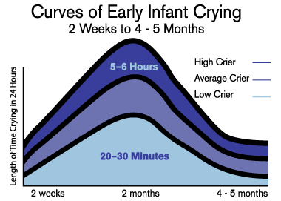
Normal Crying curve
(Barr 1990)

Slide 7
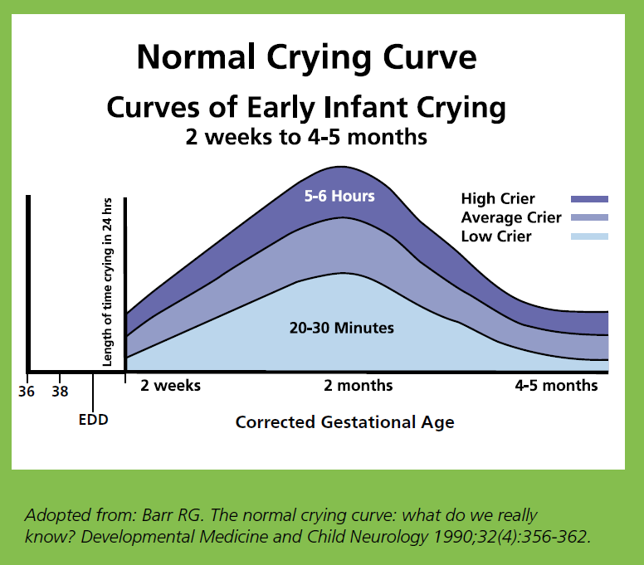

Slide 8
Coping strategies
Success depends on controllability
Problem solving where the stressor cannot be controlled can lead to frustration and distress
support through the problem rather than solving the problem
The need for a careful approach towards a responsive professional intervention that is rooted in evidence is, therefore, crucial
Notes:
The success of any coping strategy depends on the controllability of the situation. Coping strategies relying on problem solving may lead to increased frustration and distress when used in a context where the stressor cannot be controlled and where there is no response (Folkman 1992; Compas et al 1988). Taking excessive infant crying as an example, Long and Johnson (2001) found parents eventually accepted that coping involved support through the problem rather than solving the problem (i.e. stopping the baby crying) which was frequently an impossible task. The need for a careful approach towards a responsive professional intervention that is rooted in evidence is, therefore, crucial.

Slide 9
Living on a cliff edge!
Excessive infant crying can be associated with:
Parental stress
Depression
Possible relationship problems
Feelings of guilt, inadequacy and helplessness
https://www.iconcope.org/wp-content/uploads/-%20PHE%20Traumatic%20Head%20Injury%20Infographic%20and%20Animation%20ES%20WITH%20CAPTIONS%20(1).mp4

Slide 10
Are some babies more at risk than others?
Research shows that the most at risk babies are:
Baby boys
Babies under 6 months old
Babies born pre-term or at low birth weight
Babies who have previous involvement with child protection services.

Slide 11
Why are premature/LBW babies at increased risk?
Pre-existing factors within the family or environmental context which may have contributed to premature/LBW delivery and which are also risk factors for abuse and neglect (e.g. substance misuse, domestic abuse)
Increased risk of disability which can also be associated with increased risk of abuse or neglect
Disruption of attachment due to need for ongoing neonatal intensive care
Increased care needs for baby

Slide 12
Cost
Human and Emotional
Financial
  Hospitalisation
  Long term health and educational needs
  Medical equipment
  Legal proceedings
  Child Safeguarding Practice Review
Loss of societal productivity
Ellis’s Story: https://youtu.be/aqCbREcduMA

Slide 13
Does prevention work?
A co-ordinated, hospital based parent education programme targeting parents of all newborn infants can significantly reduce the incidence of abusive head trauma in children less that 36 months.
Dias et al (2005) Preventing Abusive Head Trauma Infants and Young Children: a hospital based prevention program Pediatrics 115: 470 – 477
16 infants who were born in the 8 year study period were treated at the children’s hospital for shaking injuries sustained during their 1st year of life. Of those infants 14 were born during the 5 year control period and 2 during the 3 year post implementation period. The decrease from 2.8 injuries/year to 0.7 injuries/year represents a 75% reduction (P=03).
Altman et al (2010) Parent Education by Maternity Nurses and Prevention of AHT.

Slide 14
Does prevention work?
The primary aim of this study was to determine whether there was any change in visits of 0 to 5 month old infants to the Medical Emergency Room (known as the Emergency Department in the UK). After program implementation, crying cases were reduced by 29.5% (p < .001). The most significant reductions were for crying visits in the first to third months of life.
Barr R G, Rajabali F, Aragon M; Colbourne M., Brant R., Education About Crying in Normal Infants Is Associated with a Reduction in Pediatric Emergency Room Visits for Crying Complaints J Dev Behav Pediatr 36:252–257, 2015
A New Haven AHT prevention programme that chose to teach parents how to recognise their feelings of frustration with their infants crying and to walk away from the baby found that those who received the programme were 79% less likely to have been diagnosed with AHT.
Bechtel et al (2020) Impact of the Take 5 Safety Plan for Crying on the Occurrence of Abusive Head Trauma in infants. Chlid Abuse Review vol 29: 282-290

Slide 15
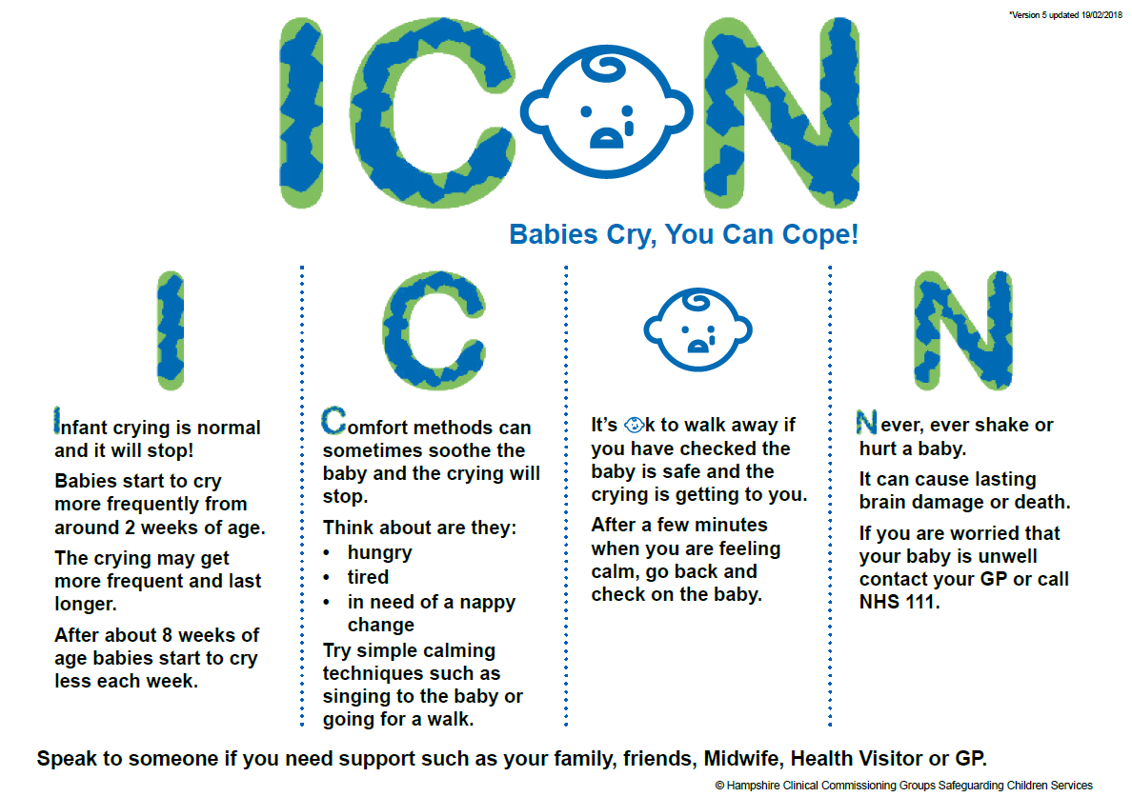
What is ICON?

Slide 16
Implementing ICON
Research shows that AHT prevention programmes are most effective when the same message is given by different professionals on a number of occasions.
For those babies born prematurely or requiring neonatal intensive care, it is recommended that the Premature Baby ICON leaflet should be given to both parents and the ICON message discussed with them as part of the discharge planning for their baby
The ICON message can then be reinforced and parents supported by Health Visitors, specialist community neonatal nursing teams and GPs

Slide 17
The ICON Touchpoints
Each area can deliver ICON through additional routes e.g. antenatally, via 0-19 teams. The touchpoints below represent the CORE ICON programme.
In hospital/at home following delivery before the Mother and baby are discharged (this is the time when men are often present and the opportunity to engage with men at this point is crucial). The leaflet provided and explained in detail using the ICON script as a guide if necessary.

Slide 18
ICON Touchpoints (cont)
Within the first 10 days during Community Midwife visit (a light touch reminder)
Between 10 and 14 days during Health Visitor contact (a light touch reminder and conversation about comforting techniques)
Around 3 weeks via text/telephone/visit/clinic contact by Health Visiting service (a light touch reminder and conversation about a plan about how to cope)
At the 6/8 week check with GP (a questionnaire included in RCGP national toolkit)

Slide 19

How can professionals help parents?
By offering ICON as a way to avoid a situation where frustration can lead to abuse
By discussing the issues raised
By talking through the key points in the ICON leaflet
Showing ‘I Am Unshakeable’ video

Slide 20
Introducing ICON to a parent/carers
Help parents understand that crying is normal… all parents can feel like this
Make a positive effort to engage with male carer/dad
Explain that crying is a normal part of development
Reassure parents that babies are not doing this on purpose
Support parents in coping with their own emotions and stress (Coping with Crying Plan)
Teach parents soothing and safe sleep techniques
Inform parents/carers about sharing the ICON leaflet with anyone who cares for your baby.

Slide 21
ICON resources
Leaflet
Stickers
Fridge magnets
I Am Unshakeable video
Coping with Crying Plan
GP questionnaire
Series of short videos
C is for Comforting methods infographic

Slide 22
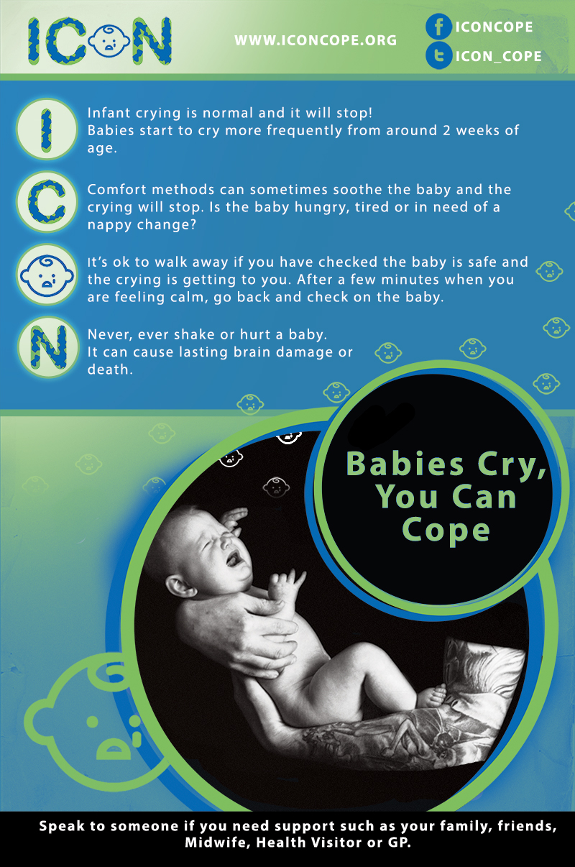
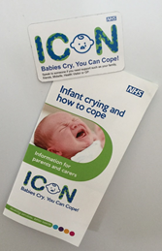

Slide 23
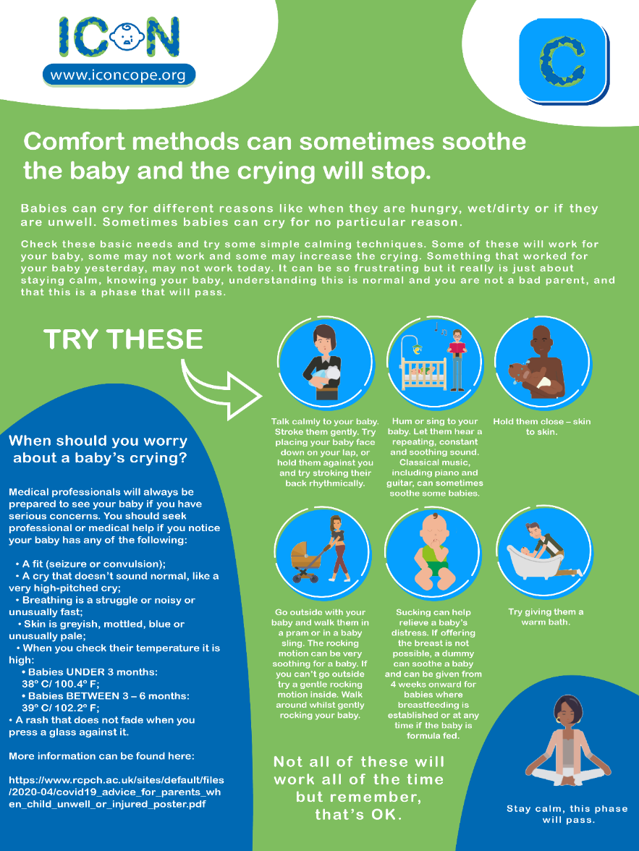
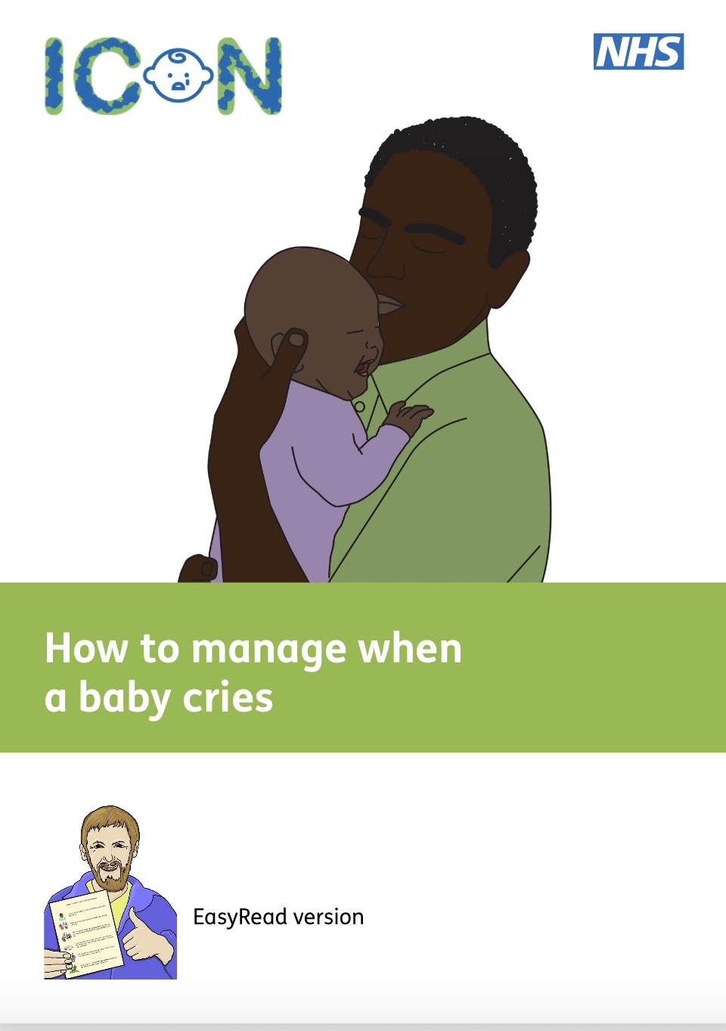
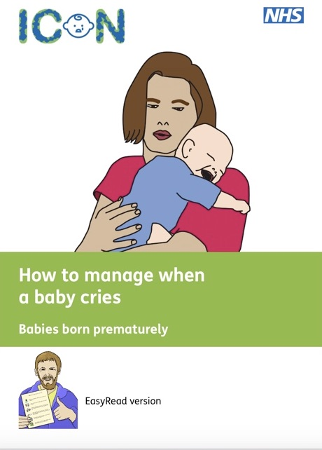


Slide 24

Thank you!

