Slide 1
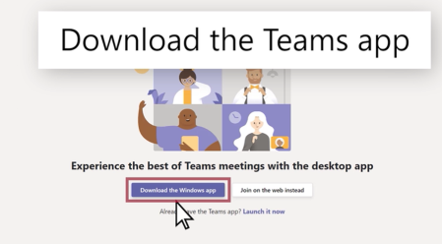
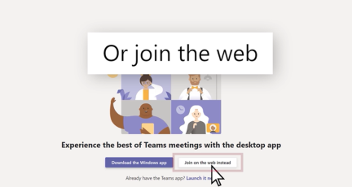
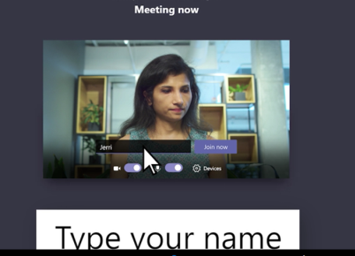
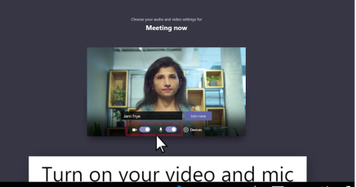

Join a Teams meeting
You have been asked to join a Microsoft ‘Teams’ Meeting
You have two choices:
Download the Windows app:
Download the Teams app.
Join on the web instead:
Join a Teams meeting on the web
3 Type in your name.
Choose the audio and video
settings you want.
Select Join now.

Slide 2
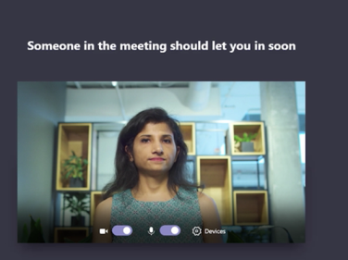
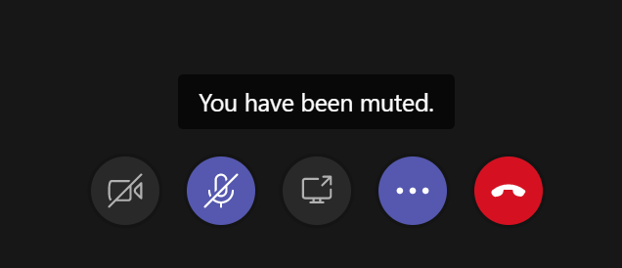
Depending on meeting settings,
you'll get in right away, or go to a lobby where someone in the meeting can admit you.
There are a number of functions that can be completed during the teams meeting which include:
Putting your microphones on mute or unmute.
Putting your video camera on or off
Leaving the meeting
If there is a line through the icon then this means that function is off

