Slide 1
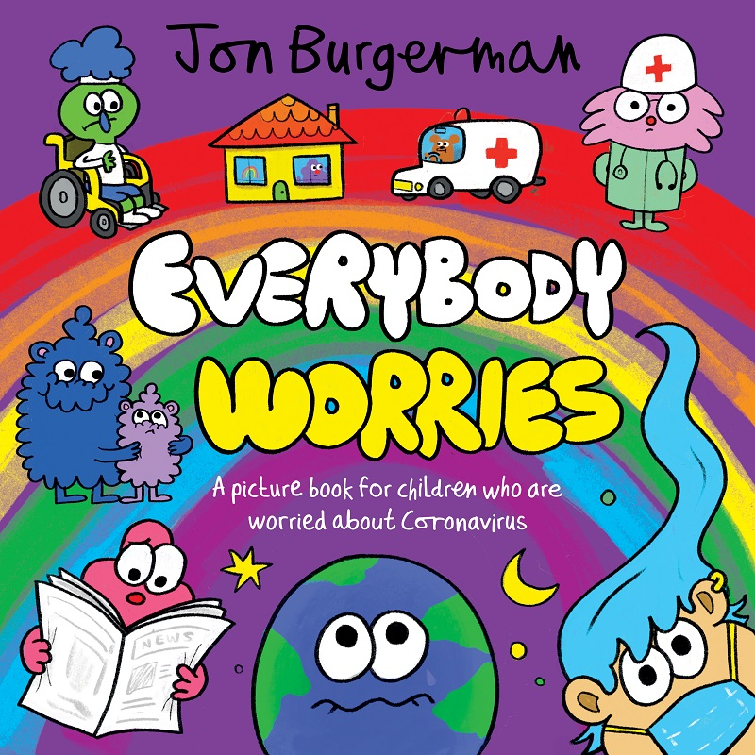
Children’s Mental Health Week 1st-7th Feb 2021 Some suggestion for activities to do with young children
Top supportive websites
Public |Health England-Every mind matters https://www.nhs.uk/using-the-nhs/nhs-services/mental-health-services/children-and-young-peoples-mental-health-services-cypmhs/
Childline calm zone- https://www.childline.org.uk/
Barnardos https://www.barnardos.org.uk/sites/default/files/2020-05/Mindfulness%20with%20Your%20Child.pdf
Children’s mental health week
https://mentallyhealthyschools.org.uk/media/2305/childrens-mental-health-week-toolkit-final.pdf
BBC- Teach https://www.bbc.co.uk/teach/childrens-mental-health-week/zk37bdm
Emotional well-being- supporting mindfulness
Create a ‘Mind Jar’
https://heartmindkids.com/how-to-make-a-glitter-jar-for-mindfulness/#:~:text=1%20Fill%20your%20bottle%20about%201%2F8%20to%201%2F3,glue%20gun%20to%20seal%20the%20cap%20closed.%20
Make a den- supports children with feeling safe. They can use it to calm down and have a brain break
Breathing activities
Blowing bubbles -focus on taking in a deep, slow breath, and exhaling steadily to fill the bubble.
Playing with balloons. the aim of this game is to keep the balloon off the ground, but they must move slowly and gently.
Body Poses- simple yoga
https://childreninspiredbyyoga.com/
Support children with creating pose- cat stretch, mountain pose, superman, volcano
Sharing books-
Free eBook: Everybody Worries by Jon Burgerman
Everybody Worries offers your child the reassuring message that this crisis will pass, we are there for them, and we will get through this together.
https://home.oxfordowl.co.uk/bookshop/jon-burgerman-everybody-worries-free-ebook/
Spend time outside
Pretend to blow out the candles on your birthday cake 5 times and breathe fresh air in and out.
Talking time-
Name one thing you are grateful for
Share a funny joke, picture or video
Tell your day as a story
Tell an adult:
5 things you can see, 4 things you can touch/feel,3 things you can hear, 2 things you can taste , 1 thing that you can smell.
Exercise:
Go for a walk in the fresh air or dance around to your favourite music/ Sing ‘heads, shoulders, knees and toes’ or another action song.
Sleep well:
Make a dreaming den with a blanket, a pillow and a teddy and have a nap.

