Slide 1


Giving Children the Best Start in Life in Solihull
Denise Milnes
Senior Public Health Specialist - Children and Young People
Public Health - Solihull Metropolitan Borough Council

Slide 2
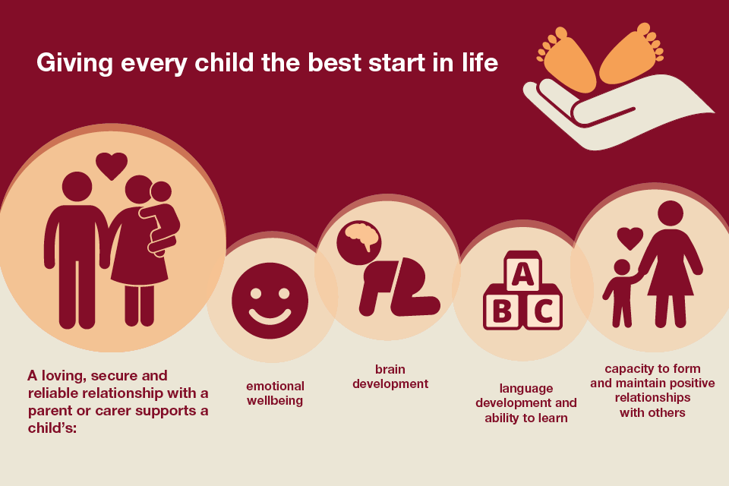
[Source Public Health England 2016]

Slide 3



Commissioned Children’s Public Health Services
Health Visiting
Family Nurse Partnership
Infant Feeding
School Nursing
Parenting Programmes -
Eat Well Move More -
Solihull Healthy Child Programme
(0-19 years) provided by
Budget: £3.6 million

Slide 4

Our vision is for a service that is child and family focused and aims to deliver the national priorities for families to have a healthy pregnancy, for children to be ready to learn at 2, ready for school at 5, have good emotional well-being and be a healthy weight.
        Early identification of families experiencing lower level problems before they escalate
        Integrated with other parts of Solihull’s early help system, e.g. Engage
        Integrated pathways to enable fast access to specialist services

Slide 5
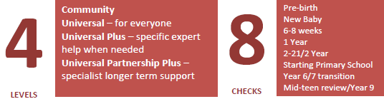
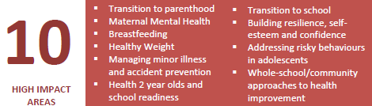
Service Model

Slide 6
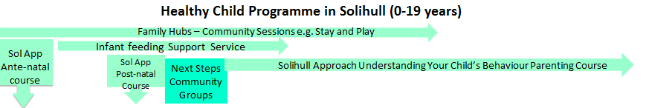
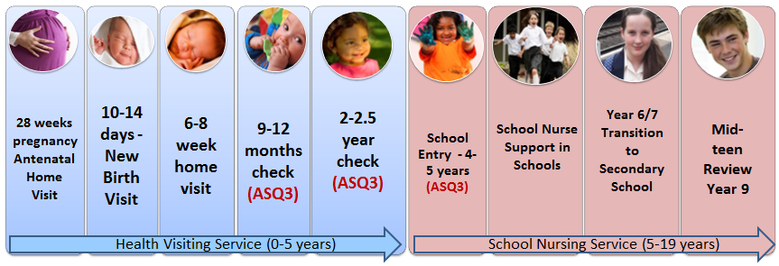

Slide 7
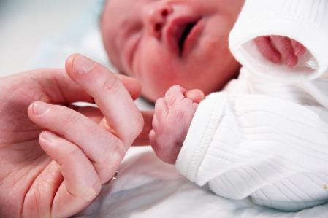
FNP is a voluntary, intensive programme for first time young parents, aged 19 or under from pregnancy until 2
Aims to enable young mums to:
  Have a healthy pregnancy
  Improve their child’s health and development through effective parenting
  Plan their own futures and achieve their aspirations

Slide 8

Infant Feeding Support Service
UNICEF Full Baby Friendly Accreditation
Range of support offered to women
  Breastfeeding Cafes
  Breast Pump Loan
  Specialist home support
  Training Programme
  Website, Feeding Friend app, Facebook support

Slide 9
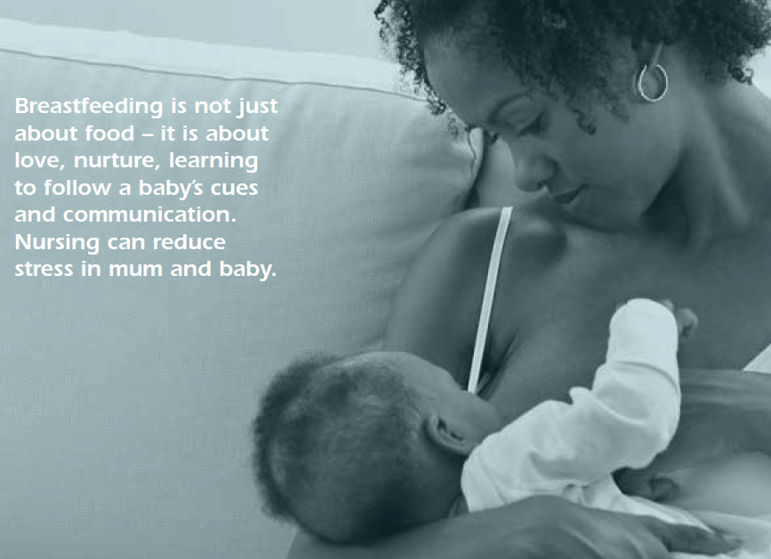

Slide 10

Scope and Challenges
In 2016-7 8,412 health checks were carried out from pregnancy to 2 and a further 6,000 for school children
Health Visiting care for 12,400 children under 5
School Nursing provides a service for approx. 38,000 children and young people aged 5-19
Reduced Health Visitor numbers
Ensure the spec reflects best practice
How best to integrate with other Services

Slide 11

Ages and Stages Questionnaire (ASQ)
US evidence-based developmental tool
National tool for mandated 2 year check
Based on research with 15,000 children
ASQ-3 – 21 age-specific questionnaires (0-5 years)
ASQ-SE is a version which assesses social and emotional development
Used at 12 months, 2 years and soon 4 years in Solihull
Data collected for all 2016-7 for 2 year olds

Slide 15

Sharing ASQ Information at 2 years
ISA signed by SMBC and SWFT
Trackable ASQ data for each child will securely transfer to the Council for schools to access the information for their new intake
Can inform developmental profile of the new intake into Nursery and Reception
Not completed on children with severe delay

Slide 16
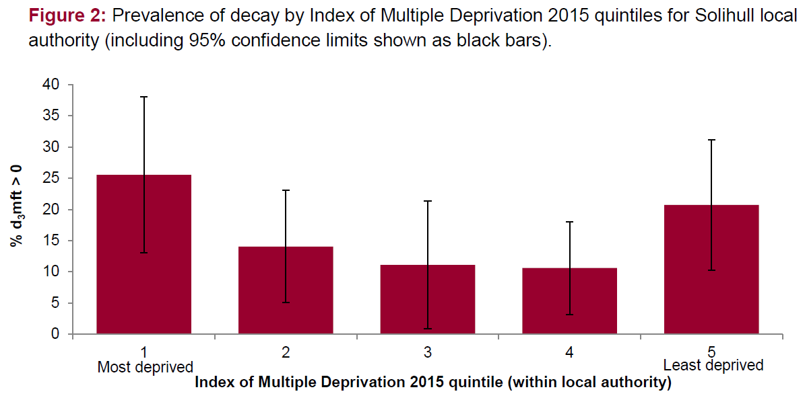
Tooth Decay in Solihull
England average-24.7%
Source: Public Health England (2017) Dental Health Profile: Solihull

Slide 17
England average 24.7%
2017 Data – 16.3% average for Solihull

Slide 18
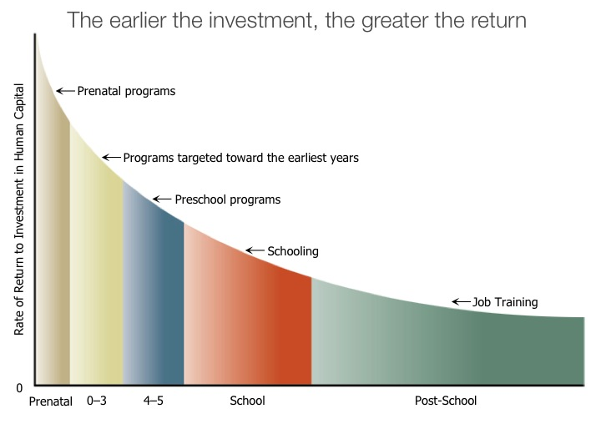
Early interventions yield higher returns as a preventive measure compared with remedial services later in life
Source: Heckman & Carneiro (2003) Human Capital Policy at www.worldbank.org (search for Early Child Development)

Slide 19







Brain Development Timelines –
‘Magic windows’
Pre-Birth 1y 2y 3y 4y 5y 6y 7y 8y 9y 10y 11y 12y 13y 14y
Conception to age 2-3
Adolescent brain
Steady development

Slide 20
Brain development synapse density over time
(Diagram adapted from Corel JL, The postnatal development of the human cerebral cortex. Cambridge, MA;
Harvard University Press; 1975 cited in The Urban Child Institute
http://www.urbanchildinstitute.org/why-0-3/baby-and-brain (accessed 25th July, 2013)

Slide 21

Five to Thrive Approach
‘Five to thrive’ offers a simple framework for families to promote healthy baby brain development in five ways: Play, Talk, Respond, Cuddle and Relax (Kate Cairns Associates, 2017).
Training is given to professionals and volunteers in communities to embed the approach conveying consistent messaging and delivering evidence-based activities.
The framework has been endorsed as an effective programme for early intervention (Social Mobility and Child Poverty Commission, 2014) and has evaluated as a successful and low-cost approach (Ghate et al., 2014).

Slide 22


“Recent research proves that how a parent behaves around their baby in the first three years of life has a direct impact on how their baby's brain develops. This is the foundation of how the brain will work as the child grows up and becomes an adult, so if a baby's brain develops healthily they are more likely to be happy and successful as older children and adults.”
Source: Kate Cairns Associates – www.fivetothrive.org.uk

Slide 23


The success of five to thrive is founded on the fact that it is not a rigid, one-size-fits-all programme.
Central to the approach is the set of five key areas:
‘Building blocks for a healthy brain’
Drawn from research into the key processes of attachment and attunement that forge bonds bet. young children and their carers

Slide 24


Crucially, they are designed to support positive feedback processes, enabling practitioners to observe and reinforce positive interaction between parents and their children
Resources
The five to thrive resources — posters and online guides — help parents and practitioners gain an appropriate awareness of the science of brain development while ensuring that the focus remains practical rather than academic
Supports creative, individualised work with families & offer a range of suggestions to meet the needs of children at different ages

Slide 25
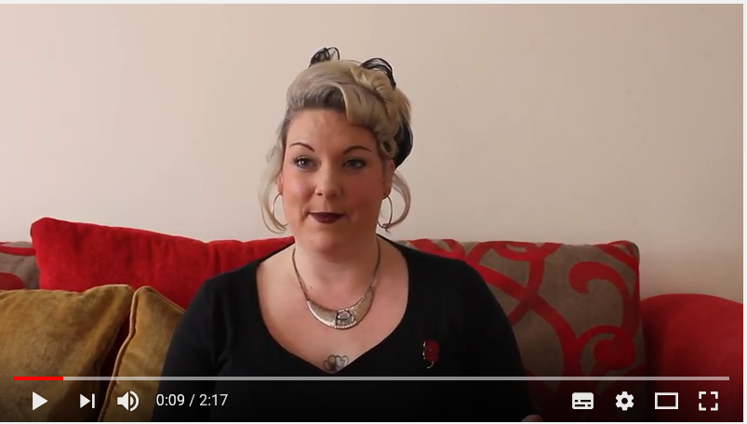
Five to Thrive Video

Slide 26

Process
Health Visitors to become practicing advocates for Five to Thrive
Consulting with parents/carers on how to convey messages – develop digital resources (web, apps)
Roll out to for Early Years professionals and partners
Train parent volunteers
Train social workers
Evaluate the approach

Slide 27
Parenting Support
“To enable every parent in Solihull to be an effective and engaged caregiver via access to advice, parenting education and building peer support in the community”

Slide 28

Parenting Courses
3 types:
  Solihull Approach Online Courses
  Solihull Approach face-to-face courses
  Empowering Parents Empowering Communities (EPEC)- NEW Autumn 2018

Slide 29


Understanding Pregnancy, Labour, Birth and Your Baby
Antenatal Online Course
www.inourplace.co.uk use FREE code: APPLEJACKS
Done at a time and pace to suit family life
9 modules each taking around 20 minutes
Interactive activities, quizzes, video clips
Covers: Relaxing & breathing/Getting to know your baby in the womb/Stages of labour/Birth positions/Feeding /Fathers and babies/Baby care

Slide 30


Understanding Your Baby
Postnatal Online Course
www.inourplace.co.uk use FREE code: APPLEJACKS
There are 11 modules each taking around 20 minutes
Interactive activities, quizzes, video clips, practical hand-outs
Covers: Understanding feelings: both yours and your baby’s/Understanding your baby’s brain/Understanding and responding to crying/Your baby’s rhythms, sleep patterns, & feeding/Fathers and babies/Babies’ development and play /Thinking about childcare

Slide 31

Solihull Approach Online:
Understanding Your Child Course
Over 90% of parents think a course would be useful
Completed at a time and place to suit family life
11 modules long and each module takes about 20 minutes with voiceovers for the main text
Interactive activities, quizzes, video clips and practical handouts
PCs, Macs, iPads, laptops, mobiles, tablets
Courses at www.inourplace.co.uk
Code: APPLEJACKS

Slide 32

Solihull Approach Face-to-Face Courses
Core offer to parents/carers in Solihull borough
10 week course – 2 hours per week
Facilitated by a range of agencies – Schools, Engage, School Nursing, Voluntary Agencies…
Evidence-based and is underpinned by the 3 principles of –
      Containment
      Reciprocity
      Behaviour management

Slide 33

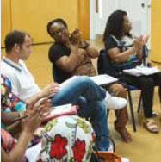

EPEC is an evidence-based, low-cost parenting programme
EPEC courses are peer-led by local parents who successfully complete accredited EPEC training (60 hours over 10 weeks)
EPEC courses offered: Chelmsley Wood, Kingshurst & Fordbridge and Smiths Wood to vulnerable families particularly those with children with behavioural issues aged 2-11 years initially from Autumn 2018.
Courses consist of eight 2 hour sessions for 8-12 parents/ carers and integrate behaviour change with adult learning
EPEC aims to improve child development and outcomes, parenting, family resilience and social capital combining developmental science and theory with well-evidenced parenting strategies

Slide 34

Accessing Parenting Sessions
Solar (Children’s Emotional Wellbeing and Mental Health Service) co-ordinate parenting programmes in the borough
Contact: Parenting Co-ordinator –
0121 301 2773

Slide 35
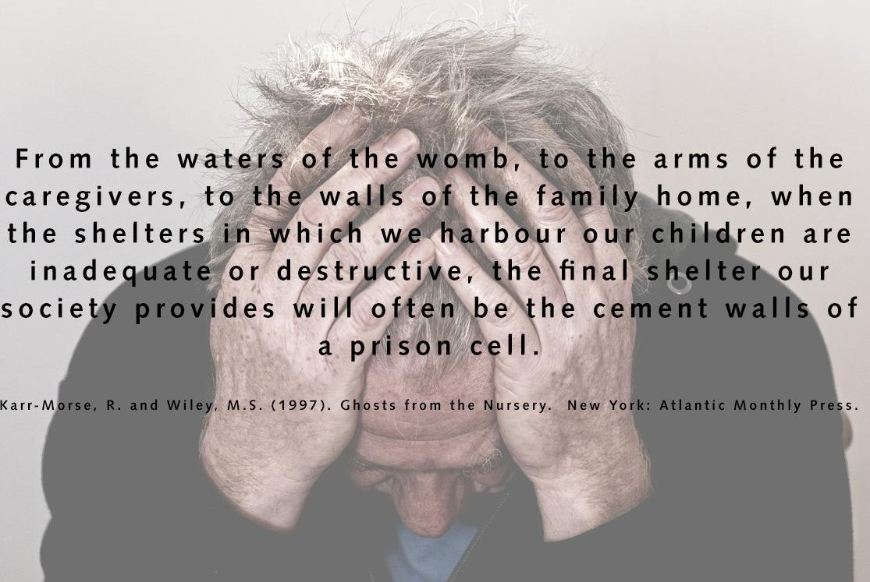

Slide 36
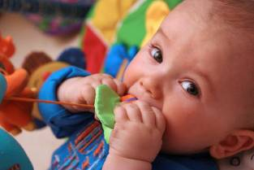
Any questions?
“an effective and high-quality preventive programme in childhood is the foundation of a healthy society.”
Dr Sheila Shribman
Healthy Child Programme 2009
“It is easier to build strong children than to repair broken men”
Frederick Douglass (1855) Social Reformer, Abolitionist and Statesman
Denise Milnes
Senior Public Health Specialist - Children
Public Health - SMBC
denise.milnes@solihull.gov.uk

