Slide 1


Getting ready –30 hours childcare for working families in Solihull
Making the extended entitlement work for you

Slide 2
Welcome
Cathy Barber and Cheryl Morris
Childcare Works
Lisa Morris
Solihull Early Years and Education Improvement Service [SEYEIS]
Solihull childminders, group settings and schools

Slide 3
Aims
A brief introduction to Childcare Works
Understand the policy and the parameters of the 30 hour entitlement
Reflect on the local childcare market
Consider the opportunities and challenges
Making business choices

Slide 4
Agenda
Looking forward - current policy and direction
30-Hours early education [Free Extended Early Entitlement –FEEE]
The early years sector in Solihull
Thinking about opportunities and challenges in a changing market
Planning ahead – identifying opportunities and challenges and developing an plan
Notes:
Suggest have post it notes on table for collection of things I want answered and then if we cant – I can sign post when we can

Slide 5
The Childcare Works team
The same partnership in Achieving Two Year Olds (A2YO) 2012-2016
Mott MacDonald – project management and leadership
Hempsall’s – leadership and delivery of the field work programme for providers and local authorities
Plus the new addition of the Action for Children Foundation Years team bringing 30-hours special LED events and a new SEND board
Notes:
We have already communicated this to our providers so whizz through

Slide 6
The job, the challenge
30-hours is a popular idea with parents, demand will be high
We need quality places in areas of demand
Providers need to examine what will work for children, providers and parents
There will be new ways of working, collaborating, and organising ourselves
Meeting children’s needs in the best
ways possible is a priority

Slide 7
The entitlement, eligibility and delivery model – a brief reminder...
From September 2017 – 30 hours of free childcare for eligible families
Options:
1,140 hours a year
30 hours over 38 weeks
24 hours over 47.5 weeks
22.35 hours over 51 weeks
Other models
Notes:
30-hours childcare is a new Government policy. It comes into force in September 2017. Early implementers (8) and early innovators (24) are working with DfE now to test out different models of delivery and how the policy will work in practice (including eligibility checking systems).
The key policy aim is to reduce the cost of childcare for working families.
All families will receive the existing universal entitlement of up to 570 hours a year early learning/early education remains the same .
Eligible families will receive an additional 570 hours per year to be taken over no less that 38 weeks a year.
It may be taken as 30 hours over 38 week – however for most working parents a working year is longer so they will be looking for models which offer all year round and a reduction of 22.35 hours per week.

Slide 8
Eligibility for the entitlement will include households where:
  Parents (whether two-parent family or lone parent) are working
  Not 16 hours working but equivalent of 16 hours a week at the National Minimum Wage or National Living Wage
  Income cap of £100K
  Includes zero-hours contracts and self-employed
  One/both parent/s is away on leave (parental, maternal etc.)
  One/both parent/s is on Statutory sick pay
Notes:
The earnings threshold is the equivalent of 16 hours a week at National Minimum or Living Wage. There is also introduced an earnings limit – any parent earning over £100k a year will not be eligible. Where both parents in a couple earn (say) £50k a year, they will still be eligible. If one parent earns over £100k a year the household will not be eligible.
This aligns with eligibility criteria for Tax-Free Childcare.
Other criteria are – where one parent is temporarily away from work because they are on maternity, paternity, adoption or statutory sick leave they may still be eligible for 30 hours. Also, where one parent is in receipt of disability benefits or has caring responsibilities (based on the receipt of specific benefits) but the other meets the income requirements, these households will be eligible.
The DfE intend to make provision for a 'grace period'. i.e. where parents' circumstances change, they may no longer be eligible, but they will keep their childcare for a short period to avoid disruption to the child and to allow the parent to find alternative employment. They are thinking about how this might work in practice now.

Slide 9
Eligibility
  One parent is employed and the other parent has either: substantial caring responsibilities/and or disability; is a foster carer with their own three- and four-year-old children
  Parents who are in training will not be eligible
  Not 390,000 new families but existing children, families and customers.
  Switchers to funded places, some families increasing, some new to childcare and others purchasing more
  Working families – needing many different patterns
  Places are still required for 15 hours
  and two-year-olds
Notes:
The earnings threshold is the equivalent of 16 hours a week at National Minimum or Living Wage. There is also introduced an earnings limit – any parent earning over £100k a year will not be eligible. Where both parents in a couple earn (say) £50k a year, they will still be eligible. If one parent earns over £100k a year the household will not be eligible.
This aligns with eligibility criteria for Tax-Free Childcare.
Other criteria are – where one parent is temporarily away from work because they are on maternity, paternity, adoption or statutory sick leave they may still be eligible for 30 hours. Also, where one parent is in receipt of disability benefits or has caring responsibilities (based on the receipt of specific benefits) but the other meets the income requirements, these households will be eligible.
The DfE intend to make provision for a 'grace period'. i.e. where parents' circumstances change, they may no longer be eligible, but they will keep their childcare for a short period to avoid disruption to the child and to allow the parent to find alternative employment. They are thinking about how this might work in practice now.

Slide 10



Slide 11


Slide 12
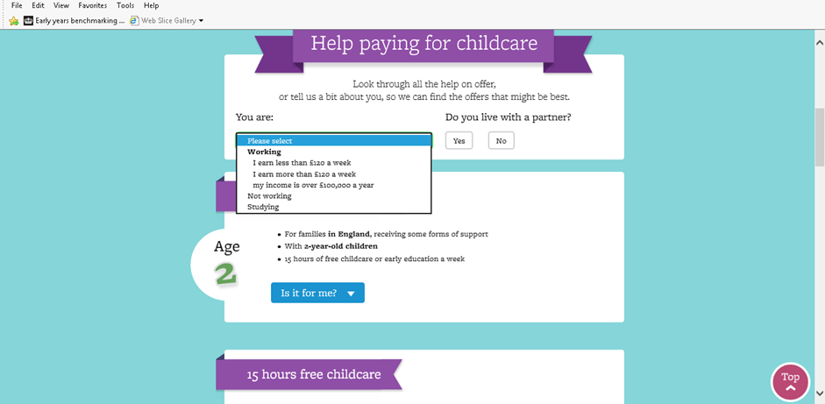

Slide 13
Applying through the childcare service
1
2
3
4
Malcolm wants to know more about the Government’s childcare offer
Malcolm looks online for more information.
Malcolm applies through the childcare service. First, he is asked to confirm his identity.
Once his identity is confirmed, Malcolm completes the application.
5
6
7
8
Malcolm gets his child’s eligibility code for 30 hours.
He can also pay money for Tax-Free Childcare into his childcare account.
Malcolm takes his 30 hours eligibility code to his childcare provider.
From mid-June the childcare provider will check the eligibility code via the Provider Portal. Prior to this the childcare provider will contact the Local Authority to check the code.
Every three months, Malcolm re-confirms eligibility through the childcare service
Notes:
At the most basic level, the childcare service is an online account. Parents will apply for support - and once that’s done, they’ll have a digital account that they can use to administer TFC and 30 hours.
Parents eligible for 30 hours will get an eligibility code.
Meanwhile, Tax-Free Childcare offers financial support – so parents can pay money into the account, receive a government top-up, and then pay their childcare provide directly

Slide 14
Delivery model – flexibility
Extending the hours over which funded provision can be delivered from the current 7.00 am to 7.00 pm, to 6.00 am to 8.00 pm
Keeping the maximum funded session to 10 hours per day and remove the minimum session length for funded places
Parents can access provision at a maximum of
two sites per day to minimise transitions for
the child
Notes:
Flexibility will be key – parents need childcare to meet their working hours and this can include commuting time. New guidance is looking at extending hours, removing the minimum session length and limiting the number of sites per day to minimise transitions for the child

Slide 15

Delivery model
There is no requirement that funded places must be taken on or delivered on particular days of the week or at particular times of the day
A minimum - 5 hours per day over 3 days of the week or 3 hours per day over 5 days of the week
Parents and providers are made aware that funded places can be delivered:
  over more than 38 weeks of the year
  outside of setting terms
  or at weekends

Slide 16
What do we know so far?
demand
Families are very interested, demand is high
Partners are supportive
Economies of scale are important
Partnerships are key
supply
Notes:
The 8 early implementers have been sharing their experiences with us.
We know from take up so far that families are keen. By just six weeks into delivery an average of 70% of eligible families in the EI LA areas were taking up a place. Your local experiences and conversations with parents may be evidencing this too. The entitlement is worth approximately £3-4,000 per year towards the costs of childcare, could you afford not to take it up?
Partners such as JCP, housing and children’s centres are also benefiting by supporting their own agendas to support families, combatting poverty and supporting well being. Health visitors are also promoting the entitlements as art of their contracted requirements.
Providers are expanding in lots of areas, either to deliver more days, more sessions or in more settings. We know that economies of scale are important in realising savings and pooling resources, so….
Partnerships are key too. In many areas (e.g. Hertfordshire) collaborations are being piloted and directly supported by the LA. In West Sussex for example providers(e.g. a preschool, out of school club and two CMs) are actively promoting their services as a collaboration – so that families find the group of providers locally when first looking for childcare, instead of having to piece together different provisions themselves.
Responding to demand is key – in York where originally 70% of providers said they would not engage, over 70% are now offering the extended entitlement, demand drives supply, which drives demand etc. etc. etc.

Slide 17
Early years in Solihull– Funding
A PVI hourly rate of £3.90 from 1 April 2017
A school hourly rate of £3.80 from 1 April 2017, rising to the PVI rate in 2018-19 , or as government funding permits.
EYPP 63p/ hour
Increase the two year old hourly rate from £5.00 per hour to £5.24 per hour from 1 April 2017 in line with the increase in grant.
Confirmation of Disability Access Fund which is £615 per eligible child.
Notes:
Set a contingency fund of £100,000 from 1 April 2017.
Set a Special Educational Needs (SEN) Inclusion Fund at £250,000.
Approved a supplement in respect of deprivation only equivalent broadly to the value of that in 2016-17
To change the measure from Income Deprivation Affecting Children Index (IDACI) to the per pupil measure used for the Early Years Pupil Premium (EYPP), at £0.63 per hour
A PVI hourly rate of £3.90 from 1 April 2017
A school hourly rate of £3.80 from 1 April 2017, rising to the PVI rate in 2018-19 , or as government funding permits.
Increase the two year old hourly rate from £5.00 per hour to £5.24 per hour from 1 April 2017 in line with the increase in grant.
Confirmation of Disability Access Fund which is £615 per eligible child.

Slide 18
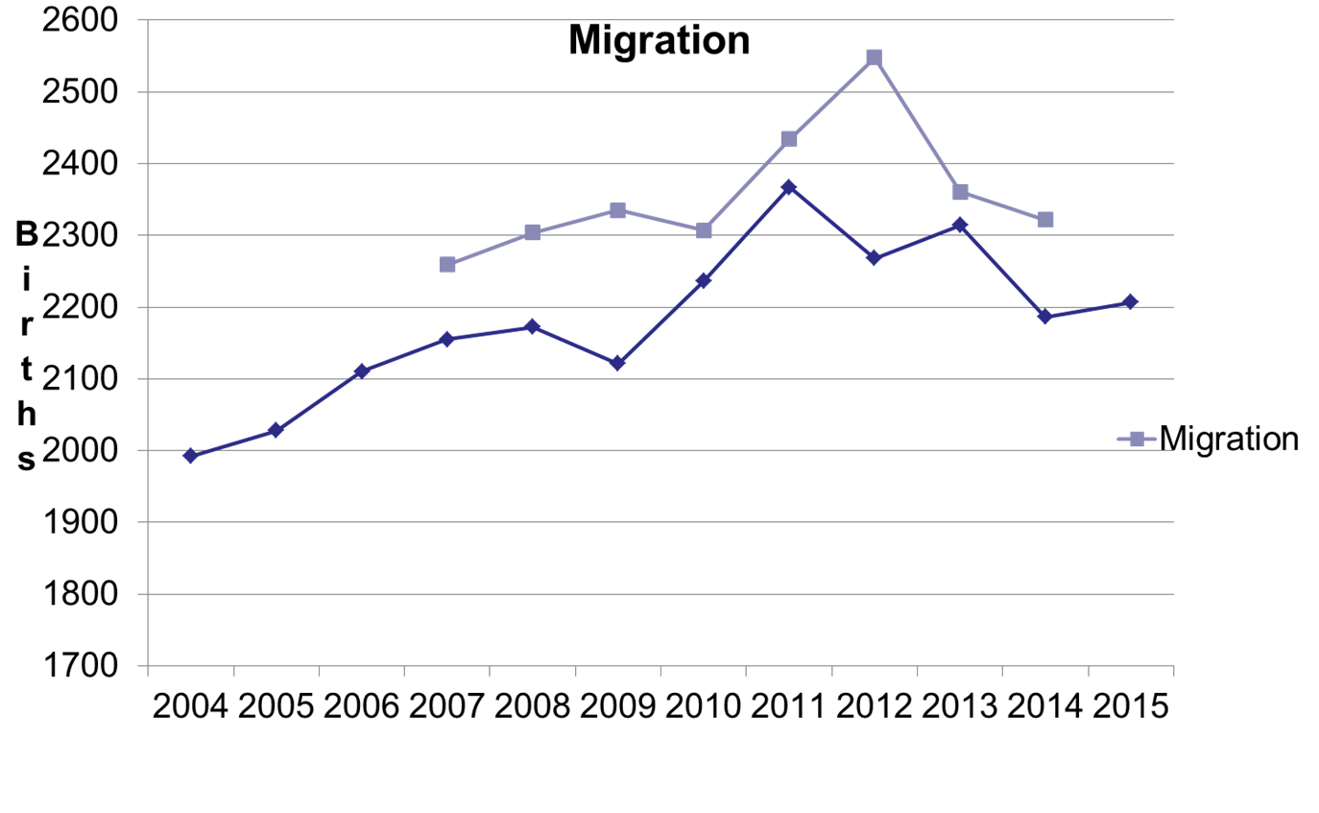
Birth rate and migration = high numbers
Notes:
SOLIHULL

Slide 19

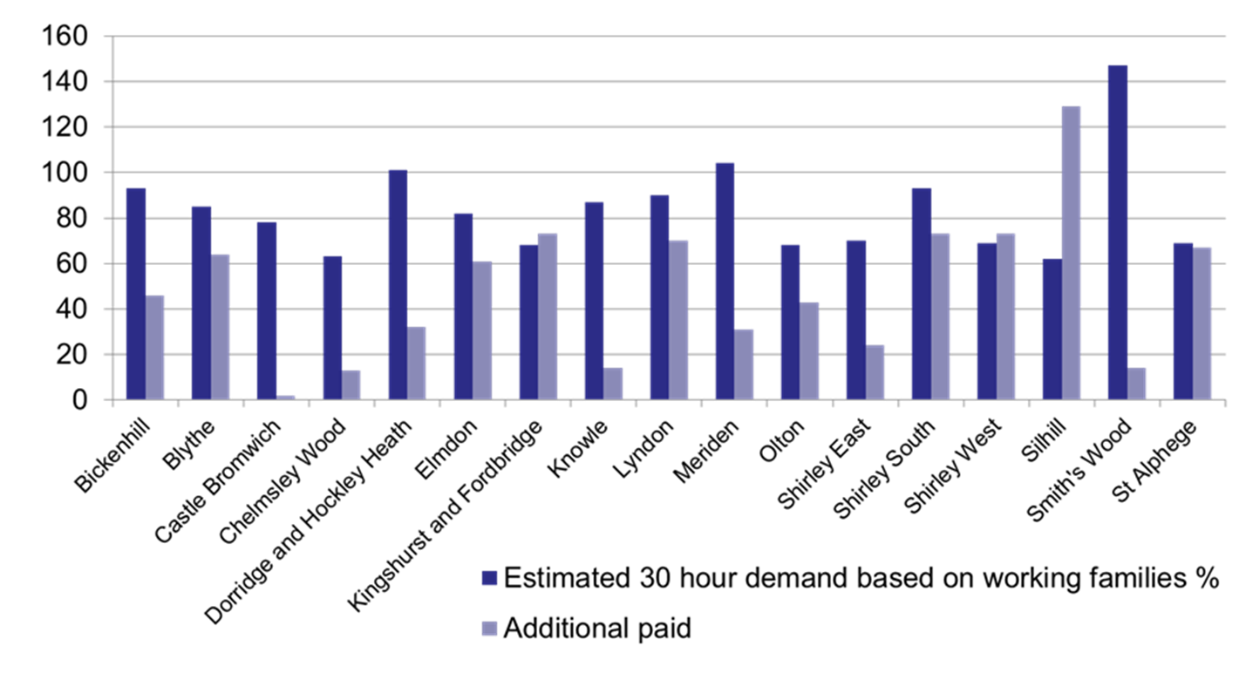
Forecast Demand for Extended Offer of 30 hours
Notes:
SOLIHULL based on numbers indicated ahead of march 21st meeting
Also new housing across solihull

Slide 20
Planning ahead
Understand your local market
Think about your delivery model
Consider partnership opportunities
Timeline/ flexibility
What do you and your colleagues in your locality offer families now ?
How do families of 2,3 and 4 year olds currently access the funded entitlements of 15 hours and paid for
care?
Notes:
Some things to think about
NB model parent survey sheffield on solgrid.org.uk

Slide 21
10 steps to assist you to get ready
1 Understand your business – you are a business
2 Understand the local market in which you work
3 Understand the needs of families
4 Understanding your finances
5 Managing and monitoring your money
6 Consider the options available to you
7 Use your market research to create a business plan/action plan
8 Implement your plan
9 Communicate and promote the entitlement to families
10 Review and monitor your plan
Notes:
Show getting ready guide and highlight link at end

Slide 22
Step one
Understand your business
Political, Economical, Social, Technological (PEST analysis)
Strengths, Weaknesses, Opportunities and Threats (SWOT analysis)
Notes:
Use workbook and getting ready guide to introduce steps 1 – 3. Ask Local authorities on tables to discuss the business planning they currently offer, what is working and how they could incorporate this information into their provider engagement. Flipchart and tools Las currently have available via links or on website for Childcare works to obtain and share.
Step 1 – understand your business
Before you make any change to your delivery in preparation for the new 30-hours free childcare in September 2017, it is important you understand your business now.
PEST analysis is a useful tool for understanding how the things going on around your nursery may impact on your business and your plans.
PEST is an acronym for Political, Economic, Social and Technological factors.
PEST analysis is similar to a SWOT analysis - it's simple, quick, and uses the four key perspectives which allow you to consider the environment in which your service is provided and identify all the things that may support or threaten your business planning and service delivery for the year ahead.
A SWOT analysis is a useful tool to review the strengths and weaknesses (or areas for development), and to look at opportunities and threats that exist for your business. This tool will help you to work out where you are now, before you start to plan for change, growth or expansion.
Thinking about your strengths allows you to identify what is good about your business and what can be improved or built upon.
Focussing on weaknesses (areas of development) helps you to identify areas within your business which could let you down if they are not dealt with or resolved.
Identifying opportunities creates areas that have potential for development. What could you change to improve your sustainability or income for example: is there a new housing development planned which will increased the demand for childcare Being clear about threats allows you to describe any risks that could affect the success of your plan. What needs to be prepared for, controlled or minimised within the business. For example: maybe there is a new nursery opening which could increase places and competition locally.
A SWOT analysis should be completed annually your management or as a full team activity and this information used to inform your development plan for 30-hours free childcare.

Slide 23
Step two
Understanding the local market in which you work
To know what is missing and consider what you could do you need to understand:
  What childcare providers are in your area?
  What do they offer families?
  What flexibility choices can families get from other providers?
  What do they charge?
Notes:
Understanding your local childcare market is really important when you are considering expansion, delivering places differently or starting something new.
To know what is missing or to find opportunities you need to understand:
What other childcare providers offer in your area?
What do they do?
What flexibility choices can families get from other providers?
What do they charge?
Understanding the fees being charged in your area informs your financial planning.
Remember all childcare settings will have different costs. Whatever you charge should be based on what it costs you to deliver your services - not necessarily what everyone in the locality is charging.
Once you have an understanding of what is on offer in your area, you can start to identify gaps in the market or opportunities. You can see how much, what type and how flexible or not the childcare solutions in your area are. Think about the DfE consultation response and the new delivery model – there may be opportunities for you if you are wanting to do something different. Some things to consider:
If all providers offer term time only. Can you deliver a 24 hour model over 47.5 offering families increased flexibility or even stretch the entitlement further to 51 weeks?
If no-one in the area opens earlier than 8.00am and all provision closes at 6.00pm – Can you extend your day? Is there demand? If you operate near a call centre, hospital, retail park or any other business which operates shifts and weekends there may be parents who want to access childcare when they work – weekends, evenings and early morning. The new delivery model of 6am – 8pm will support you to think creatively should you WISH to.
If there is a lot of term time and sessional provision in your area – Could you develop and offer a collaborative solution for a number of sessional providers and/or schools offering a new before, afterschool and holiday care which wraps around the core sessional offer provided by partners and supports working parents ?
Use local authority Childcare Sufficiency Assessments (CSA) report, parent survey results and your local knowledge to inform your market research.

Slide 24
Step three
Understand the needs of families
Understand the eligibility criteria
Think about the arrangements working
parents who currently use your service make
Conduct market research

Slide 25
A family who work full-time may need
8.00-9.00 | 1 hour paid for with partner for 38 weeks and paid for holiday childcare
9am | 30 hours in a setting for 38 weeks
3pm
3.00 – 6.00 | 3 hours paid for with childminder/partner for 38 weeks and paid for holiday childcare

Slide 26
Some providers will be able to offer stand alone solutions… all year round
8.00 6.00 | 22.35 funded hours for 51 weeks – standalone offer | 27.65 paid for hours for 51 weeks – stand alone offer
Notes:
Some families will require childcare all year round (50 – 52 weeks a year), therefore some providers may choose to offer a simple model which stretches the 1,140 hours over the number of weeks they are open. The rate for paid for hours is set by the provider and they may choose to include or exclude refreshments and additional services.

Slide 27
Some providers will be able to offer 5 and/or up to 30 hour options and extended day solutions term time
8.00-9.00 | 1 hour - paid breakfast club
9.00-3.00 | 6 | 6 | 3 | 6 | 6
 |  |  | 3
3.00 –6.00 | 3 hours paid afterschool care
Paid for hours x 38 weeks
15 hours or 30 hours funded childcare x 38 weeks
Paid for hours x 38 weeks

Slide 28
A collaborative approach...
9.00 – 12.00 | 15 hours funded with a partner one for 38 weeks
12.00 – 3.00 | 15 hours funded with partner two for 38 weeks
9.00 3.00 | 15 hours funded with partner one | 15 hours funded with partner two

Slide 29
A collaborative approach to create a
10 hour day
8.00 - 9.00 | 1 hour paid for with a partner for 38 weeks
9.00 - 3.00 | 30 hours funded in setting for 38 weeks
3.00 - 6.00 | 3 hours paid for with a partner for 38 weeks
Notes:
Top - full day care – one provider model
Bottom – 30 hours term time only with option to pay for additional childcare through a partner/ partners . Parent may buy holiday care also.

Slide 30

Steps four and five
Understand your finances
  Occupancy
  Breakeven analysis
Managing and monitoring
your money
Cambridge occupancy tool on www.solgrid.org.uk/eyc
Notes:
Oldham occupancy calculator also www.solgrid.org.uk

Slide 31
Work out the finances
Know how much it costs to deliver the free entitlements for two, three and four year olds
Explore different models of delivery and work out which will work financially for you
Calculate how much you need to charge per hour, per session or per day to cover all the costs associated with delivering the EYFS
Ensure your fee structure based on a breakeven analysis and that it generates the income you require
Notes:
Understand how Tax Free Childcare, Universal Credits, voucher schemes, etc, can assist parents to reduce the cost of paid for childcare.

Slide 32

Step six
Consider the options available to you – decide which model will work for your setting and your families
Notes:
The options
Do nothing
Increase capacity
Increase flexibility
Linking with other providers
Being aware of the LA statutory guidance and operational guidance

Slide 33
What can you do?
Possible options:
Do nothing
Increase flexibility
Increase capacity
Partnership working and collaboration
Notes:
Doing nothing is an option – if your market intelligence tells you there will be limited impact and low demand locally, or if you choose to maintain your current delivery model...
But we would urge you to think about the options available to you ...For example – think about increasing flexibility

Slide 34
Increase flexibility?
Possible options:
Open longer days/ Saturdays – think creatively!
Change delivery models e.g. 15 hours delivered across 2.5 days
Offer some 30 hour places
Offer some flexible places
Stretch the entitlement by opening beyond
school terms - think creatively !

Slide 35
Increase capacity?
Possible options:
Open longer days (6am – 8pm)
Open more weeks a year (all year, on weekends)
Take on an assistant
Use unused space in a community space/school space to offer additional services
Notes:
CM AND PVI

Slide 36
Increase capacity?
Possible options:
Use unused space on school site
Use unused space in a community space close to the school
Reconfigure space to maximise intakes
Notes:
SCHOOLS

Slide 37
Increase capacity?
Possible options:
Buy and open a new space
Use unused existing space
Use unused space in a community space/school
Reconfigure space to maximise intakes
Deliver new provision for partners and schools
Notes:
PVI

Slide 38
Partnership working
Possible options:
Work with PVI partners and schools to provide collaborative models of 30 hours (and more if needed)
Work creatively with other childminders – is there a joint option? [50% rule]
If you want to grow .... look out for business opportunities to deliver additional services for partners.
Notes:
CM 50% time working at a village hall/ school?

Slide 39
Partnership working
Possible options:
Work with schools, other PVI and childminders to provide collaborative models around your core offer (and more if needed)
Work creatively with other group settings – is there a joint option?
Work creatively with other group settings to create attractive business opportunities to sell to schools and partners.
Notes:
PVI

Slide 40
Partnership working
Possible options:
Work with PVI partners and childminders to provide the additional 15 hours around your core school offer (and more if needed)
Work creatively with other schools – is there a joint option?
Work creatively with other schools to create attractive business opportunities for partners.
Notes:
SCHOOLS

Slide 41
Governance
Possible options:
Direct delivery as pupil of the school
Section 27 Community powers as non-pupil of the school
Both – as two stand alone/separate provisions
Commissioner on or off site
Partnership arrangement on or off site
Notes:
SCHOOLS

Slide 42

Next Steps and Summary
http://www.solgrid.org.uk/eyc/30-hours/
Notes:
30 hours will impact on the local childcare market. It will offer eligible working parents opportunities to reduce the cost of their childcare, buy more, take-up blended childcare solutions, even change their working hours...
This presents challenges to the LA and to providers, but also real opportunities.
We hope today has been informative, and provided food for thought.

Slide 43
Action planning – tools, resources and support
Getting Ready Guide – http://childcareworks.co.uk/
DfE/FCT Mixed model partnership tool kit –http://www.familyandchildcaretrust.org/resources
Childcare Hubs – http://www.foundationyears.org.uk/hubs/
Subscribe to www.hempsalls.com PS newsletter
Visit www.foundationyears.org.uk for LED schedules, and information
Visit www.childcareworks.co.uk

