Slide 1

The Early Years Entitlement
15/11/16

Slide 2

Overview [6.30-7.30pm]
30 hour update
Funding
SEND
Provider portal
What happens next?
Q&A

Slide 3

What is the Early Years Entitlement?
Probability of funding |  | 
2 year EEF | Yes | No | Eligibility check
3 year EEF | Yes | Yes | Universal
Extra 15 hours | No | Yes | Eligibility check
EYPP | Yes | No | Eligibility check
Notes:
All 3 and 4-year-olds in England are entitled to 570 hours of free early education or childcare a year. This is often taken as 15 hours each week for 38 weeks of the year.
Some 2-year-olds are also eligible.

Slide 4
30 hours eligibility
The ‘extended entitlement’ for 15 hours in addition to the ‘universal offer’ of 15 hours. Both parents are working (or sole parent in a lone parent family) & each parent/carer earns on average: a weekly minimum equivalent to 16 hours at national minimum wage (NMW) (for under 25 yr olds) or national living wage (NLW) (if over 25 yrs old), and less than £100,000 per year
Notes:
What is the extra funding for?
The extra funding is to:
•support working parents to manage the cost of childcare
•support parents into work
•allow parents to increase their hours, should they wish to
The additional 15 hours of free childcare is available for families where both parents are working (or the sole parent is working in a lone-parent family), and each parent earns the equivalent of 16 hours a week at the national minimum or living wage, and earns less than £100,000 a year.

Slide 5
30 hour free childcare entitlement: delivery model
Government consultation response
We [DfE] will retain the same stringent quality standards to ensure the best possible experience for the child - providers delivering any part of the 30 hour entitlement will need to follow the requirements of the Early Years Foundation Stage and must be registered with Ofsted.
Notes:
LA directory of providers
DfE Consultation – Level 3 early years educator: numeracy and literacy requirements
A consultation on the literacy and numeracy skills and knowledge needed by level 3 staff has been launched by Minister for Early Years, Caroline Dinenage. This consultation is an opportunity to better understand what knowledge, skills and appropriate qualifications in mathematics and English are required to perform an effective level 3 role. It also seeks to consider what literacy and numeracy qualification requirements can put level 3 staff in the best position to progress in their careers
The consultation runs until 28th November and can be accessed here:
DfE Consultation Outcome – 30hours free childcare
The DfE has published the consultation outcome to the 30-hour free childcare entitlement. It includes the summary of the responses it received, along with the government’s response outlining the next steps.

Slide 6
DfE Consultation response…
November 2016
The free early years entitlements must be provided over no fewer than 38 weeks, local authorities are expected to work
with childcare providers to enable, as far as possible, parents to ‘stretch’ their free childcare over the full year where that is what they wish.
The government intends to extend the hours in which the free entitlement can currently be funded (from 7am-7pm at present) to between 6am and 8pm.
Limit to two the number of sites on which children can take up their free entitlement in a single day
Notes:
Our previous consultation with parents demonstrated the importance of being able to ‘stretch’ the entitlement over more than 38 weeks per year. We propose to mirror provisions in the existing statutory guidance so that both the first and second 15 hours can be taken over no less than 38 weeks and stretched over a full year, where there is parental demand.
We know that a large number of parents need access to childcare in the early morning or later into the evening to cover shift patterns. This is why we proposed to extend the hours over which funded provision can be taken from the current framework (7am-7pm) to 6am-8pm, to allow parents to drop off their children earlier in the day and collect them later in the evening. There would continue to be a maximum of 10 hours of funded provision in one day.

Slide 7
Children will not be able to access more than ten hours of funded provision in one day.
Minimum 2.5 > negotiable.
Develop a model agreement template.
Changes to the regulations and the statutory guidance will apply to both the universal and extended entitlement.
The government wants to encourage providers to establish partnerships.
Notes:
Proposed to extend the minimum session length for funded provision from 2.5 hours to 3 hours between 9am and 3.30pm to support children’s learning outcomes as it would guarantee a period of continuous attendance for the child. In addition we proposed to remove the minimum session length outside 9am and 3.30pm, to enable ‘wraparound providers’ (such as breakfast and after-school clubs) to support the flexible delivery of 30 hours in a way that matches parental working patterns. We also set out that parents should be able to split their extended entitlement between a maximum of 3 providers in one day.

Slide 8
Free early education
Government funding - deliver 15 or 30 hours a week of free, high quality, flexible early education and childcare. It is not intended to fund the cost of consumables or additional services.
The government believes it is right to put in place a ‘grace period’ for families whose circumstances change, so that they can retain their childcare place if the parents become ineligible for the extended entitlement.
Notes:
It is not intended to fund the cost of consumables (such as drinks, meals and nappies) Providers are already free to charge parents for such discretionary items provided they are not compulsory.
The consultation set out a proposition for a grace period lasting for either a quarter or to the next half of a term. We

Slide 9
Funding
Government are changing the national funding arrangements to support priorities of fairness, 30 hours delivery, improving provision for SEND.
Solihull will need to change our funding arrangements – for 1 April 2017 –
with your consent
Notes:
Consultation launched 11 August to 20 September. In the document they set out detailed proposals, including a schedule of impact on each LA and illustrations of what that might mean for providers.
Government have not announced response to the funding consultation
Solihull has to produce a local funding formula that fits government rules, and must do this in consultation with providers – but time is very, very short.

Slide 10
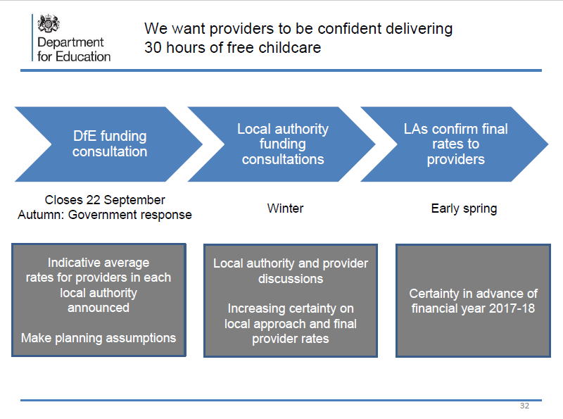

Slide 11
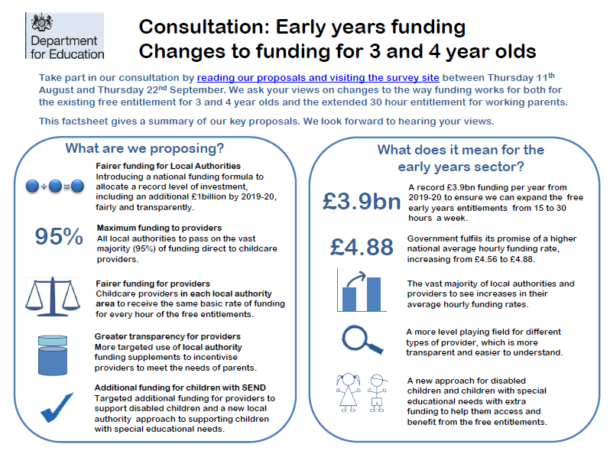

Slide 12
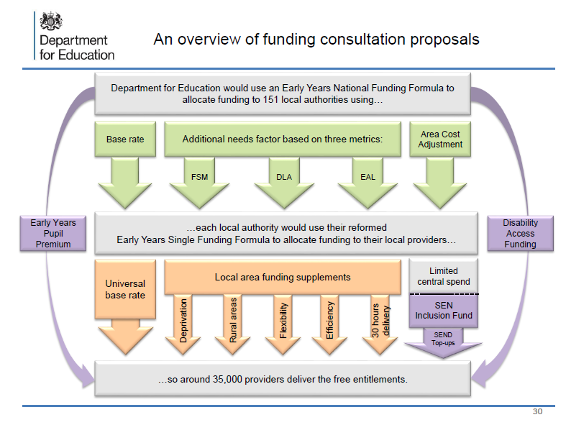
Notes:
Universal base rate must be the same across all settings, regardless of size or type of provider.
Will be phased over 2-3 years
Central spend limited to 7% 2017-18, maximum 5% 2018-19 onwards
No LA will lose more than 10% - so not quite fair funding…
Our (DfE) proposals at a glance Part 1: National funding to local authorities
• Hourly funding rates (national average) will increase from £4.56 to £4.88 for three- and four-year olds (including average Early Years Pupil Premium spend) and from £5.09 to £5.39 for two-year olds.
• A new early years national funding formula would allocate funding to local authorities for the existing 15-hour entitlement for all three- and four-year-olds and the additional 15 hours for three- and four-year children of eligible working parents.
• The formula would include factors for additional needs and an area cost adjustment to reflect variations in local costs.
• While the majority of local authorities would see increases in their hourly funding rates, we would set a funding floor to ensure that no authority could see a reduction of more than -10% once the formula is fully implemented.
• We would also use transitional protections (Part 4) to ensure that no local authority could see an annual reduction in their hourly funding rates of more than -5% in any year.
• We propose all local authorities should be funded by the early years national funding formula, without any transitional protections, by 2019-20.
Part 2: Local funding from local authorities to providers
• We would require that all local authorities pass 93% in 2017-18 then 95% in 2018-19 of early years funding to providers. This would maximise funding to childcare providers.
• Local authorities would use a universal base rate to fund providers for each hour of the free entitlement, by no later than 2019-20. This would bring about greater equality in funding between different types of provider.
• There would be supplementary funding for maintained nursery schools for at least two years to keep their transition to a universal base rate manageable.
• There would be a limited set of permitted funding supplements, limited to those which reflect drivers of cost and incentivise providers to meet the needs of parents. These supplements would be capped at 10% of the hourly funding rate.
Part 3: Meeting children’s additional needs
• There would be a new Disability Access Fund to support disabled children to access the free entitlements.
• Local inclusion funds for children with special educational needs would support providers in driving outcomes for these childre

Slide 13
Solihull LA position -1
Overall, Solihull will gain significantly.
Solihull currently receives the lowest amount for early years of any local authority, at a rate of £3.20 per hour, which equates to £6,781,000 in 2016-17. The highest funded authority (Camden) receives £9.46, nearly 3 times as much. On a like-for-like basis, Solihull will receive £4.36 per hour, £9,252,000 in total, an increase of £2,471,000 or 36%.
Under the transition proposals, this would be scaled back for two years, so Solihull would actually receive £8,331,405 (£3.93 per hour) in 2017-18.
Funding for the 30 hours from September 2017, plus the new Disability Living Allowance pupil funding would be in addition to these amounts.

Slide 14
How it all adds up: -
We receive: -
£4.36 per hour which equates to £9,252,000.00 PA
- 0.22p for Solihull Central Services = £632,000.00 PA
- 0.05p for Contingency Fund = £100,000.00 PA
- 0.12p for the Inclusion Fund = £250,000.00 PA
- 0.10p for Deprivation Fund = £180,000.00 PA
= 0.49p Which leaves:-
£3.87 = £3.90
+ 0.52p if funded at National Average
= £4.39

Slide 15
Solihull LA position 2
Solihull Local Funding Formula – thinking so far:
Report to Finance Group 19th September 2016.
Report to School Forum 17th October 2016 – considered basic design decisions for basis of formula, conscious of time constraints.

Slide 16
Solihull LFF – Key questions
Phasing of the new single rate – we have to move to a single rate – but how to do that – who gets what?
The pros and cons of using a local supplement to incentivise 30 hours.
Deprivation element – weighted at 8% in the NFF, currently 2.5% in LFF – what should it be in the new LFF?
An element for special needs – should we have/ create an inclusion fund? How much?
There are some risks here – we don’t have a contingency fund – Do we need to create one?

Slide 17
Solihull LFF – about Solihull
2015-16 created a provision to fund SEND pupils in nursery settings - £30,000 budget, spent £40,000 September to March. Budget £90,000 in 2016-17.
The current basic hourly rate is £3.60 for PVI settings, and a variable rate by size, £2.60 to £2.70 for school settings.
The only supplement used is deprivation, using the IDACI measure (a post code measure of deprivation). And that’s a bit messy…
No supplements for “quality” or to incentivise flexibility in the present funding formula.
Notes:
The income deprivation affecting children index (IDACI) is an index of deprivation used in the United Kingdom

Slide 18
Solihull LFF – what Forum thought
Being aware that every £100,000 equates to 5p to the hourly rate.
Thinking that the priority is to maximise the basic hourly rate.
Everybody agrees that SEND needs some solutions.
In Solihull the most significant impact will be on schools because there must be a single hourly rate, AND PVI settings critical to 30 hour delivery.

Slide 19
Solihull LFF – what Forum agreed
A contingency fund of £100,000 feels OK
An inclusion fund of £250,000 feels OK (much less, little impact, much more – too big impact on basic rate). Details to be worked out later.
Prioritise PVI settings for maximum hourly rate as soon as possible – phase increases for schools as funding increases from government permit.
No 30 hour incentive supplement, no other supplements except deprivation
Deprivation – drop IDACI and use same measure as EYPP, largely keep existing cash -PVI will increase.
Notes:
Deprivation – The new LFF will use actual pupils eligible for the EYPP rather than an IDACI proxy measure, which will enable a standard supplement per child in every type and size of setting. Initial modelling suggests this would entail a small increase (£57,000 to £88,000). The deprivation element will rise from £153,000 to £184,000 so that funding for PVI settings can be in line with that of school nursery settings.

Slide 20
Solihull LFF – what this means
Initial calculations suggest, that after all transitional arrangements have been worked through, the hourly rate for providers in Solihull would be in the region of £3.90 to £3.95.
This suggests funding for schools would rise by around £1,816,000 (55% increase) and by £300,000 (11% increase) for PVI settings.
For 2017-18 - schools get a £894,000 increase, hourly rate increases to £3.24. PVI settings would get £300,000 increase at full £3.90 in the first year (with that increase in deprivation)

Slide 21
Solihull LFF – what next
These proposals for consultation – survey monkey will be launched on-line this week – window for responses will be very short.
Soundings suggest this approach “feels right” and will have wide support.
Proposals can be changed if we have got them horribly wrong – but time is so, so short…
Appreciate providers will have views about if the government proposals go far enough – but let’s be clear about what Solihull can and cannot do – Please!
Government has NOT published final arrangements
Notes:
Consultation responses to Forum meeting 7th December – if widely supported, fine, if aspects need consideration then some kind of interim position will be worked out.

Slide 22
SEND
Targeted Disability Access Fund and an SEN Inclusion Fund,
Include proposals for improving SEND support in our forthcoming early years workforce strategy.
Develop best practice guidance to improve the quality of early years sections of the Local Offer.
£250,000 “pot” from new EYFF – to fund individual pupils and support services – thinking will be developed through reference groups.
Soon launch Early Years SEND graduated response

Slide 23
Provider portal
Our aim is to streamline and simplify the process of claiming Early Years funding for 2, 3 and 4 year old children for all PVI settings by introducing a Provider Portal.
School settings and the LA already have electronic data links (census)
What is a Provider Portal?
A secure, web-based solution for PVI providers to submit advance claim information, final headcount details, and adjustment information on a termly basis.

Slide 24
Provider portal - benefits
Benefits for providers:
Simplify the claims process by removing the requirement to print and complete forms by hand.
Reduce the cost of submitting paperwork to SMBC.
Provides access to view up to date information on claims submitted for the current term, along with details of previous claims.

Slide 25
Provider portal – next steps
Establish a pilot to take place February 2017 to June 2017. Pilot to run in parallel with the funding claims process for 2016/17 Summer Term.
Complete full rollout of the Provider Portal to all PVI providers for the 2017/18 Autumn Term funding claims. Full go-live prior to September 2017.
Information on the Provider Portal project will be issued via the Family Info Service by the end of the year and through your network meetings.

Slide 26
EYPP 3 & 4 y/os
Time scale
[__________]___________]__________]
EYPP
Eligibility
check
Final
Payment
headcount
and EYPP
Advance Payment 75%
Head count &
parental declaration
Notification of eligible children
Notes:
Funding will be at the national rate of 53p per hour per eligible pupil. This means that in the financial year, the setting will receive £302.10 for each eligible child who takes up the full 570 hours of Early Education Funding they are entitled to.
The Local Authority will advise the setting of the outcome of this check, who in turn must inform the child’s parents or legal carers. Nobody else should be advised of the outcome. WHEN?????

Slide 27



Childcare Works
Notes:
James hempsall
Sue robb
Ann van dyke
Hempsall’s, Mott MacDonald and Action for Children have been awarded a two-year DfE contract to ensure settings and local authorities work together to create enough childcare to implement the 30 hours policy. The project, called Childcare Works, has the aim of achieving the delivery of childcare for two- three- and four-year-olds in ways in which high-quality childcare is accessible, flexible and affordable. In doing so, Childcare Works will work directly with providers, local authority early years teams, and central government. We will be signposting you to resources as they become available on the Childcare Works website to be launched later this year.

Slide 28
Next steps
Revised statutory guidance to make LA / provider responsibilities clear.
By September 2018 childminders should be paid monthly; and all other providers should also be paid monthly unless they request an alternative payment model.
Publish information for parents to support take up, flexibility and choice.

Slide 29
Regulations and guidance
Regulations are subject to affirmative debate and will be discussed in both the House of Lords and House of Commons in due course. Subject to Parliament’s views, DfE will publish final regulations once those debates are concluded.
The statutory guidance for the free entitlement will be published in early 2017 to inform the rollout of the extended entitlement. Any changes in the statutory guidance will come into force in September 2017.

Slide 30

Further consultation
The government will undertake further informal consultation with the sector on the length of the national grace period.
Further LA discussion particularly around SEND funding.
Notes:
The government is not consulting on the point at which summer-born three year olds access their early education entitlement. We have made clear in primary legislation that the early education entitlements can be accessed on the 1st September, January or April following a child’s third birthday. Children remain eligible until they reach compulsory school age. This means that all three and four year olds receive five terms of early education regardless of whether they are born in the summer, autumn or spring terms, with some accessing all of it in an early years setting and others accessing some of it in a school reception class.
The government has recognised concerns around summer-born children and compulsory school age. We have already announced our intention to support summer born children in being admitted to the reception class at the age of five, and to ensure that they can remain with that cohort as they progress through school. Further information will be available in due course.

Slide 31
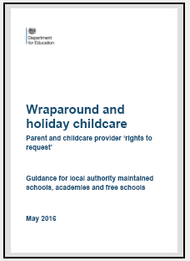
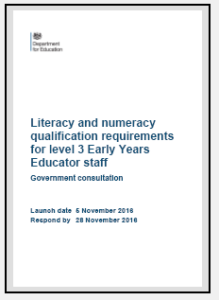
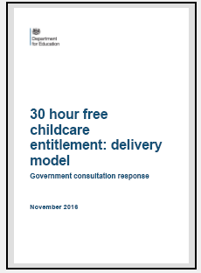
DfE early years consultations/ responses
Notes:
To support employers to attract and retain good quality staff to deliver the offer we will revisit the GCSE requirement. We [DfE] will consult on the numeracy and literacy skills needed in a level 3 role and consider which qualifications best support staff to develop these. We will publish a workforce strategy by March 2017 that sets out our response to the level 3 consultation and government’s wider plans to support employers to attract, retain and promote staff.
Wraparound and holiday childcare
New guidance to help schools understand how to respond to requests from parents and childcare providers about wraparound and holiday childcare.
Schools:
•Did you know that parents and childcare providers have a right to request wraparound or holiday childcare at your school?
•We’ve created a guide to help you understand what it means for your school.
Providers:
•If you’re looking to expand your childcare business, have you thought about using the facilities at your local school?
•You now have a right to request to use school facilities for wraparound or holiday childcare at times when the school isn’t using them.
Parents:
•Did you know you now have a right to request wraparound or holiday childcare at your child’s school?

Slide 32
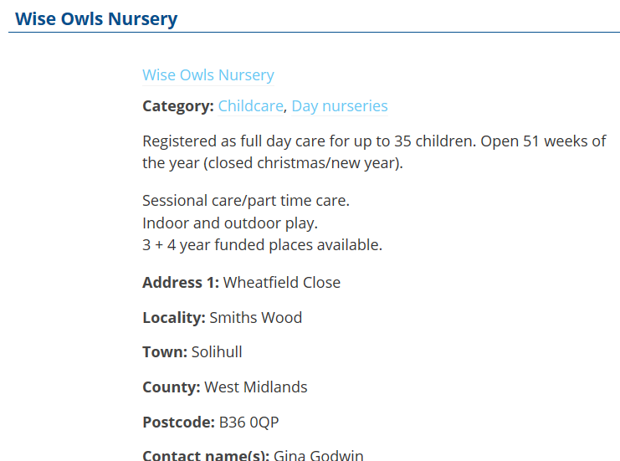
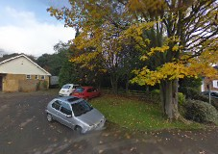
School forum reps
Gina Godwin [Whitesmore and Wise Owls]
Sheila Thompson [Kingsley Childcare]

