Slide 1
Assessment and Planning in RE
Simon Bennett – RE Adviser

Slide 2
Welcome and Plan for the Day
Housekeeping
Visitors to the training

Slide 3
Visitors
9.30 Atallah Fitzgerald - Muslim Faith community in Solihull
10.00 Ashok Bardwhara - Hindu Faith community – linked to the Shree Ram Mandir on the Walford Road Sparkbrook
10.30 Rabbi Pink – Jewish faith community in Solihull
11.00 Christine Boyett and Semira Manaseki-Holland – Baha'i faith in Solihull
2.30 Ajahn Manapo – Buddhist monk from the Forest Hermitage near Warwick

Slide 4
Outcomes
To make you aware of some of the faith groups in the local area and how they can support you in the delivery of RE
To work on some short and long term plans for RE in our own school
To think about how RE and assessment can be delivered in our own school
To become more familiar with the new agreed syllabus and the conceptual approach

Slide 5
Should we be assessing in RE?
We cannot really assess in RE as we are dealing with ethereal and spiritual matters that go beyond a grade or level.
How can you assess someone’s beliefs or someone’s spiritual progress? Or even should you?
Is this an acceptable response?

Slide 6
The Rationale
It is important to link assessment of attainment and progress in RE to those aims of the subject that relate to pupils’ developing knowledge of the key subject matter and of their ability to understand and evaluate it.
For RE, attitudes of curiosity in exploring the ideas of religion and belief and willingness to listen to and consider others’ points of view in a spirit of fairness, should also be part of the assessment of learning.

Slide 7
The Rationale
In RE, as for other subjects, assessment can only be made of what pupils actually communicate. There may be all sorts of progress going on in pupils’ minds, and a self-assessment exercise may bring out some of this, but unless newly gained knowledge and understanding is in some way communicated, teachers and pupils’ peers will not be able to comment.

Slide 8
Attainment Targets AT 1 and AT 2 learning about and learning from - where have they gone?
They continue to be important despite their omission from the 2103 REC recommendations pupils should know how they are doing in relation to these aspects of the subject so that (a) they see the value of RE to their own development as individuals living in a complex society, helping them to make the most of their lives and cope with life’s difficulties
and (b) they get a sense of empowerment in being able to grasp something of the influence of religions and beliefs on the people and world around them.

Slide 9
Feedback
That is why it is a vital part of the rationale for assessment in RE that pupils are given feedback on how well they are acquiring and applying the knowledge, understanding and skills they need to reach targets.
When done well, assessment should provide encouragement, since it will provide clarification on the strengths and weaknesses of pupils’ application to set tasks.

Slide 10
Feedback
Clear feedback with explanations of strengths and weaknesses can help direct pupils’ attention towards the gaps in their knowledge, understanding and skills that are worth developing in order that they can grow in (a) their awareness of themselves and the world around them, (b) their sense of the most important questions they need to face in life and (c) the depth of their reflection on the values and commitments that they live by.

Slide 11
The National Picture
In February and march St Gabriel's trust got the good and the bad from the Re world together and then consulted about assessment in RE. They are that there is an urgent need for a beyond-levels model for RE.
Three areas of exploration were identified:
A. Use of bloom’s taxonomy
B. SOLO taxonomy
C. Religious and theological concepts and iterative statements of attainment
Two approaches looked at in detail were
A and C

Slide 12
Outcome
Working on a similar model to Geography Toolkit to be published:
EY KS1 LKS2 UKS2 KS3 GCSE
NCFRE 1:
Knowledge
NCFRE 2:
Understanding
NCFRE 3:
Skills
The project is no longer funded and the work is with Mark Chater at Culham St Gabriel’s and we will see what comes of it

Slide 13
Solihull Agreed Syllabus
Expectations at the end of each key stage
Division of progress through the terms emerging, secure and exceeded
In terms of a breakdown emerging equates to bottom 20% secure to the majority 80% and exceeding top 20%
Examples are in the Agreed syllabus and hot off the press some examples linked to Islam and the core content

Slide 14
Assessment Suggestions
Some thoughts:
Create benchmark statements at the end of each year
Create portfolio of work for pupils
Create assessment wall with post- its and comments
Create an audio record with pupil statements

Slide 15
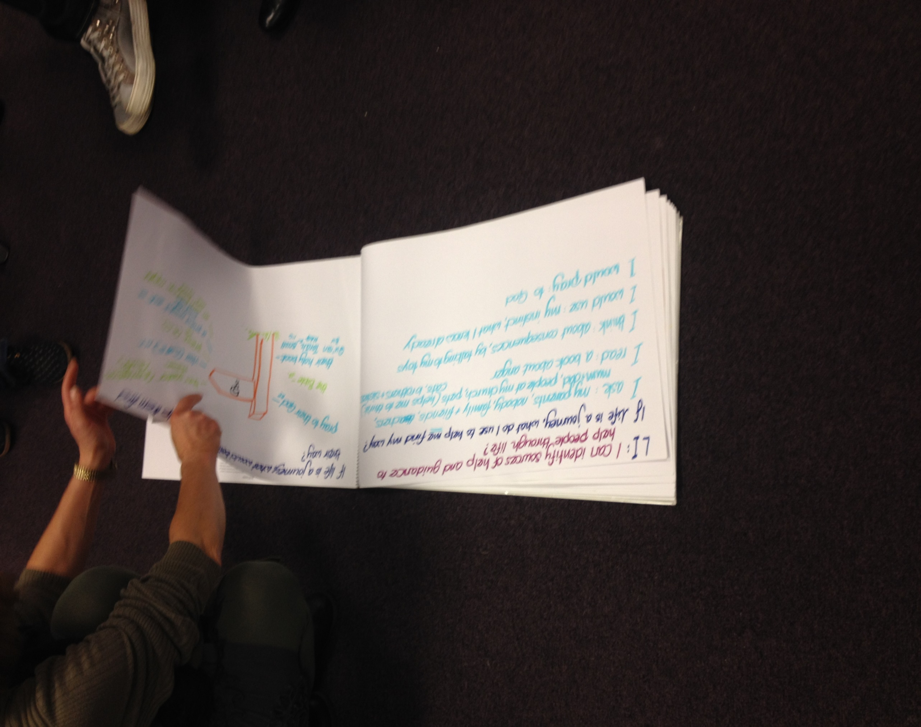

Slide 16
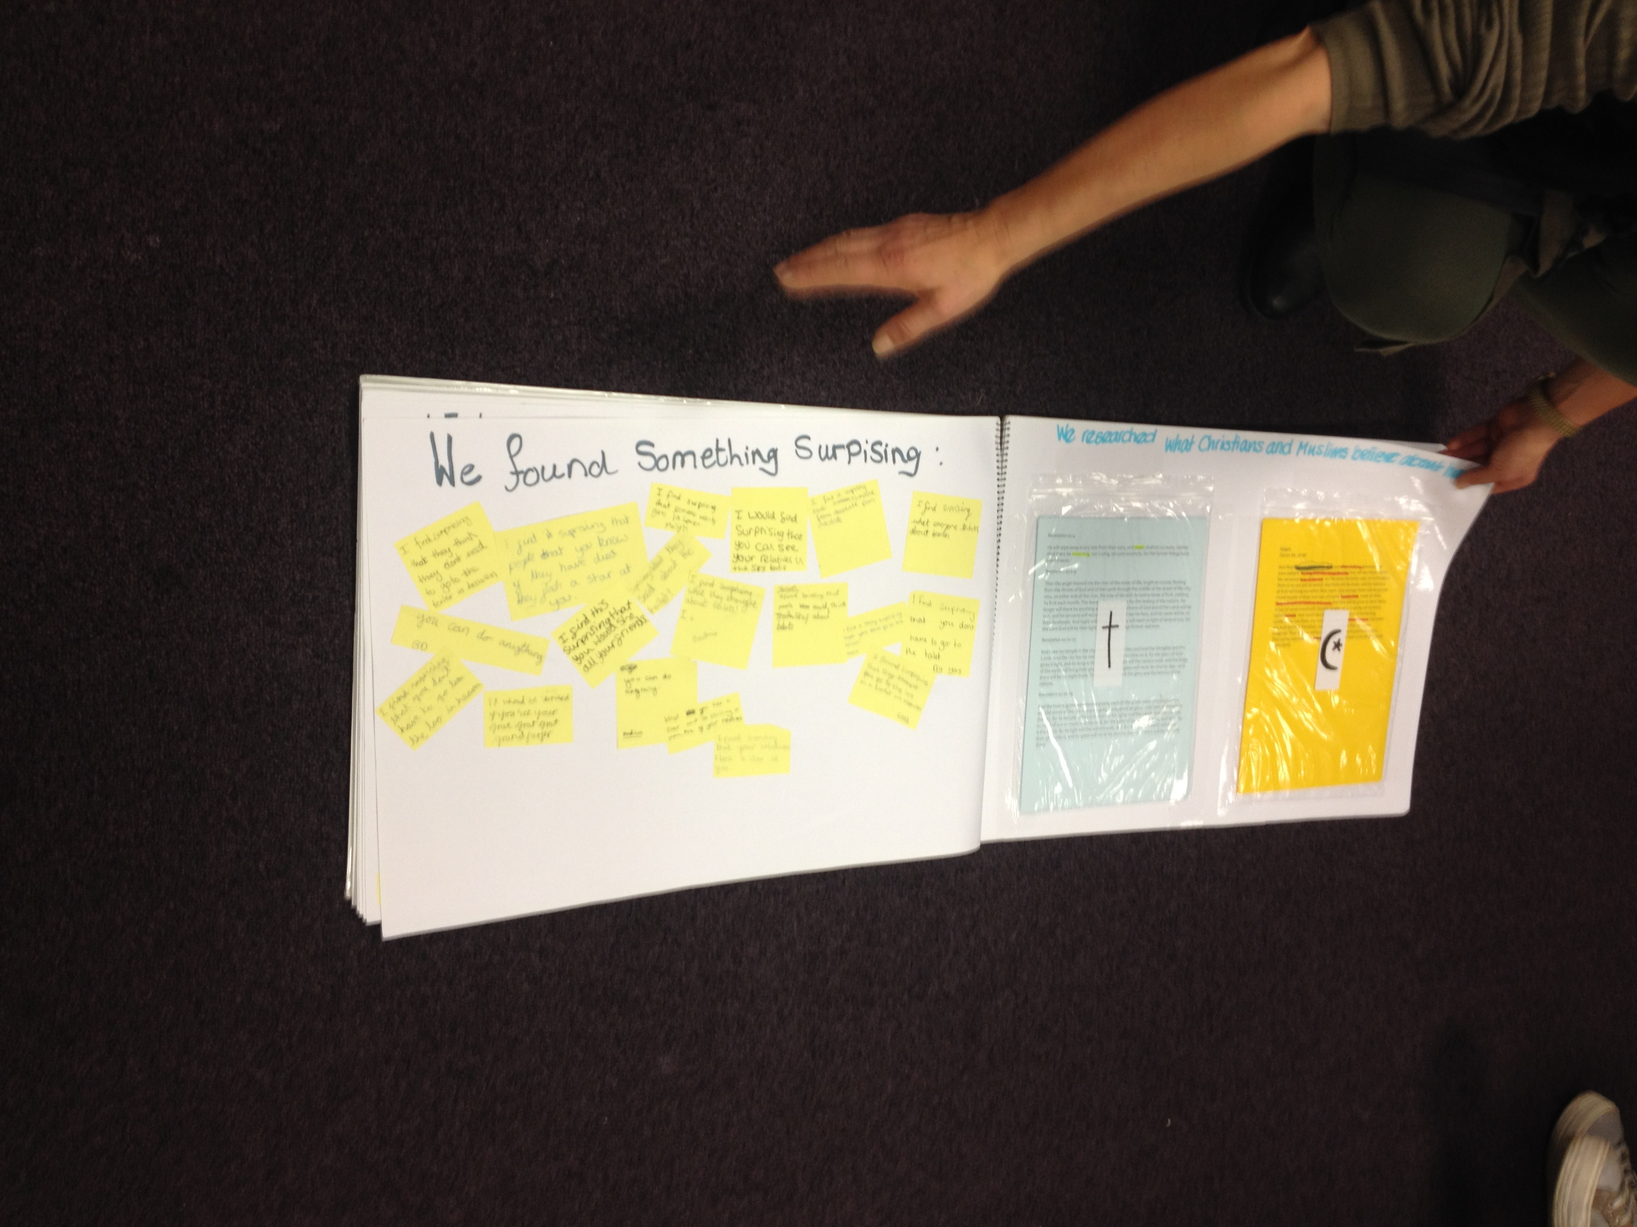

Slide 17
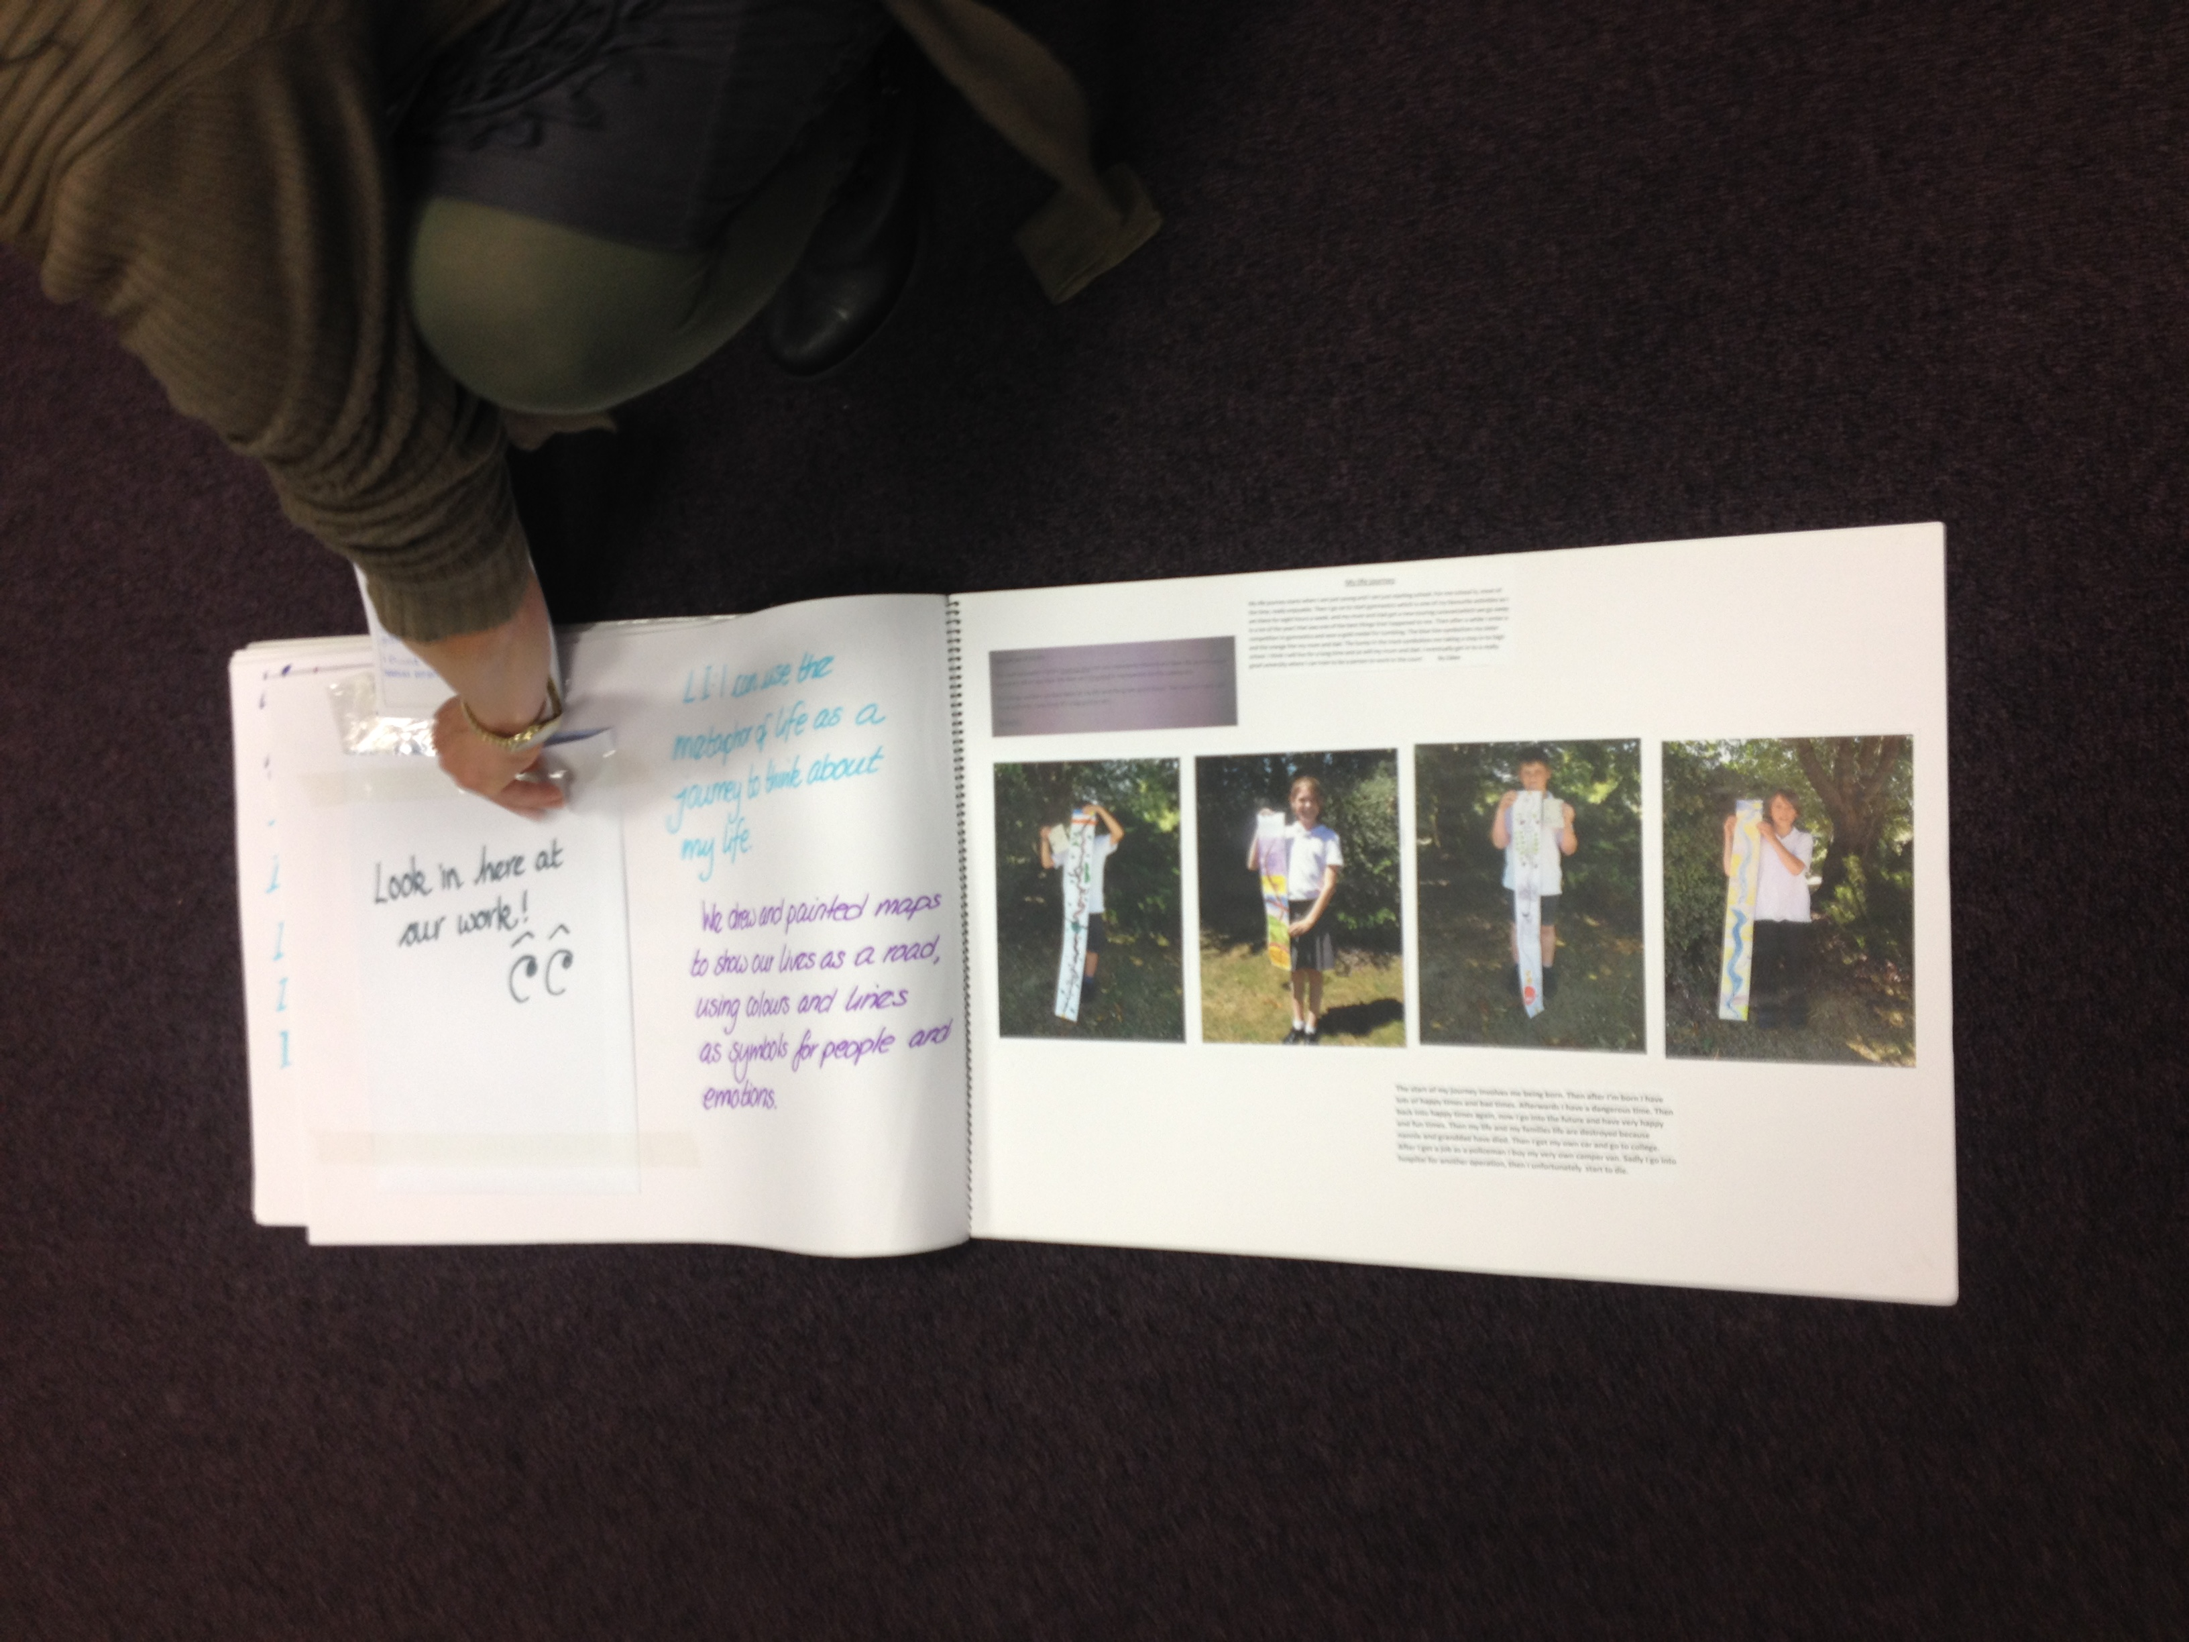

Slide 19
What works well - works!!

Slide 20
Options for the Day
Continue planning units of work using the enquiry cycle
Create some assessment linked to units of work using emerge , secure and exceed
Create assessment slinked to your own school system

