Slide 1
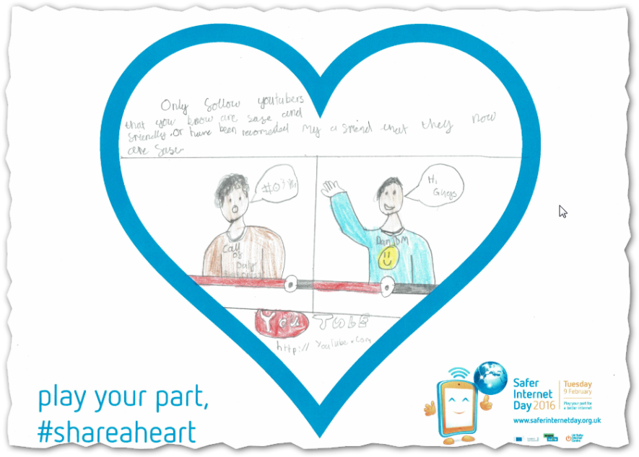
Safer Internet Day 2016 Play your part for a better internet! Sans Souci training centre 26 January 2016

Slide 2
Safer Internet Day 2016 Play your part for a better internet!
Outcomes
To tell you more about what Safer Internet Day is and why it can help your pupils and your school
To give you suggestions about how you could support Safer Internet Day
To give you the chance to discuss and test your ideas about what you could do on the day
To tell you where you can get help planning and preparing your day

Slide 3
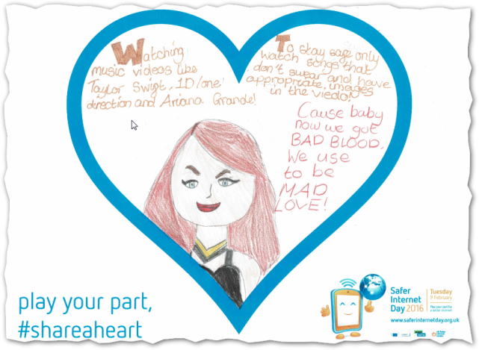
Safer Internet Day 2016 Play your part for a better internet!
When?
Tuesday 9 February
2016

Slide 4
Safer Internet Day 2016 Play your part for a better internet!
‘Globally, Safer Internet Day is celebrated in over a hundred countries…’
Notes:
This, and the following three, autoplay. You have to click off ‘…Get involved to play your part!’

Slide 5
Safer Internet Day 2016 Play your part for a better internet!
‘…to highlight positive uses of technology and to explore the role we all play in helping to create a better and safer online community…’

Slide 6
Safer Internet Day 2016 Play your part for a better internet!
‘…It calls upon young people, parents, carers, teachers, social workers, law enforcement, companies, policymakers, and wider, to join together in helping to create a better internet…’

Slide 7
Safer Internet Day 2016 Play your part for a better internet!
‘…Get involved to play your part!’

Slide 8
Safer Internet Day 2016 Play your part for a better internet!
‘This year we are using the day to inspire a kind, respectful and inclusive internet, and help raise awareness about the issue of online hate.’

Slide 9
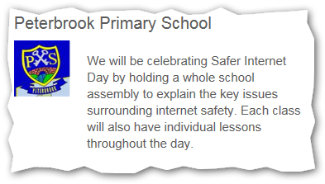
Safer Internet Day 2016 Play your part for a better internet!
Safer Internet Day website
http://www.saferinternet.org.uk/safer-internet-day/2016
Notes:
Peterbrook’s pledge happened to be on the site while I was planning the session. What are the chances?

Slide 10
Safer Internet Day 2016 Play your part for a better internet!
Audiences
Pupils?
Parents and carers?
Staff?
Wider community?
Local media?
Activities
Assemblies?
Lessons?
Activities?
Parent and carers sessions?
Pupil and parent workshops?
Taking SID home?

Slide 11
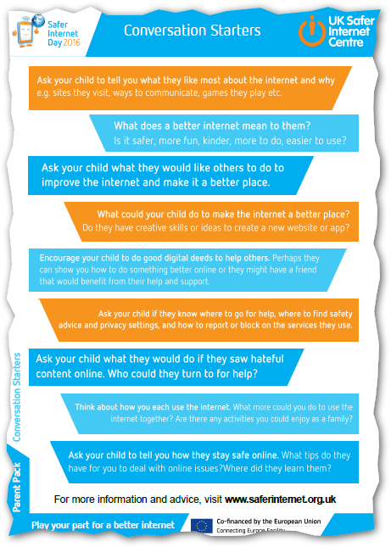
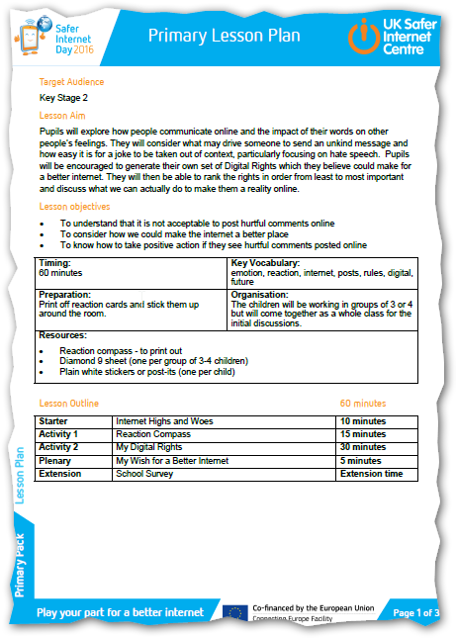
Safer Internet Day 2016 Play your part for a better internet!
SID Resources
Primary pack
Secondary pack
Parent pack
SID TV

Slide 12
Safer Internet Day 2016 Play your part for a better internet!
Primary
Assembly
The theme encourages children to think about how they play a part in making the internet a positive place, and consider what to do if they experience anything negative online.
Lesson plan
To understand that it is not acceptable to post hurtful comments online
To consider how we could make the internet a better place
To know how to take positive action if they see hurtful comments posted online

Slide 13
Safer Internet Day 2016 Play your part for a better internet!
Secondary
Assembly
The theme encourages children to think about how they play a part in making the internet a positive place, and consider what to do if they experience anything negative online.
Lesson plan
To understand the laws online and what online hate might look like
To consider our behaviour online and debate what can be done to combat online hate
To consider what we can do if we encounter online hate

Slide 14
Safer Internet Day 2016 Play your part for a better internet!
Parents’ and carers’ meeting (~30 mins)
Draft letter
Poster
Powerpoint presentation
Script
Parents’ factsheet
Conversation starters
More information about supporting people online

Slide 15
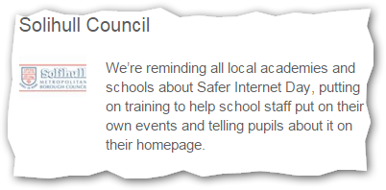
Safer Internet Day 2016 Play your part for a better internet!
Using (social) media
It’s a great story to tell
Become a SID supporter
Local media
School website
School Facebook or Twitter accounts
Twitter with #SID2016, @solihull_schs and @SaferSolihull
Take part in the SID thunderclap

Slide 16
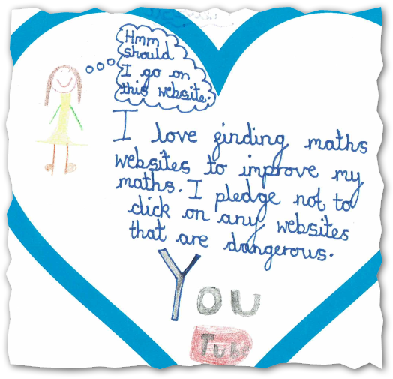
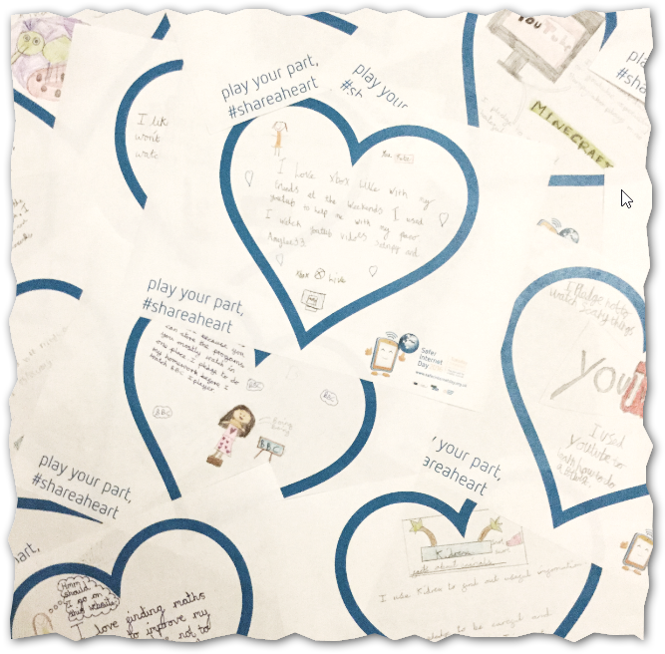
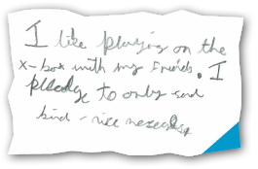
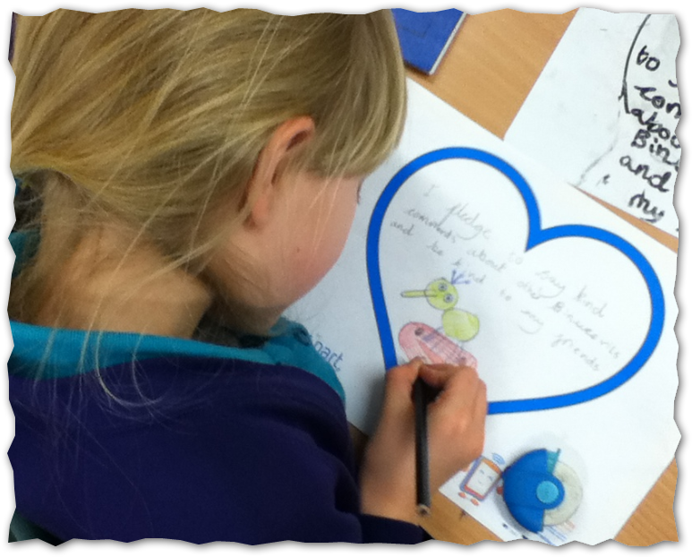
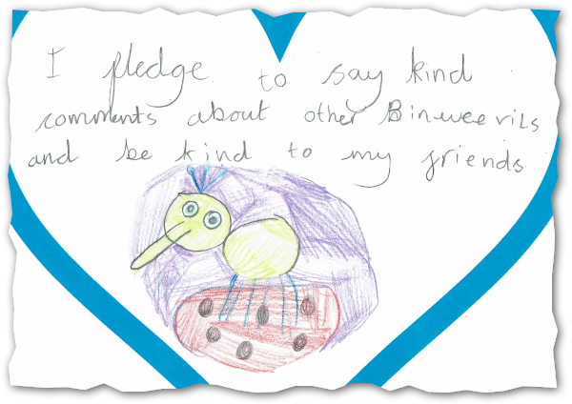
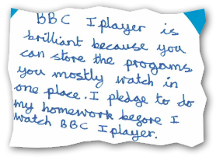
Safer Internet Day 2016 Play your part for a better internet!
Using (social) media
#shareaheart activity
Dickens Heath Community Primary School

Slide 17
Safer Internet Day 2016 Play your part for a better internet!
Plans and pledges - discussion
Discuss what you could do
Prepare three sticky notes
Decide one thing that you will do (pink)
Decide one thing that you could do (green)
Decide one thing that you won’t do (yellow)
Share the most important with all of us
We’d like to take photos of them to use

Slide 18
Safer Internet Day 2016 Play your part for a better internet!
www.solgrid.org.uk/SID2016

Slide 19
Safer Internet Day 2016 Play your part for a better internet!
https://www.youtube.com/watch?v=5VUsxQulYrg&feature=youtu.be&t=2m11s
Notes:
Stampycat (Minecraft hero) with an online safety message (https://www.youtube.com/watch?v=5VUsxQulYrg&feature=youtu.be&t=2m11s)
You can’t avoid an advert. It pays Stampycat.

Slide 20
Safer Internet Day 2016 Play your part for a better internet!
Penguinpig
Written by Stuart Spendlow
Illustrated by Amy Bradley
http://www.penguinpig.co.uk/
For Ipad and Kindle
And printed on paper
Audio book coming soon

Slide 21
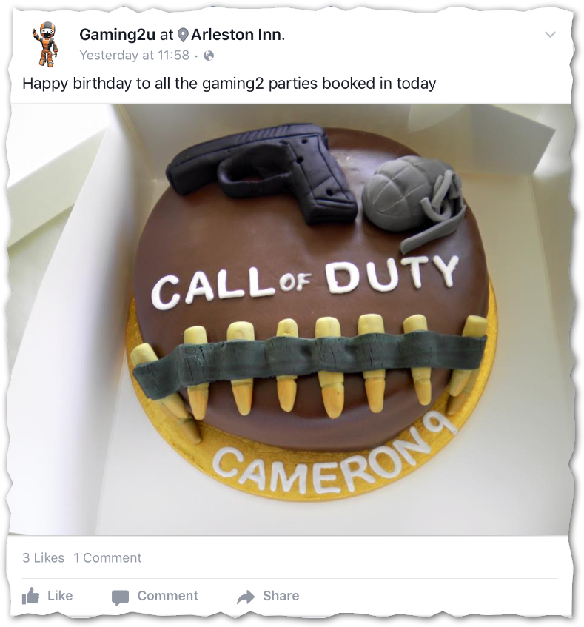
Safer Internet Day 2016 Play your part for a better internet!
Tuesday 9 February 2016
(questions)

