Slide 1
Solihull online safety toolkit Using social media
Dickens Heath
Community Primary School
11 April 2016
Notes:
This is a draft presentation for school staff – to help them understand the social media policy.
It is to support the actual policy – not replace it. Staff must be given copies of the policy to read. And you must emphasise that the actual policy (not this presentation) is what staff must follow.
Please re-brand this for you school as you wish. It’s an open licenced document.
This is draft – comments welcome!
DB

Slide 2
Using social media Session objectives
Staff should
understand more about the issues around using social media in schools
Have a copy of the social media policy and understand more about it
be more aware of protecting their professional identity when using social media
be more aware of privacy issues in their private lives when using social media
know when to seek help or advice
Notes:
The evaluation staff are asked to complete will reflect these and form a part of the schools’ inspection evidence.

Slide 3
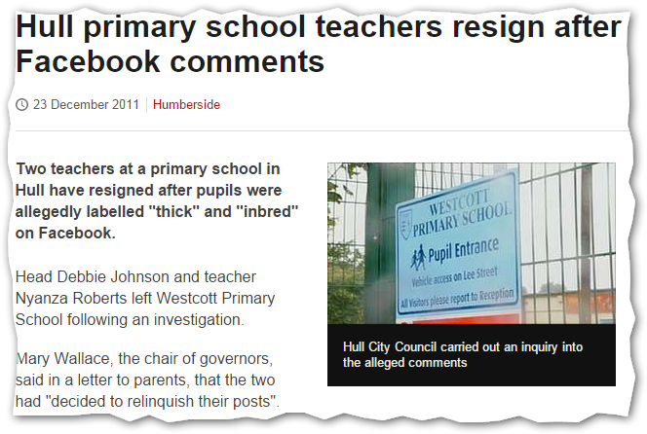
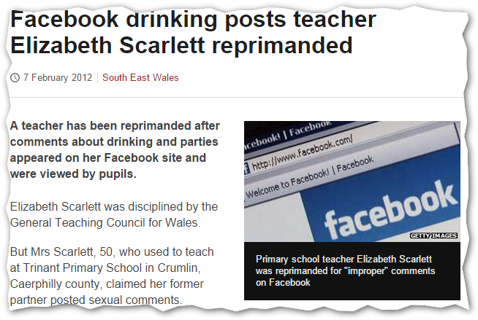
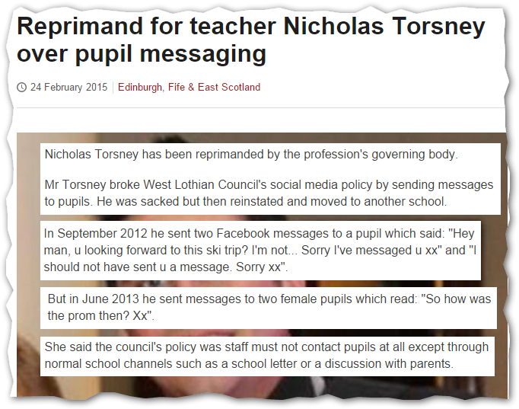
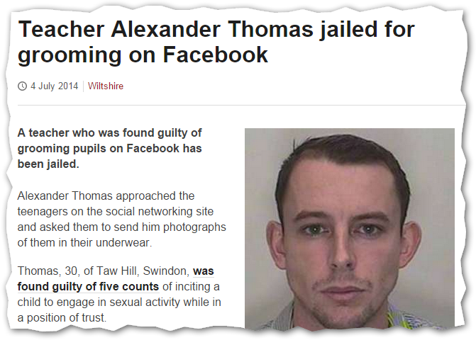
Using social media Examples from schools
But some things are less clear-cut.
Sometimes people are more foolish than bad.
We all want to stop bad things from happening.
Notes:
We all know what we want to stop – we all know what’s ‘wrong’. We identify things like predatory behaviour, radicalisation, trolling, hate speech as being unacceptable and easily identify them as ‘the issue’. But it can be a little more complicated.
We are all capable of being foolish – naïve – thoughtless – unaware sometimes. But social media is relatively new and makes mistakes more likely. And, even if it might only be a mistake? Some mistakes can really matter, can’t be sorted out and can cost us our jobs.
We’ve shown a couple of these before. But, before we used to obfuscate the names. We’ve now left them in to show what can happen to real people and how their actions and names become newsworthy.
Show stories.
One day, you will sound off in the staffroom about a child or their parents. Just make sure no one hears you. You know that.
You have a right to say what you like to your friends when they’re at your house having dinner. You have to be a bit more circumspect of you say the same things to them in the pub in case you’re overheard. And you always have to worry about someone repeating what you say. Social media is very similar to real life. Always compare it with real life. ‘How would this look…’
Emphasise Nick Torsney (last story).
Young teacher
Had signed social media policy – which specified no contact with pupils through social networking
Sent two messages “Hey man, u looking forward to this ski trip? I'm not... Sorry I've messaged u xx”
Given final warning.
Repeated behaviour “So how was the prom then? Xx”
Disciplined and sacked.
Appealed, reinstated but moved to another school.
Reprimanded by General Teaching Council for Scotland.
Made the BBC website.
His entire life and future has been affected.

Slide 4
Using social media The benefits of social media in education
‘We need to teach young people the way to use them appropriately, to build their sense of entitlement into a sense of responsibility and to work with them on effective and safe strategies for protection whilst using social media.
If we were seeking to develop water safety we wouldn't keep children away from water until they are 16 and then throw them off the pier - similarly with social media, blindly banning them is inappropriate and equally dangerous.’
Juliette and Stephen Heppell http://www.heppell.net/facebook_in_school/
Notes:
Social media is not bad. It has risks that you need to think about and address.
Good in education, part of children’s worlds – emphasise ‘keep children away from water’
Good for school life – Facebook is pushed to parents, or using Twitter to update parents about arrival times of coaches back to school
Good for professional development – ‘how do I’ groups on Facebook for year 3 and 4 teachers.
Good for our personal lives, but we know that already.

Slide 5
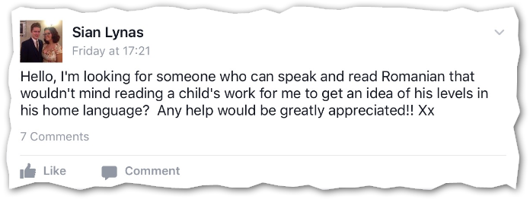
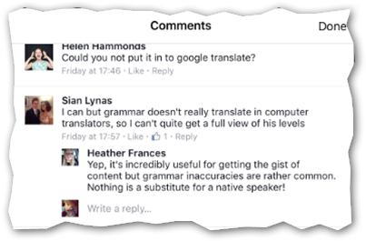
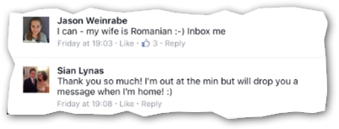
Using social media The benefits of social media in education
Year 3 and 4 teachers Facebook group

Slide 6
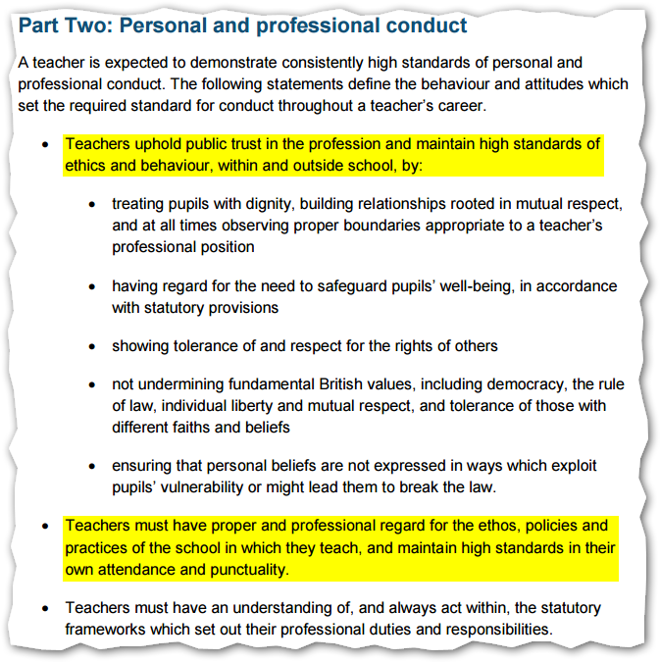
Using social media Getting it right
DFE – teachers' standards
‘maintain high standards of ethics and behaviour, within and outside school’
‘Teachers must have proper and professional regard for the ethos, policies and
practices of the school’
Notes:
You are teachers. You are pillars of the community. Legally.
You have responsibilities. Teaching is not the same as being a builder or butcher – not that there’s anything wrong with being a builder or butcher.
But your parents will care more about what you say about their children that what their butcher might say.
Your parents will care more about your private life that their butcher’s private life.
They will gossip more about you.
They form into groups regularly, even at the school gate every night.
They use social media too.

Slide 7
Using social media Social media policy
‘This policy applies to all staff use of social media, including:
on behalf of the school;
as part of their work directly with pupils;
in their wider professional lives; and
in their personal lives.’
Breaching the social media policy can, and will, lead to disciplinary action.
Serious breaches are gross misconduct.
Notes:
You must read the actual policy. It’s the policy that you will be measured by – this presentation is a synopsis of what’s in the policy but might not cover everything.
Emphasise that we must be transparent in what we do. We must worry about how something might look (be interpreted) rather that rely on knowing ‘what we meant’.
Using social media in different ways at different times can be done to different standards but each way of using it has different risks and gives different responsibilities.
If in doubt, ask. For your own protection.

Slide 8
Using social media Social media policy
When using social media at any time
You still have a safeguarding duty
You must not allow social media to affect your job
You must not damage your professional reputation
You must not damage your school in any way
You must respect the privacy of your school and members of its community
You must take full responsibility for what you share
You should raise any questions or concerns

Slide 9
Using social media Social media policy
When using social media on behalf of your school
You must have permission
You must follow related policies and procedures
You must have dedicated (separate) user accounts
You must not take part in personal discussions

Slide 10
Using social media Social media policy
When using social media as part of working with pupils
It must be sanctioned by the school
It must only use agreed social media
It must follow agreed policies and procedures
Notes:
Emphasise that this is particularly sensitive.

Slide 11
Using social media Social media policy
When using social media in your wider professional life
Be clear it is your personal opinions
Do not brand anything as being from your school
Do not share any other people’s private information
Behave appropriately
Notes:
Your personal opinions not representing school
Branding – don’t used school logos or ambiguous account names
Respect privacy – don’t say “I have this year 4 boy who…”
Behave appropriately – like a meeting in real time. You wouldn’t swear in a phase leaders’ meeting. And wouldn’t turn up drunk.
You can use your own personal accounts but think about what information you might allow to leech. You might have friends or interests that you might want to keep very separate from you working life.

Slide 12
Using social media Social media policy
When using social media in your personal life
Don’t talk to parents, pupils or ex-pupils who are only parents, pupils or ex-pupils
Think very carefully about implications of talking to colleagues who are also parents or governors
Think about implications of mixing private life and work life
Think about social media privacy settings
Notes:
Relationships in schools can be complicated.
Give example of Solihull teacher who is also a parent and a governor.
You can always check that it’s OK – it protects you.
Privacy setting – use Facebook ‘friends of friends’ as an example. Emphasise that all SM apps and sites are different. But it is your responsibility.
Anything you say can become public and is there forever.
Mention talking about digital footprints later.

Slide 13
Using social media Social media policy
If you use school resources you must follow the school’s acceptable use policies when using them
You must not use social networking while pupils are around or during directed time
You must not use social networking excessively
Remember that what you do on school technology is monitored

Slide 14
Using social media Social media policy
If you are not sure?
Ask

Slide 15
Using social media Questions?
Social media is not a technology issue
It is a behaviour issue
Notes:
Ask for questions
Reassure that intended to help and protect.
And that we don’t want them to become an example in someone else’s presentation.

