Slide 1
Solihull online safety toolkit Online safety for parents and carers
School name
Date
Presenter’s name
Presenter’s email address
Notes:
General
Welcome [remember any housekeeping]
Working together to keep children safe and to be the best they can be
We don’t have all the answers – but want to raise some questions.
Because there often aren’t clear answers and you (as parents) need to find the right answers for you and your children.
Invite questions as you go? Short ones? Pick up detailed issues after?
School-specific

Slide 2
What is online safety?
‘
The term ‘online safety’ reflects a widening range of issues associated with technology and a user’s access to content, contact with others and behavioural issues
’
Online safety is not just about technology
It is also about safeguarding
It is also about behaviour
Notes:
General
The session does not really focus on technology and how to use it but touches on it.
Is technology good or bad? Or is it neutral, depending on how it’s used? For good? Or bad?
Explain safeguarding briefly.
Explain behaviour – doing the right thing and making the right choices: both when people are watching and when they aren’t.
Some things are probably not right right at age five – for example having a mobile phone – but are probably right at age 15. Parents need to decide when something is right for their children.
Generally, we accept risks and know how to deal with them, not just avoid them. We teach our children to cross roads. Keeping child safe online is the same.
School-specific

Slide 3
The world is changing
Notes:
General
Some examples
The first VHS video recorder was sold in the UK in 1978 – now a redundant technology.
The first audio CD was released in 1982 – now a dying technology.
The first commercial ISP (AOL) launched in 1989.
Wikipedia launched in 2001.
iPhone launched in 2007.
The world that children are growing up in is not the same world as the one we grew up in.
School-specific

Slide 4
What is changing for children?
One in four children under eight owns a tablet
63% of children have a smartphone before they start secondary school
23% of children are seen on the internet before they’re born
74% of eight- to 11-year olds have access to a tablet at home
One in 10 children has a mobile phone before they’re five
Notes:
General
What do parents/carers think of each statistic? Not necessarily bad?
Perhaps ask for shows of hands for some – number of families with tablets?
1 in 10 five-year-olds with a mobile? Too young? What about year six? Year seven at secondary school? Remember benefits as children become independent with ‘Mum/dad – I’ve got home safely’ ,for example.
Question – when do children start to travel/be alone in any way? Walking to school alone? Is that a guide for when they start to need their own mobile phone?
[23% of children are seen on the internet before they’re born is prenatal scans published on Facebook] When do you think children have rights not to be put in their parents’ Facebook pages? Or grandparents…
School-specific

Slide 5
What is changing for children?
Health-related behaviour questionnaire in Solihull
Year 2
78% use the internet for playing games
36% go on internet when parents not in room
8% chat to people online that they’ve never met
67% have been told how to stay safe if chatting online
62% say that their parents/carers have rules for use
12% use Facebook or Bebo
Notes:
General
One third of children on internet when parents not in room. Tablets make this harder to enforce than previously with PCs. This means we need to focus more on getting children to do the right things rather than restrict them – this is a big change in the last 10 years.
8% chatting online could be a problem but not necessarily. Club Penguin (for example) has fixed, pre-defined, statements that children can use to message other users.
12% on Facebook is not good. Higher in some schools. Often aided by older siblings without parents’ knowledge.
[67% being told how to stay safe is not good enough?]
School-specific

Slide 6
What is changing for children?
Health-related behaviour questionnaire in Solihull
Year 4 and year 6
70% use the internet for playing games
75% go on internet when parents not in room
15% chat to people online that they’ve never met
3% have had received a chat message that scared or upset them
91% have been told how to stay safe if chatting online
76% say that their parents/carers have rules for use
82% watching YouTube, Netflix, Amazon Prime…
Notes:
General
Percentage of children gaming has dropped slightly in the last two years.
Increase in percentage with rules in place and who have been told how to stay safe.
3% of children is roughly one child in each class – that feels more real than a percentage.
Netflix and other streaming services is new. 18 films? Explicit lyrics on Spotify?
What about illegal devices and file sharing? Do you as a parent legitimise breaking the law? How does that transfer into other areas? As they get older?
School-specific

Slide 7
The benefits
learn
find help
have fun
discover
connect
create
Notes:
General
Emphasise that the online world is (on balance) a positive thing that offers children many, many, good things.
Children have opportunities to learn – including independently – than previous generations did. Compare Wikipedia with Encyclopaedia Britannica
Children can find help – with getting help on how to do more with Minecraft at seven to being able to access emotional information through teenage years.
It can just be fun – gaming, chatting, watching and making. But keep it in its place – not 10 hours a day.
Discover new things
Connect to people in new ways – schools using video-conferencing across the world, learning about different people and cultures. Or Skyping with Nasa scientists or arctic explorers or even Vikings.
School-specific

Slide 8
Online safety in school
Notes:
General
Look at what happens in schools – when children are in our care.
Keeping children safe when they’re in our care and preparing them for when they’re not.
As example, schools must have appropriate filtering/monitoring in place – part of Keeping children safe in education.
[All internet access is filtered in primary schools where they are supported by Solihull Council – no child can get to Facebook – they’re not old enough]
Role of Ofsted inspection
Online safety is part of safeguarding
[Online safety is not just part of computing?]
[Online safety is cross-curricular and linked to PSHE?]
School-specific

Slide 9
Keeping children safe in education
Protecting children from
Abuse
Physical abuse
Emotional abuse
Sexual abuse
Neglect
bullying including cyberbullying
children missing education
child missing from home or care
child sexual exploitation (CSE)
domestic violence
drugs
fabricated or induced illness
faith abuse
female genital mutilation (FGM)
forced marriage
gangs and youth violence
gender-based violence/violence against women and girls (VAWG)13
hate
mental health
missing children and adults
private fostering
preventing radicalisation – and Annex A
relationship abuse
sexting
trafficking
‘it is essential that children are safeguarded from potentially harmful and inappropriate online material. As such, governing bodies and proprietors should ensure appropriate filters and appropriate monitoring systems are in place.’
Keeping children safe in education Deportment for Education, September 2016
Notes:
General
Online safety is only mentioned a couple of times.
Important as can underpin/enable other safeguarding issues.
Sexting is an increasingly important issue to address – perceived by parents as a secondary age issue but it’s important to address privacy appropriately younger to get good habits (real issues in schools with year five pupils Skyping from their baths)
School-specific

Slide 10
Effectiveness of safeguarding arrangements
‘
’
Children and learners are protected and feel safe.
Children and learners are protected and helped to keep themselves safe from bullying, homophobic behaviour, racism, sexism and other forms of discrimination.
Staff and other adults working within the setting are clear about procedures where they are concerned about the safety of a child or learner. There is a named and designated lead who is enabled to play an effective role in pursuing concerns and protecting children and learners.
‘
’
‘
’
Inspecting safeguarding in early years, education and skills settings
Ofsted, September 2016
Notes:
General
Emphasise protected and feel safe.
All staff involved – as an example, pupils often turn to other staff – perhaps lunchtime staff – when worried. ‘What would you do if a child came to you with…’?
School-specific

Slide 11
Effectiveness of safeguarding arrangements
All areas of school are considered
Pupils
Staff
Wider school community
Governors
Parents and carers
Notes:
General
Online safety is not computing, looked at across the curriculum.
Staff need how to keep themselves safe as well as pupils.
Office staff, dinner staff, ground staff, volunteers, clubs…
Governors – role in checking and monitoring
Engaging parents and carers – people here are helping with the school’s Ofsted.
School-specific

Slide 12
Online safety outside school
Notes:
General
Age ratings on internet games and sites are not ‘legal’. Many (those that are 13) are to meet US data-protection law about holding children’s data.
Parents actually need to decide what’s right for their children.
Sticking to the age rating is often unsustainable – in face of peer-pressure. Instagram or WhatsApp are actually used by the vast majority of years five and six pupils.
But it’s your decision about what’s right for you and your child.
School-specific

Slide 13
What are the issues outside school?
gaming
tablets
social media/networking
mobile phones
content
contact
Notes:
General
Why do issues outside school matter to schools?
Issues that happen outside can spill over into schools – they can affect relationships and learning in schools.
Gaming example – children can learn to use profanity by playing 18-rated games. And use it in the playground.
Social media/tablets example – a friendship group issue resulting from what happens at home, on devices supplied by parents, using apps condoned by parents can affect learning for the whole group – not even just those in the friendship group.
Mobile phones example – surreptitiously bringing mobile phone in is a common way of showing off to peers
Content – being exposed to unsuitable material and sharing it at school
Contact with unsuitable people. Not necessarily paedophiles – incredibly rare – but older children/teenagers when gaming is much more common. This can lead to issues with profanity and attitudes.
School-specific
Text

Slide 14
Social media/networking
Notes:
General
There are often panics around particular apps. The app is rarely (almost never) the issue – it is more often how the app is being use that is causing the issue.
Mention the panic around Oovoo – people were advised to delete it as a particularly bad risk.
There are thousands of similar apps all that can be (mis)used in similar ways.
Blaming the app can be dangerous – deleting an app may give a false sense of security – other apps can be misused in the same way. It’s about behaviour.
And apps’ popularity change all the time.
School-specific

Slide 15
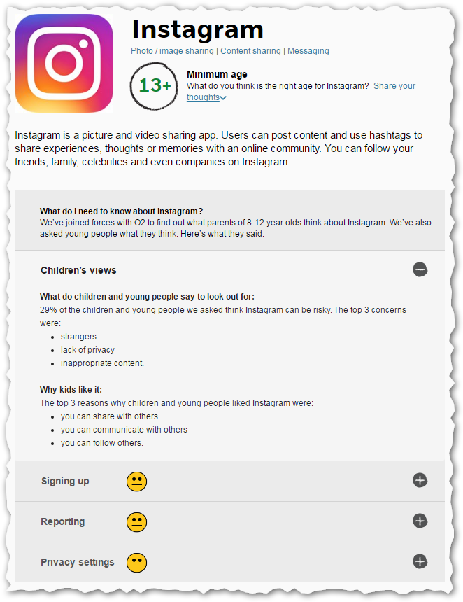
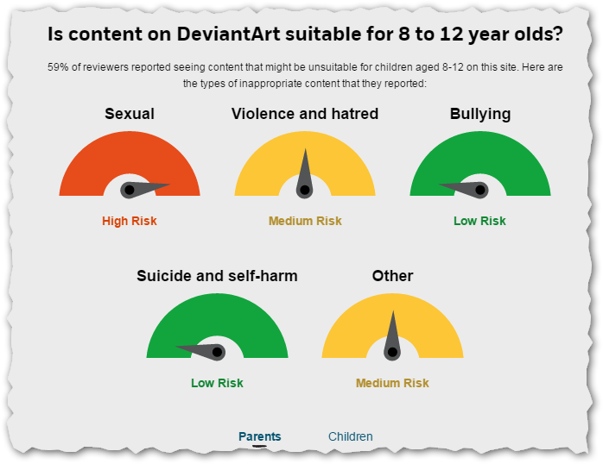
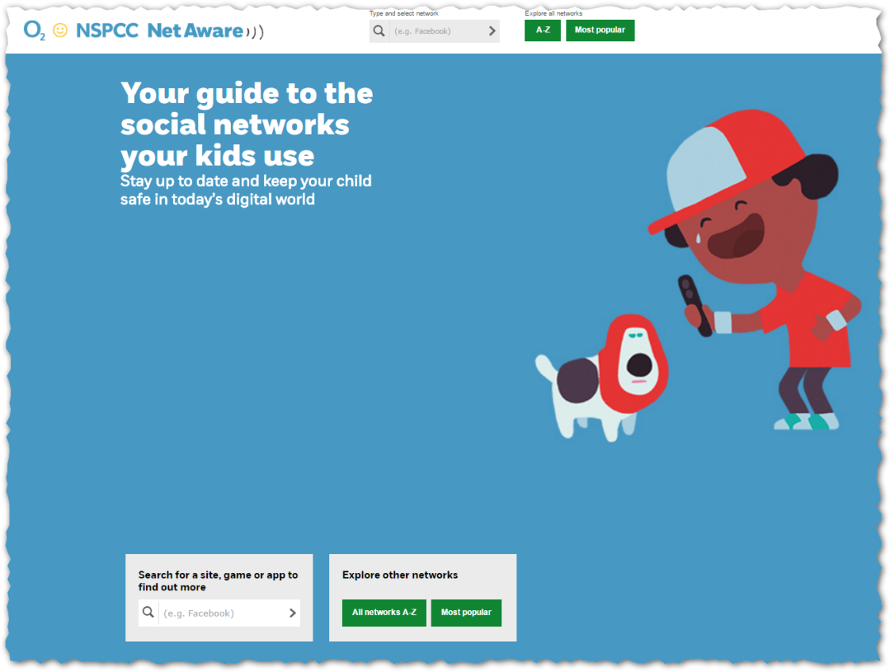
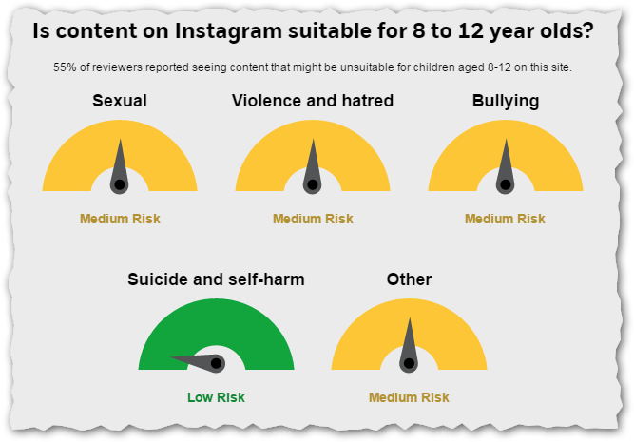
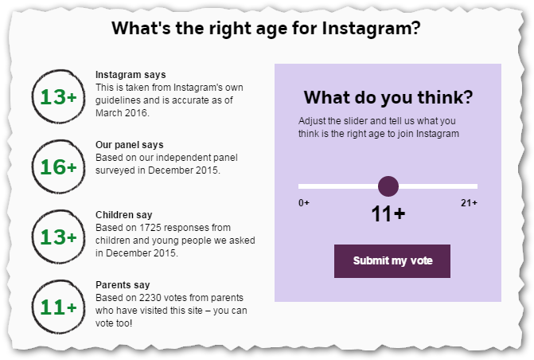
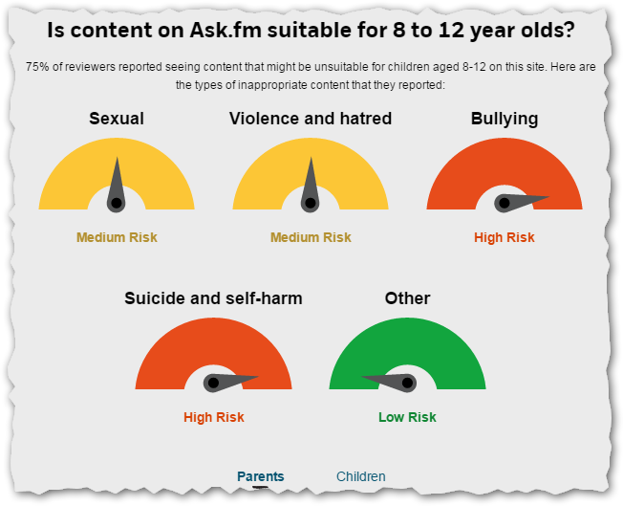
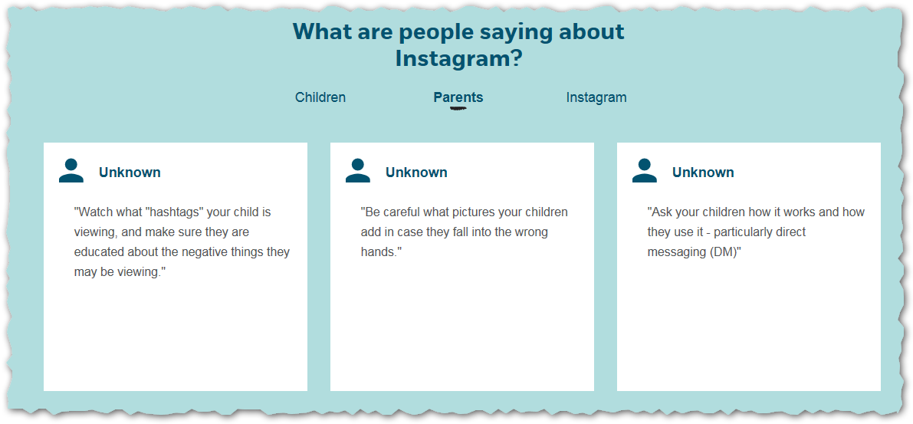
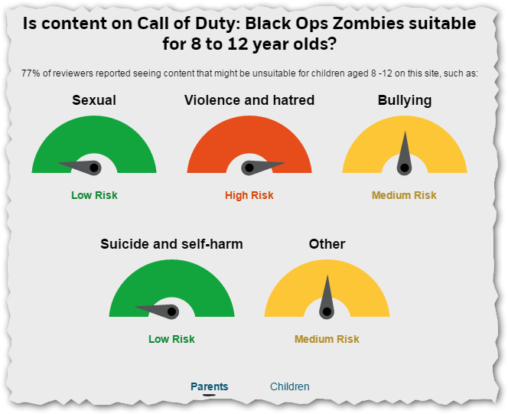
Online safety advice – NSPCC Net Aware
https://www.net-aware.org.uk/
Notes:
General
This is an example of what you can learn from the internet and how you find supportive information.
NSPCC Net Aware – 50 social media apps compared and evaluated by experts, parents and children. Aimed at parents of 8-12 year-old children but still useful to others.
Step through Instagram app as example – currently an issue in many schools.
29% of 8-12 year-old children think Instagram can be risky.
Age ratings – supplier/expert/child/parent – rarely match – but parents often give the lowest age-rating. In this case children game 13+, parents 11+.
See comments from children and parents – example about watching hashtags. Do we all know about hashtags on Instagram?
There’s a category rating system – varies with app – compare with DeviantArt, Ask.FM and Call of Duty: Black Ops Zombies. Which is played by some 8-12 year olds…
School specific

Slide 16
Social media/networking
Make it age-appropriate
Check for more help – regularly
Be you child’s ‘friend’
Check links to games
Restrict privacy settings
Notes:
General
What might you think about?
Age-appropriate – refer back to last slide.
Restrict privacy settings – to friends? Friends of friends? Public? Each app is different
‘Be you child’s ‘friend’’ – they can use social media if you are a friend (promise not to embarrass) and can see what’s going on.
Links to games can leak personal data – using a social media account as a game account.
Individual service providers off service-specific advice eg Facebook Safety Centre. Search for advice on the internet?
Parents might need to agree device checks? Check out what the device is being used for? When younger perhaps?
School-specific

Slide 17
Gaming - PEGI
Notes:
General
Explain PEGI ratings system
It’s actually illegal for a shop to sell a game to an underage child. But not illegal for parent/carer to buy on child’s behalf.
Not like BBC after watershed. Can be extremely violent – find out some content from game like Grand Theft Auto (4 or 5). Wikipedia on GTA5 “A segment in the latest instalment caused controversy for scenes containing player initiated torture. The mission "By the Book" features graphic depictions of kneecapping, electrocution, dental extraction and waterboarding, and the player is required to perform the acts in order to progress in the game.”
School-specific

Slide 18
Gaming - online
Make it age-appropriate
Take care with headsets
Find out how you can report problems
Consider ‘real’ friends only
Don’t share information
Use a nickname
Consider age-locks if possible
Notes:
General
Age appropriate - do you want a child to be exposed to unsuitable materials? Use age-rating as a good guide?
Some consoles – like Xbox 360 – can be restricted to stop users playing games above certain age ratings.
Some parents encourage children to use an anonymous nickname rather than the child’s actual name
You can dictate who the child games online with – restrict to those you know? Especially with younger children? Consider gaming with only people you know in real life.
Online gaming – children can chat and give stuff away about them, where they live, etc. Make children aware of privacy? Strategies to deflect questions?
Headsets – profanity/ bad language from others.
Report any problems/misuse/abuse/bullying.
School-specific

Slide 19
Phones
Unsupervised internet access?
Risk of loss or theft?
Think about content control
Text messaging (including images)
Do you want to share your location?
Image sharing?
Notes:
General
Phones are small and easy to use surreptitiously.
Smart phone give unsupervised internet access – by default. And to all apps like Instagram and Whatsapp…
Image sharing/sexting/bullying needs to be appropriately discussed before.
Location sharing can be good or bad – you need to be conscious of it. It can be nice to know where you teenage child is. When does the child have rights to privacy?
Text messaging at night? Leave phones downstairs?
School-specific

Slide 20
Tablets
Think about setting up controls
Think about video calls and privacy
Find out how you can report problems
Think about restricting purchases – especially in-app purchases
Think about wi-fi issues, privacy and parenting
Notes:
General
Talk about controls in more detail later – overlaps with phones as well.
Dressing appropriately when making video calls? Using video calls with others around – impact on others?
In app purchases – games can be free but can be charges during use. Check you’ve set it up right. Some parents get bills for hundred of pounds.
What happens if one of your children’s friends visits and want access to your wi-fi? And remember that wherever you (older, more independent) child goes they may get internet access.
School-specific

Slide 21
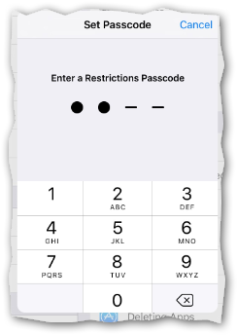
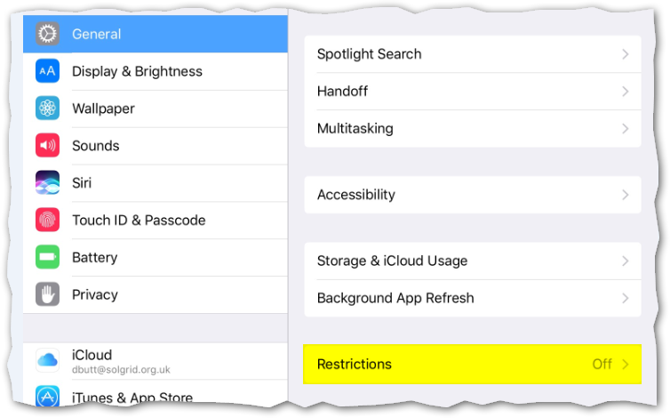
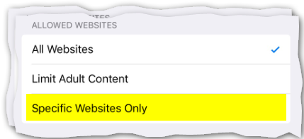
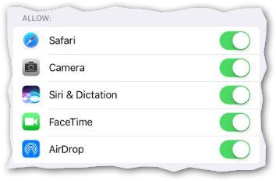
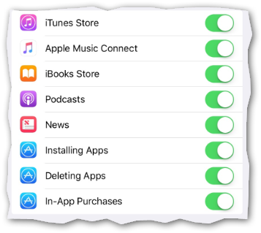
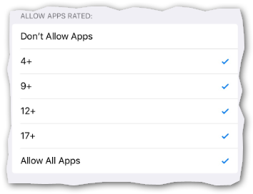
Tablets
Parental controls (iPad as an example)
https://www.nspcc.org.uk/preventing-abuse/keeping-children-safe/online-safety
Notes:
General
This shows how do make changes to an iPad. You can do similar on an Android tablet.
General > Restrictions > put in passcode > switch off apps and functions >
Can restrict in-app purchases
Can restrict to particular web sites as well – good for very young children
Can restrict age-rating for apps
You can also lock a tablet (in accessibility) to a particular app, so that you can’t exit from the app without putting in a password.
School-specific

Slide 22
What to do if (when?) something goes wrong
Before it happens
Make sure your child trusts you and knows to tell you
Make sure your child knows to leave it - evidence
Never threaten ‘no more internet’
The worst things happen very rarely
Other (less bad) things happen more frequently
Deliberate or accidental?
malevolent or thoughtless?
Victim or perpetrator?
Notes:
General
Reassure, reassure, reassure.
As an example, In very minor cases the school might find it helpful to know a child has had a scary/nasty fright and might be a upset at school for a bit.
Service providers may take action where under-age children are involved (YouTube and age ratings as an example) – search ‘service provider’s name’ and ‘report’. Service providers can sometimes care about their image and negative publicity. Sometimes not.
NSPCC – again, as an example – have a helpline to support all issues around online safety – including advice on how to control device settings.
Explain who CEOP are and the report abuse button.
999 in an emergency – a child has left to meet a stranger is an emergency.
School-specific

Slide 23
What to do if (when?) something goes wrong
When it happens
Reassure your child
Listen to them about what they’ve seen
Look at what they’ve seen – with them? Without them?
Think about nature of incident
Think about who you might talk to -
School
Service provider
NSPCC or other support
Police/CEOP (101 or 999)
Notes:
General
Reassure, reassure, reassure.
As an example, In very minor cases the school might find it helpful to know a child has had a scary/nasty fright and might be a upset at school for a bit.
Service providers may take action where under-age children are involved (YouTube and age ratings as an example) – search ‘service provider’s name’ and ‘report’. Service providers can sometimes care about their image and negative publicity. Sometimes not.
NSPCC – again, as an example – have a helpline to support all issues around online safety – including advice on how to control device settings.
Explain who CEOP are and the report abuse button.
999 in an emergency – a child has left to meet a stranger is an emergency.
School-specific

Slide 24
Think about boundaries and rules
Think about time restrictions
Think about your own behaviour
Think about ‘manners’
Think about sharing rules with other parents
Think about buying ‘rules’
Notes:
General
Time restrictions? Many parents look at an hour on weeknights and a couple of hours a day at weekends.
Manners – no devices at mealtimes?
Buying rule – integrate into pocket money regime?
Compare rules with other parents – so children don’t try to play parents’ rules against each other.
Don’t give your children rules you can’t/won’t follow – lead by example?
School-specific

Slide 25
Think about your digital footprint
Ask yourself -
What do I look like?
Would I want this shared about me?
Am I giving away too much?
Would it pass the ‘front page test’?
Is it a footprint or a tattoo?
Notes:
General
Do I look like a good person if I say this? Or mean?
Am I trolling? Am I gossiping?
Am I about to tell the world my house is empty because I’ve checked in at the airport?
What would I feel if it was on the front page of The Solihull Times?
Footprints fade. Tattoos don’t. A lot of stuff on the internet is indelible.
School-specific

Slide 26
Questions?
Notes:
General
Text
School-specific
Text

