Slide 1


4 questions in 5 minutes

Slide 2

4 Questions in 5 minutes

Slide 3
1. Are you concerned about the number of children with SEND coming through the system?
Notes:
Invite and acknowledge the issues and challenges – ask for a show of hands so that you are illustrating the shared concerns there are in the sector and that you are on side with them.

Slide 4
2. Do you want to say yes to the next family with a child with SEND?
Notes:
Establish the right motivators and again shows that you are getting along side the sector and not accusing them of being discriminatory. Acknowledge the challenges out there again and state that you have never met anyone in the early years who actively wanted to exclude children with SEND.

Slide 5
3. Are you confident you have tried everything you can to say yes to the next family, including your staff completing at least the first training course?
Notes:
At this point you will probably get a handful of folks who will put their hands up. This is the point at which to highlight the honeypot effect. Ask them what percentage of places they currently have four children with SEND. You can almost guarantee that they will have higher than the average number there are out there which illustrates that when one or two providers are brilliantly inclusive, it often means that others are not. Don’t we want all of our settings to be inclusive?
Also, this is a solution to the very real challenge the sector have stressed over and over, and we know our training makes a significant difference and has been designed to keep in mind capacity challenges in the sector. After all 96% of practitioners out of over 25,000 can’t be wrong!

Slide 6
4. If not, can you sign up now? https://dingley.org.uk/dingleys-promise-training/comic-relief/
Notes:
Hold space to sign up there and then… you can even invite someone from the audience who has done the training to share what they learnt (have the confidence to do this as we know the feedback is exceptionally good).

Slide 7
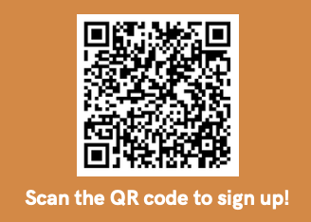
https://dingley.org.uk/dingleys-promise-training/comic-relief/

Slide 8
Thank you for your hard work
and commitment to inclusion!

