Slide 1




SCW Improving Immunisation Uptake Team
Childhood Immunisations
Early Years Project

Slide 2

Introduction into the Early Years Project
The Improving Immunisation Uptake (IIU) Team are providing training on behalf of NHS England. The IIU Team work with GP practices to improve vaccination uptake in children under 5 years old, the team consists of nurses who work with administrators and data analysts within NHS SCW Child Health Information Services (CHIS).
Education and childcare settings have a vital role to play in supporting the routine immunisation programme through sharing of information with parents/carers.
This training will be free of charge and aims to support Early Years providers to raise awareness of the importance of routine childhood immunisations in their settings.

Slide 3

How will the Early Years Project Work
The IIU Team will provide free educational training and resources for Early Years staff to provide them with information that they need to be able to raise awareness of the importance of routine childhood immunisations in their settings.
Information staff will gain:
An understanding of who is eligible for vaccination on the NHS routine UK immunisation schedule
An awareness of potential barriers to vaccination
Benefits and risks of vaccination
Where to signpost people for further information and vaccination
The recently published National Immunisation strategy (2023) identifies the need for the NHS to work with other agencies to promote the understanding and importance of vaccinations. The IIU team believe the Early Years setting would be ideally placed with the established trust of parents and carers to fit into this model.

Slide 4

What Support will be Offered
Free One Hour Training Sessions will be delivered to Early Years Providers virtually via MS Teams throughout Feb & March 2025
Free digital training Packs, educational material and links to sources of credible information will be shared with Early Years providers
Childhood Immunisations - a free guide for Early Years providers will be shared with all Early Years providers

Slide 5

Anticipated Benefits of the Early Years Project
Raise the awareness of childhood vaccinations amongst the early years’ staff
Make discussing immunisations normal practice within early years settings
Increase the confidence of early years staff in having vaccination conversations with parents/carers
Provide the early years staff with links to credible resources that they can share with their parents/ carers
Increase sharing of reliable information amongst families and communities
Increase the uptake of the MMR vaccination at a time of increased cases

Slide 6
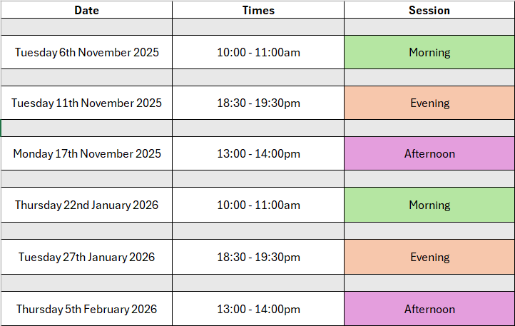

Book a Free of Charge Training Session
Training Session Timetable
Available Dates & Times
Book your preferred training session at:
https://www.tickettailor.com/events/nhssouthcentralandwestcsu/1810823

Slide 7

Childhood Immunisations
Early Years Project
IIUT Contact Information:
Telephone Number:
0300 561 1855
Email Address:
scwcsu.improvingimmsuptake.projects@nhs.net
Website Address:
https://chis.scwcsu.nhs.uk

